Slide 1




FY2026 Ryan White Part A
Provider Services Meeting
March 31, 2026
ccbh.net
216.201.2000
5550 Venture Drive, Parma, OH 44130

Slide 2
Agenda
9:00 – 9:15 Welcome & Opening Remarks
9:15 – 9:30 HIV/STI Prevention
9:30 – 10:20 Provider Presentations (10 min. each)
AIDS Taskforce, Cleveland Clinic, DSAS,
May Dugan, Mercy
10:20 – 10:30 Break
10:30 – 11:30 Provider Presentations (10 min. each)
MetroHealth, Neighborhood Family Practice, NLURC, Signature Health, The Centers, UH
11:30 – 12:00 Closing and Networking

Slide 3


Slide 4
Ryan White Part A Staff
Anastassia Idov
Part A Grant Supervisor
aidov@ccbh.net
216-201-2000 ext. 1446
Elly Falter
Part A Program Manager
efalter@ccbh.net
216-201-2000 ext. 1552
Melissa Hansen
Part A CQM Program Manager
mhansen@ccbh.net
216-201-2000 ext. 1527
Brittanie Evans
Part A Grant Coordinator
bevans@ccbh.net
216-201-2000 ext. 1316

Slide 5
FY2025 Cleveland TGA Data
Total number people living with HIV in the TGA: 6,213
Total number Ryan White Part A clients served: 3,231
48%
52%

Slide 6
FY2025 Cleveland TGA Data
Service Category | Total Number Clients Served in FY25
Early Intervention Services | 630
Emergency Financial Assistance | 3
Food Bank/Home-Delivered Meals | 358
Home and Community-Based Health | 21
Home Health Care | 21
Medical Case Management | 951
Medical Nutrition Therapy | 151
Medical Transportation | 795
Mental Health Services | 583
Non-Medical Case Management | 1,370
Oral Health Care | 297
Other Professional Services (Legal) | 122
Outpatient/Ambulatory Health Services | 2,250
Psychosocial Support | 134

Slide 7

Cuyahoga Regional HIV Prevention and Care Planning Council
If you would like to be added to the Planning Council mailing list to receive meeting updates and connection info, please see Lisa-Jean Sylvia Reyes, Planning Council Facilitator, or Brittanie Evans, Planning Council Support Staff.
Meetings are open to the public. You do not have to be a member to attend a meeting!
https://www.youtube.com/watch?v=nYQWOPQ9Cw0
Notes:
Cuyahoga Regional HIV Prevention and Care Planning Council represents the Transitional Grant Area (TGA) that includes Ashtabula, Cuyahoga, Geauga, Lake, Lorain, and Medina counties.
The Planning Council helps identify priorities and needs for the HIV/AIDS community; Distribute HIV/AIDS funds throughout the community; Inform everyone about how to access HIV/AIDS programs and services.
The mission of the Planning Council is to plan for the comprehensive delivery of HIV/AIDS services and allocation of resources for the TGA. The goal of the Planning Council is to identify HIV positive individuals, see that they are linked into care, stay in care and improve health outcomes.
The Planning Council consists of a maximum of thirty-five (35) members, at least 33% of which are persons living with HIV/AIDS. Members are appointed by the Cuyahoga County Executive and Mayor of the City of Cleveland.
Council members identify and rank service priorities and determine funding allocations based on needs assessment data gathered from each local jurisdiction in the TGA and other relevant data.

Slide 8

Disease Intervention Specialists
HIV/STI Prevention Program

Slide 9

HIV/STI Prevention Program
Comprised of two grants (STI Prevention & HIV Prevention) that support programming and staff
Funded by Ohio Department of Health (ODH funded by CDC)
6 County Region: Cuyahoga, Ashtabula, Lake, Geauga, Medina, Lorain

Slide 10
Program Staff
Melissa Kolenz, Supervisor
Danielle LeGallee, HIV Prev. Program Manager
Shameem Ahmad & LaJuanna White, DIS Program Managers
Disease Intervention Specialist (DIS)
Ta’Juanna Simpson | Julie Boylan
Lindsey Akpo-Esambe | Priscilla Clark
Morgan Dugan | Imani Tunson
Angelique Garcia | Markayla Mariner

Slide 11
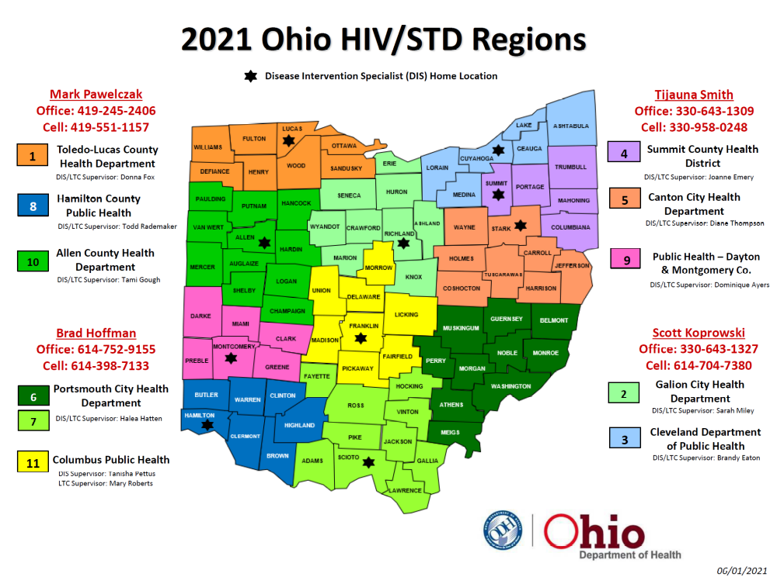
Region 3

Slide 12
STI Prevention Program Components
Mandated Reporting forms for HIV and all STIs
Lab results from labs/providers for HIV and all STIs
Epidemiology and Surveillance (in partnership with ESI)
Fielding provider calls that pertain to treatment and history of disease (Syphilis)
Promotion of health messaging via social media, websites, other marketing media.

Slide 13
STI Prevention Program Components
STI Prevention
● DIS (New Syphilis, Congenital Syphilis cases)
● Partner Services
● Linkage to Care
● Outreach and education
● Congenital Syphilis Review Board
● Outbreak detection and response

Slide 14
What is a DIS?
A Disease Intervention Specialist (DIS) is a public health worker who is responsible for locating persons newly infected with HIV and syphilis for the purpose preventing the spread of disease and further complications.
This is done by:
educating them about their new Diagnosis
providing risk reduction counseling
Linking individuals to care
Ensuring appropriate treatment
Providing Partner Services

Slide 15
Role of DIS
Receives all positive lab findings for HIV & Syphilis
Follow up & interview reported cases in Region 3
Cuyahoga, Lake, Lorain, Medina, Ashtabula, Geauga
Conduct interview and field investigation with infected persons
-Ensure that infected persons are medically evaluated and appropriately treated
-Solicit partner information (Partner Services)
-Prevent future infections/transmission by educating about risk reduction/behavior
change.

Slide 16
Partner Services
Public Health Strategy to control the spread of STI’s and HIV
Ensures confidential notification, appropriate medical attention, and appropriate referrals for exposed partners and other high-risk individuals
Delivered in a non-judgmental, culturally appropriate and sensitive manner

Slide 17
Partner Service Principals
Client Centered
Confidential
Voluntary and non-coercive

Slide 18
Partner Services Goals
To provide support for infected person to notify partners confidentially
Provide testing opportunity to partners
Provide early linkage to care and other supportive services
Reduce rates of transmission by providing early diagnosis and linking to care
Provide prevention/risk reduction counseling to partners

Slide 19
DIS Skills
Ability to maintain strict confidentiality
Personal organization and time management
Informed about the causes and spread of HIV/STIs
Interviewing, counseling, taking sexual health history
Knowledge of local resources
Case analysis and troubleshooting
Provider and community engagement/education
Testing in the field (HIV/Syphilis)

Slide 20
DIS Training
Passport to Partner Services
-apx. 100 hrs. of online curriculum that focuses on HIV/STI transmission, symptoms, and treatment
-Communication/interview skills, case analysis
Other online trainings on related topics
In-person DIS training with CDC (on hold)
Topic specific sessions with ODH DIS Liaison (DIC)
Shadowing experienced DIS
Phlebotomy Certification

Slide 21

Questions?

Slide 22



LoveLeadsHere.org

Slide 23

Up Next…

Slide 24
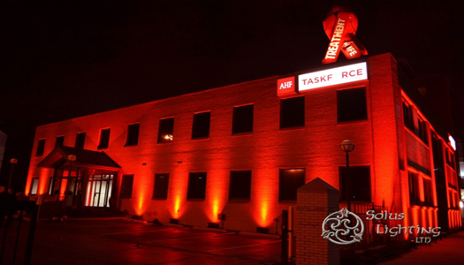
Cuyahoga County Board of Health
Ryan White Part A
FY26 Program Updates and Showcase of Part A Services
Presented by:
Chris Krueger
Administrative Director of Services & Grants

Slide 25

Our Mission
The AIDS Taskforce of Greater Cleveland provides a compassionate and collaborative response to the needs of people infected, affected, and at risk of HIV/AIDS. This is accomplished through leadership in prevention, education, supportive services, and advocacy.
Who We Are, Who We Serve
Founded in 1983, The AIDS Taskforce of Greater Cleveland (ATGC) is one of the oldest and largest AIDS Service Organization (ASO) in Northeast Ohio. We annually provide social and medical services to nearly 1,000 clients living with HIV and prevention services to over 25,000 at greatest risk for acquiring the virus that causes AIDS. Our organization provides a coordinated and collaborative response to HIV/AIDS epidemic affecting Northeast Ohio.

Slide 26
ATGC Staff information
ATGC’s Main number is 216-621-0766
Tracy Jones - Executive Director
  Email: tjones@clevelandtaskforce.org
  Phone: x52924
Rebecca Sabala- Associate Executive Director
  Email: rsabala@clevelandtaskforce.org
  Phone: x52915
Leon Hall - Director of Operations
  Email: lhall@clevelandtaskforce.org
  Phone: x52905
Janet Gibson – Controller
  Email: jgibson@clevelandtaskforce.org
  Phone: 52921
Natalijia Palasic
  Email: npalasic@clevelandtaskforce.org
  Phone: x52910
Chris Krueger - Administrative Director of Services & Grants
  Email: ckrueger@clevelandtaskforce.org
  Phone: x 52909
Andrea DeJesus – Housing Case Manager Supervisor
  Email: adejesus@clevelandtaskforce.org
  Phone: x52917
Nestor Marrero - Intake Specialist
  Email: Nmarrero@clevelandtaskforce.org
  Phone: x52953
Katherine O’brien – Medical Case Manager
  Email: kobrien@clevelandtaskforce.org
  Phone: 52916
Cheryl Gleeson – Medical Case Manager
  Email: cgleeson@clevelandtaskforce.org
  Phone: x52928
Stanley Davis – Housing Case Manager
  Email: sdavis@clevelandtaskforce.org
  Phone: 52939
Dwayne McCully – Housing Case Manager
  Email: dmccully@clevelandtaskforce.org
  Phone: x52922
Charles Kelly – Housing Case Manager
  Email: ckelly@clevelandtaskforce.org
  Phone: x52933

Slide 27
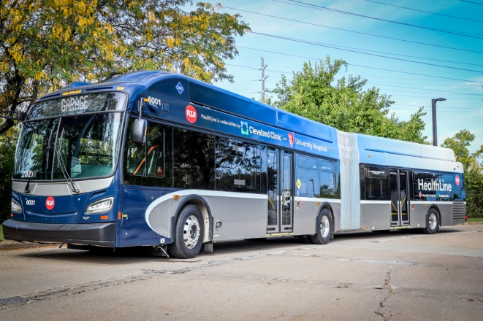
Medical Case Management
Ensures that clients have easy access to medications and medical care.
Complete assessments and create Individual Services Plans, focusing on medical
and medication goals.
Assist clients with obtaining medical insurance (ie; OHDAP, Medicaid, Medicare)
and the Marketplace.
Will make appropriate referrals to medical and other resources if needed.
Non-Medical Case Management
Provides direct non-medical services for people living with HIV/AIDS: including delivery
coordination of health care, care giver, mental health, housing services, medical transportation
assistance and recovery services.
Housing Advocacy provides services that assist in attaining/maintaining housing and facilitates
transition to permanent, safe and affordable housing.
Medical Transportation Assistance
Medical transportation services are provided by bus tickets/Para
Transit, gas cards, ride shares, to enable a client to access medical
care or other supportive services.
The agency also provides transportation using the agency van to
transport clients when needed.

Slide 28
Emergency Financial Assistance (EHE HOME)
The EHE Home Program is designed to assist clients with maintaining their households
when emergencies arise
The EHE Home Program provides the following assistance with rent:
  Assistance with first month’s rent
  Assistance with past due rent
The EHE Home Program can also provide utility assistance when a client is facing utility
disconnect
AIDS Rental Assistance Program (ARAP)
ARAP is a program to assist clients with maintaining their households when emergencies arise
ARAP provides the following assistance with rent:
  Assistance with first month’s rent
  Assistance with past due rent
ARAP can also provide utility assistance when a client is facing utility
disconnect

Slide 29

Food Bank/Home Delivered Meals Program
Provides a combination of dry goods, non-perishable and frozen items as well as nutritional staples essential to a clients diet.
A home delivered food program is also available for clients who
are housebound with a prescription.
Clients can also receive the following non-food items:
  Personal hygiene products
  Household cleaning supplies

Slide 30
Additional Programs and Services
Provides the community with information on HIV/AIDS while offering testing and prevention services through our agency.
Services include:
  HIV Mobile Testing Unit: a mobile unit that goes out into the community to various locations to provide onsite rapid testing. Unit provide immediate linkage to care when warranted.
  HIV Testing: ATGC offers free HIV testing to anyone who comes to our office during business hours. Along with in person testing ATGC also offers free at home HIV testing kits.
  Men’s Support Groups: Support and education for people living with HIV and AIDS. Every Monday starting at 5:30pm.
  Women Support Group: Support and education for people living with HIV and AIDS. Every 2nd Tuesday of the month starting at 11:00am.
  Beyond Identities Community Center (BICC): a membership based prevention education program that addresses the youth development needs of LGBTQ youth of color ages 14-24 in an effort to reduce their risk for HIV/AIDS transmission.
  Project Dawn: A program that provides naloxone to community members within Cuyahoga
  County at no cost.
  AIDS Healthcare Foundation Health Care Center and Pharmacy
  AHF Wellness Clinic: A program that provides free HIV and STD testing and treatment to community members at no cost. This program is available Monday through Thursday 1:00pm to 4:00pm and is first come first serve.

Slide 31
ATGC Data 2025
Case Management Data
719 clients in Case Management Services
  617 non-medical clients
  102 medical clients
190 clients completed intakes
Average caseload size was 98 in 2025
EHE Home Data
255 clients utilized ARAP in 2025
  64 received utility assistance
  76 received rental assistance
  37 received assistance with first month's rent/security deposit
  64 received both rental and utility assistance
ARAP Data
249 applications for utility assistance
68 applications for rental/mortgage assistance
Food Pantry Data
1720 food pantry bags provided to clients in 2025
Produce to the People (May 2025-October 2025)
2452 individuals living in Cuyahoga County participated
HIV Testing Data
ATGC provided 5752 in 2025
45 HIV positive tests results in 2025
.87% positivity rate in 2025
AHF Wellness
Wellness provided STD testing to 1185 individuals in 2025 and had 4 positive HIV test result. AHF Wellness also had 49 new Prep patients in 2025.
Beyond Identities Community Center
1,352 youth visits in 2025
13 HIV tests performed at BICC
3 positive HIV test result in 2025 from BICC

Slide 32

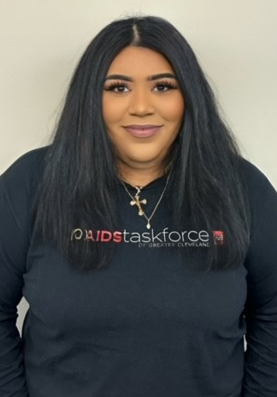
What’s New?
Natalijia Palasic
Director of Education
Andrea DeJesus
Housing Case Manager Supervisor

Slide 33
Highlights
Produce to the People Returning May 20, 2026!!!
ATGC Partners with the Cleveland Food Bank to offer free produce on the 3rd Wednesday of each month in ATGC’s parking lot at 2829 Euclid Avenue Cleveland OH 44115.
  This event is open to anyone there are no requirements to participate and receive fresh produce!!!
AHF PrEP Program
Pride Kick-off Party Date To Be Announced
ATGC is partnering with the Roxy/Mahalls to host a huge pride kick-off party. This will be a multi room experience with a live band to kick off the night followed by a DJ and go-go dancers in the main room, bowling downstairs, and drag queen led karaoke I pins and needles.

Slide 34

Up Next…

Slide 35

The
Cleveland clinic foundation
Infectious Disease Department
9500 Euclid Ave., Desk G21,
Cleveland, OH 44195
216-636-1873

Slide 36
Who we are
Cleveland Clinic’s mission is: Caring for life, researching for health, educating those who serve.

Slide 37
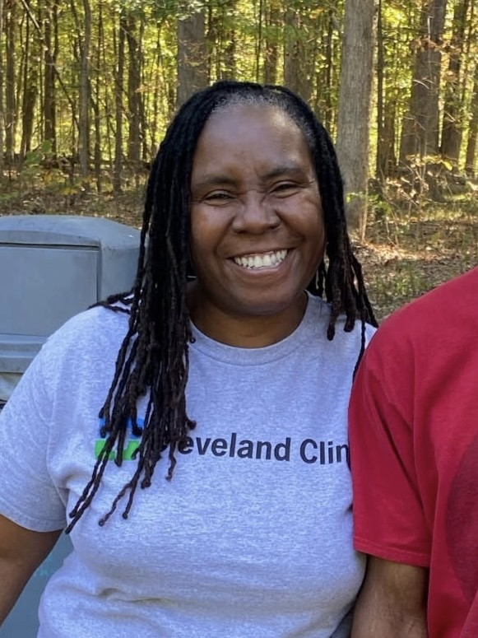
Infectious Disease Team
Administrator – Rhonda Jenkins, MPH
Program Manager and IMCM Hope Callahan, MSW LSW
EHE Team
  PI – Dr. Bethany Lehman, DO
  Rapid Start Coordinator – Shenee Dantzler
  Peer Navigator - Kimberly Moore, CHW MBA
Ryan White Team
  PI – Dr. Marisa Tungsiripat, MD
  MCM/EIS - Lydia Spangler, LSW
  NMCM – Serrena Prezioso, MPH

Slide 38
Current Staff
Physicians
  Dr. Marisa Tungsiripat, MD
  Dr. Bethany Lehman, DO
  Dr. Tricia Bravo, MD
  Dr. Caitlin Blaskewicz, MD
  Dr. Petros Svoronos, MD
  Dr. Christopher Kovacs, MD
  Dr. Katherine Holman, MD
  Dr. Vinh Dang, MD
  Dr. Francisco Marco Canosa, MD
  Dr. Anita Modi, MD
  Dr. Jessica Erickson, MD
  Dr. Patricia Bartley, MD
  Dr. Leonard Calabrese, DO
  Dr. Cassandra Calabrese, DO
  Dr. Alexander Shaffer, MD
Pharmacists (HIV Focused) :
  Andrea Pallotta, Pharm.D., BCPS, BCIDP, AAHIVP
  Janet Wu, PharmD, BCIDP, AAHIVP
Anal Dysplasia:
  Dr. Michelle Inkster, MD, PhD
  Dr. Jim Wu, MD
LGBTQ+ Center:
  Dr. Jim Heckman, MD
  Dr. Henry Ng, MD
OB/Gyn:
  Dr. Tosin Goje, MD

Slide 39
RW A&B/EHE Services Provided at CCF
Early Intervention Services
  Rapid Start (EHE)
  Case Management
Medical Case Management
Non-Medical Case Management
Peer Navigation
Outpatient Ambulatory Health Services
  Office Visits & Labs
Emergency Financial Assistance
  EHE and RW A
  JJ Euclid Avenue Pharmacy
Medical Transportation
  Parking Vouchers
  Bus Passes
  Ride Share services for non-virally suppressed (EHE)
OHDAP Applications
  RW B

Slide 40
EHE: Rapid Start and
Early Intervention Services
Rapid Start
Notified of Preliminary/Confirmatory Test Results
Contact patient with results from confirmatory (Either Negative or Positive).
Review potential barriers to care and patient supports
Confirm correct contact information.
Educate patient on
Get patient scheduled for first appointment with ID Staff.
If patient does not respond to phone calls after 3 attempts, notify CCBH for community outreach.
Early Intervention Services
Start at first doctors' appointment
Review RW Eligibility and barriers to care.
Go over HIV education.
Ensure that pt completes labs.
Referrals/Assistance:
  If need for services not provided at the Clinic, refer to outside facilities per patient’s request.
  Apply for Medicaid.
  Get patient in contact with a financial planner.
  Provide patient with community resources if patient wants to independently review options (Mental Health, Providers, Dental, etc.)
Follow Up:
  Check in with patient to ensure compliance with care and medication
  Review patient’s goals and progress and assist as needed

Slide 41
Medical Case Management
Develop an ISP to define patient goals and determine level of need for services
Assist patients with maintaining benefits and coordinate referrals to other community organizations.
Coordinate with patient and doctors to ensure engagement in medical treatment.
Assess and manage patient eligibility for program through Care Ware.
Follow up with patient as needed.
Assist with OHDAP applications and renewals as needed or coordinate with other Copayment programs.
Intensive Medical Case Management
Complete an initial assessment to clarify present and historical symptoms of mental health and or substance misuse diagnosis.
Discuss current problems and barriers to engagement to treatment examples include active substance use , mental health symptoms .
Referrals to community and or inpatient individual or group treatment.
Regular check-in by phone at intervals that are specific to patient lifestyle, weekly to monthly, with a goal to become engaged in treatment and virally suppressed.

Slide 42
Peer Navigation
· Initial Client Contact & Intake: Upon identification or referral, clients are contacted within 24–48 hours to schedule an intake appointment. This includes collecting baseline information, conducting a needs assessment, and obtaining consent for services.
· Medical Appointment Coordination: Clients are linked to an HIV care provider within 7–14 days of intake. Staff assist with appointment scheduling, transportation coordination, and reminder calls or texts.
· Support Services Engagement: Clients are connected to supportive services such as case management, housing, mental health, and substance use services based on identified needs during intake.
· Follow-Up & Retention: Case managers conduct follow-ups within 30 days of the initial medical appointment to ensure the client attended and is retained in care. Missed appointments trigger outreach efforts, including phone calls, home visits, or collaboration with partner agencies.

Slide 43
Cleveland Clinic Services
Lesbian, Gay, Bisexual, and Transgender Health (Center for LGBTQ+ Care)
  Lakewood Family Health Center: 14601 Detroit Ave., Lakewood, OH 44107
    Phone Number: 216-237-5500
    Primary Care (Adult and Pediatric), Behavioral Health (Adult and Pediatric), Specialty Care, Gynecologic Care, Endocrinology/Metabolism Care (Lesbian/Bisexual Health), Gender Affirming Surgical Services, Gender-Affirming Hormone Therapy, Gender Understanding, Identity and Expression (Youths)
      Provides world-class healthcare through a multidisciplinary, team-based approach for LGBT+ patients in partnership with our clinical institutes. Our providers are committed to creating a safe environment that maintains the respect and dignity of all patients regardless of sexual orientation or gender identity.
      Transgender Medicine & Surgery Program:
      9500 Euclid Ave, Crile Building (A), Cleveland, OH
      Phone Number: 216-445-6308

Slide 44
Pharmacy
Cabenuva – HIV Injectable Treatment
  RNs provide the injection.
  Coordinated by Admins, Pharmacists, and Staff for billing and approval.
PrEP Clinic
  Virtual PrEP Clinic, more easily accessed for patients.
  Staff would send a consult to the PrEP Clinic.
  Pharmacists would follow the patient to fill medications for PrEP and STD.
    Must have 1 visit a year doctor and then seen every 3 months by the pharmacist or doctor. In person or virtually.
Travel Clinic
  Dr. Bartley
  Virtual pharmacy
  Cleveland Clinic outpatient pharmacy (family health center) for vaccinations/meds.

Slide 45
DATA
We currently serve 198 patients through Ryan White and EHE caseloads. Of these patients, 87% are virally suppressed.
New Diagnoses and patients with Substance use and mental health concerns require a higher level of intervention to address barriers to viral suppression.
Medical Case Management | Early Intervention Services | Intensive Medical Case Management | Non-Medical Case Management
71% | 58% | 57% | 91%

Slide 46
ID staffed locations
Main Campus
  9500 Euclid Ave. G21, Cleveland, OH 44195
South Pointe Hospital
  20000 Harvard Ave., Warrensville, OH 44128
Mentor Hospital
  8300 Norton Pkwy, Mentor, OH 44060
Hillcrest Hospital
  6780 Mayfield Rd, Mayfield Heights, OH 44124
Avon Hospital
  33300 Cleveland Clinic Blvd., Avon, OH 44011
Marymount Hospital
  12300 McCracken Rd., Garfield Heights, OH 44125
Sheffield Family Health Center
  5334 Meadow Lane Cr., Sheffield Village, OH 44035
Standardized HIV testing in EDs throughout the organization.
  Bethany Lehman, DO
Akron General:
224 W. Exchange St. Suite 290, Akron, OH 44320

Slide 47
Questions?
Contact Information:
  Phone: 216-538-8881
  Email: Nicholh3@ccf.org

Slide 48
Up Next…

Slide 49
Division of Senior and Adult Services
Cuyahoga County
Hughes Building
2925 Euclid Avenue
Cleveland, OH 44115
Website: www.dsas.cuyahogacounty.us
DIVISION OF SENIOR AND ADULT SERVICES (DSAS)

Slide 50
Division of Senior and Adult Services (DSAS) was officially established as an agency on March 30, 1992.
Our mission is to empower seniors and adults with disabilities to age successfully by providing resources and support that preserve their independence.
History and Mission
Notes:
Services are provided to the residents of Cuyahoga County who are:
60 years of age or older OR 18 to 59 years of age AND have a disability

Slide 51
DIVISION OF SENIOR AND ADULT SERVICES

Slide 52
Adult Protective Services
Information Services
Community Office on Aging
Community Social Services Program
Options for Independent Living
Home Support Services
DIVISION OF SENIOR AND ADULT SERVICES
Notes:
No one agency can do it all, so DSAS seeks to collaborate whenever possible
Always seek new ways and best practices for service delivery
Measure our performance on a quarterly basis

Slide 53
Staff
Brenda Richardson, RN, Director of Nursing
Office: 216-443-6203 Mobile: 216-302-9096
Brenda.Richardson@jfs.ohio.gov
Lorsonja Moore, BA, BSN, CEHCH, RN, Assistant Director of Nursing
Office: 216-263-4674 Mobile: 216-544-1844
Lorsonja.Moore@jfs.ohio.gov
Yania Turney, BSN, RN, Nurse Supervisor
Office: 216-443-6909 Mobile: 216-225-1130
Yania.Turney@jfs.ohio.gov

Slide 54
Home Support
Director of Nursing
Assistant Director of Nursing
Nurse Supervisors(8)
Scheduling Supervisor
Home Health Aides (35)
Schedulers (2)
Comprised of registered nurses, schedulers, and home health aides.
Our goal is to provide services to help clients achieve and maintain a clean, safe, and healthy environment in which they reside.
Notes:
8 REGISTERED NURSES (FULL-TIME) – ONE RN ASSIGNED TO THE RYAN WHITE CASELOAD
45 HOME HEALTH AIDES (FULL-TIME) - CURRENTLY UNDERSTAFFED
SCHEDULING DEPARTMENT / MEDICAL RECORDS DEPARTMENT
ADMINISTRATORS: DON/ADON

Slide 55
In-Home Services
Personal Care Services:
Bath/Shower/Bed Bath
Incontinence Care
Basic ROM Exercises
Mouth/Dental/Oral Care
Shaving/Hair Care
Meal Preparation/Feeding
Homemaking Services
Vacuuming/Sweeping/Mopping
Laundry/Change Bed Linens
Wash Dishes
Clean Bathroom
Dusting
Grocery Shopping/Prescription Pick-Up
Notes:
Services are provided to the residents of Cuyahoga County who are:
60 years of age or older OR 18 to 59 years of age AND have a disability

Slide 56
Home Support Intake Process
  RN completes an initial assessment to develop a plan of care
  RN provides on-going case manager services
  RN visits clients every 60 days
  RN works with family members, physicians, social workers, dieticians, therapists...etc. to ensure client’s needs are met.
Referral is received from Connections Center
An RN and aide are assigned to referral
RN conducts an assessment

Slide 57
Highlights
Food Pantry
  Cleveland Food Bank
  Delivery once a month
  Frozen Meats
  Non-perishable Items
  Fresh Vegetables

Slide 58
Connections Center
“One Call Does It All”
(216) 420-6700
Notes:
Services are provided to the residents of Cuyahoga County who are:
60 years of age or older OR 18 to 59 years of age AND have a disability

Slide 59
Up Next…

Slide 60
May Dugan Center
4115 BRIDGE AVENUE, CLEVELAND, OHIO 44113
www.maydugancenter.org

Slide 61

History
The Near West Multi Service Corporation (dba May Dugan Center) was founded in 1969 and exists to support low-income individuals, seniors, and families residing in Cleveland and Cuyahoga County by providing wrap-around services through its core programs to promote access and continuity of care while partnering with other non-profit organizations across the county to prevent service duplication.

Slide 62
MISSION
We enrich lives and strengthen communities through comprehensive support services.
Who We Are
VISION
Everyone we serve has access to the resources and supports needed to thrive.

Slide 63
We are passionately invested in the success of our clients, community, and each other, guided by our core values:
Compassion -
Collaboration -
Belonging -
We care for each other. We work as a team.
We welcome all.
Accountability - We take responsibility for our work.

Slide 64
IMPACT
The May Dugan Center is a lifeline for over 24,000 individuals and families who need effective and meaningful programs that will improve their lives and their communities.

Slide 65
IMPACT
In 2025, May Dugan Center provided over 1,000,000 meals to needy individuals and families through it’s Food Distribution Program

Slide 66
CORE PROGRAMS
Behavioral Health Services
🞄 Mental Health Services
🞄 Substance Use Disorder Treatment
🞄 Trauma Support Services
Education Resource Center
🞄 GED
🞄 ESOL
🞄 Workforce Development
🞄 Financial Opportunity Center
Seniors on the Move
Food and Clothing Distribution
Who We Are
continued

Slide 67
Ryan White Part A
In PY2026, Ryan White Part A Mental Health Services are provided and/or coordinated by Bee Saffle, MSW, LSW. They are the one direct service staff member who specializes in working with individuals living with HIV and AIDS.
Services Provided

Slide 68
Mental Health Services Provided
Individual Counseling Group Counseling
TBS/ Case Management
Music Therapy
Specialized Trauma Counseling
Specialized Mental Health Services for Older Adults
Assessment Services (including CANS assessments)
Transportation (provided to all enrolled Ryan White Part A clients, if needed)

Slide 69
Ryan White Part A Services

Slide 70
Ryan White Part A
Anyone can refer someone to MDC for Ryan White, Part A
Services.
Walk-in or call (216) 631-5800, x120
2026
Referral Process
MDC actively collaborates with several community partners to serve the community
Metro Health
University Hospital

Slide 71
Ryan White Part A
As part of a CQM process to increase Ryan White Part A consumer engagement, MDC is collaborating with referral sources in 2026 to ensure a warm hand-off:
2026
Referral Process
🞄 Joint meeting with consumer, MDC and Referring Partner
🞄 3-way conference call

Slide 72
Individual Counseling*
🞄 Office-Based
🞄 In-Home/ Community-Based
🞄 Virtual
🞄 Adults
🞄 Children and Adolescents (6 and older)
🞄 Dual mental health-substance use disorder counseling available
🞄 Victims of Crime
Mental Health Services continued
* Location and interventions are tailored to the unique needs of persons served. MDC prioritizes providing a safe and welcoming environment of care.

Slide 73
Group Counseling
Anger Management Classes
🞄 In-person
🞄 Virtual
Healing Through Creativity Grief Group
Parenting Education Classes
Mental Health Services continued
Coming in 2026
Healing from Trauma through Yoga, Movement & Music

Slide 74
Mental Health Services
continued

Slide 75
Mental Health Services
continued

Slide 76
Mental Health Services
continued

Slide 77
Mental Health Services
continued

Slide 78
Intensive Outpatient Program
In-person, evening groups
Outpatient Treatment Group
Trauma-Informed Individual Counseling Case Management
Peer Support
Tuesday Recovery Group (open to the community)
Assessments Aftercare support
Substance Use Disorder Treatment Services

Slide 79
Behavioral Health Services
Selected Demographics (January 1 – December 31, 2025)
May Dugan Center
🞄 TOTAL CLIENTS (undupl):
🞄 Mental Health
🞄 Substance Abuse Services
562
🞄 | Mean Age: |  | 42 years
🞄 | Gender: 🞄 Male |  | 50%
 | 🞄 Female |  | 46%
 | 🞄 Other |  | 4%
🞄 | Race/ Ethnicity:
🞄 |  | African American | 40%
🞄 |  | White | 32%
🞄 |  | Multi Racial | 12%
🞄 |  | Other Races | 13%
🞄 |  | Unknown | 3%
🞄 |  | Hispanic / Latino | 13%
🞄 | Average Length of Stay: |  | 288 days
🞄 | New Clients 🞄 New in 2025 |  | 242 (43%)
Data

Slide 80
Insurance Breakdown
None 4%
ADAMHS 13%
Private Ins
9%
Medicare 5%
More Data
Medicaid 69%

Slide 81
More Data
Most Common Diagnoses
🞄 PTSD - | 22%
🞄 Adjustment Disorders - | 15%
🞄 Generalized Anxiety Disorder - | 14%
🞄 Alcohol Dependence - | 11%
🞄 Major Depressive D/O, Recurrent - | 10%
🞄 Cannabis Use Disorder – Severe - | 10%
🞄 Problems Related to Legal Issues - | 10%
🞄 Low Income - | 3%

Slide 82
🞄 Parenting Education Classes
🞄 Expressive Arts Grief Group
What’s New?
🞄 Child & Adolescent Counseling (including TF-CBT)
🞄 Trauma Case Management

Slide 83
What’s New?
Continued
🞄 Yoga, movement & music trauma group
🞄 Group counseling for children & adolescents
Planned Later in 2026
🞄 Substance use groups for trauma survivors

Slide 84
BROOKE SAFFLE, MSW, LSW - therapist
🞄 bsaffle@maydugancenter.org
🞄 216-403-1296
Ryan White Part A
Staff (2026)
ANNE M. SPELIC, LISW-S – director of behavioral health
🞄 aspelic@maydugancenter.org
🞄 216-631-5800, x111
ANDY TRARES – executive director
🞄 atrares@maydugancenter.org
🞄 216-631-5800, x102

Slide 85
Up Next…

Slide 87
MISSION STATEMENT
Bon Secours Mercy Health extends the compassionate ministry of Jesus by improving the health and well-being of our communities and brings good help to those in need, especially people who are poor, dying and underserved

Slide 88
Outpatient Ambulatory Health Services
Primary Care appointment assistance for the uninsured
Laboratory cost assistance for the uninsured.
RN and LPN Coordination
  Intakes for established or newly diagnosed
  Appointment and Lab Reminder Calls
  1 X 1 Consultations
  Education (Diagnoses, Lab Work, Medications and Vaccines—at length)
  Courtesy Med Box refills
  Update Data Collection (Care Ware)
  ODH VMIT Follow Up Paperwork
This allows a more improved RETENTION in care, thus allowing our clients to become more engaged in their care and remain COMPLIANT.

Slide 89
MEDICAL CASE MANAGEMENT
Complete Intakes and Assessments of client needs
Assist with Applications for clients to maintain or semedication assistance via ODAP/P.A.P.
Coordination of services with Local Resources, to reach plan of care goals per ISP
  ACA Navigation
  Insurance changes if needed
  Housing/Utility Assistance and Referrals
  Mental Health Referrals or Consoling.
  LCDJFS assistance as needed
  Dental Referral and follow up
  Social Security application as needed
  Legal Assistance Referrals
  Transportation
  Resource Linkage
Client Support– 1 x 1
Client Advocate

Slide 90
Support groups are offered once
a month at The Valor Home.
This provides socialization and support for our patients.
Education is provided via handouts,
guest speakers, and group discussions.
Meal is provided
Transportation is offered as last resort.
Support groups are offered once
a month at The Valor Home.
This provides socialization and support for our patients.
Education is provided via handouts,
guest speakers, and group discussions.
Meal is provided
Transportation is offered as last resort.
Support groups are offered once
a month at The Valor Home.
This provides socialization and support for our patients.
Education is provided via handouts,
guest speakers, and group discussions.
Meal is provided

Slide 92
Data
Mercy Retention in care is 90.07%
Viral Load suppression rate is 94.38%
Prescription ART rate is 100%

Slide 93
Highlights
We are proud to report Mercy 2025 Audit did not need any corrective actions.
Our Support group has branched out forming their own peer support group.
*RSR IMPROVED!!!

Slide 94
Staff
Medical
  Summer Barnett RN- Program Supervisor
Stephaine Fillyaw LPN – Nurse Coordinator
Medical Case Management
  Teresa Yuzon – MSSA, LSW– Case Manager
  Contact Information
    3600 Kolbe Rd Lorain 44053 STE 208
    (P) 440-233-0138 Ext. 2
    (F) 440-233-1051

Slide 95
10 Minute Break

Slide 96
Up Next…

Slide 97
Center of Excellence in HIV Care & Prevention
Cuyahoga County
R y a n W h it e P a r t A S e r v ic e s F Y 2 0 2 6
The following report is proprietary information and constitutes trade secrets of the MetroHealth System and may not be disclosed in whole or part to any external parties without the express consent of The MetroHealth System. This document is intended to be used internally for the MetroHealth System discussion.

Slide 98

ABOUT METROHEALTH
Founded in 1837, MetroHealth is leading the way to a healthier you and a healthier community through service, teaching, discovery, and teamwork. Cuyahoga County’s public, safety-net hospital system, MetroHealth meets people where they are, providing care through five hospitals, four emergency departments, and more than 20 health centers and 40 additional sites. Each day, our almost 9,000 employees focus on providing our community with equitable healthcare—through patient-focused research, access to care, and support services—that seeks to eradicate health disparities rooted in systematic barriers. For more information, visit metrohealth.org
connect @metrohealthcle

Slide 99



WE ARE…
ACCESSIBLE
3 HIV Clinic Locations · 12 Pharmacy Locations Medication Home Delivery
COMPREHENSIVE
PrEP & PEP · PrEP Navigation · STI Testing & Treatment Community Outreach · Correctional Medicine
INCLUSIVE
LGBTQ+ Pride Network · Gender-Affirming Care · Trans Care Navigation · Spanish-Speaking Staff
No longer at Bedford
To Schedule an appointment
Medical Staff
Ann Avery, MD
ID Research, RW Grants
Meghan Fibbi, DO
Primary Care – FM
Corrilynn Hileman, MD
ID Clinic Director
Laura Hmiel, MD
Infectious Disease, RW Grants
Melissa Jenkins, MD
ID Division Director
Tiffany Killings, APRN
STI Testing & Treatment
Ashley Turner, MD
Infectious Disease Fellow
Nour El Meski, MD
Infectious Disease Fellow
Kathryn Meyer, APRN
STI Testing & Treatment
Morgan Morelli, MD
Infectious Disease
Alexander Sapick, MD
Infectious Disease
Patrick Talbott, MD
Primary Care – Med/Peds
Rumilia Tolentino, MD
Primary Care – FM

Slide 100

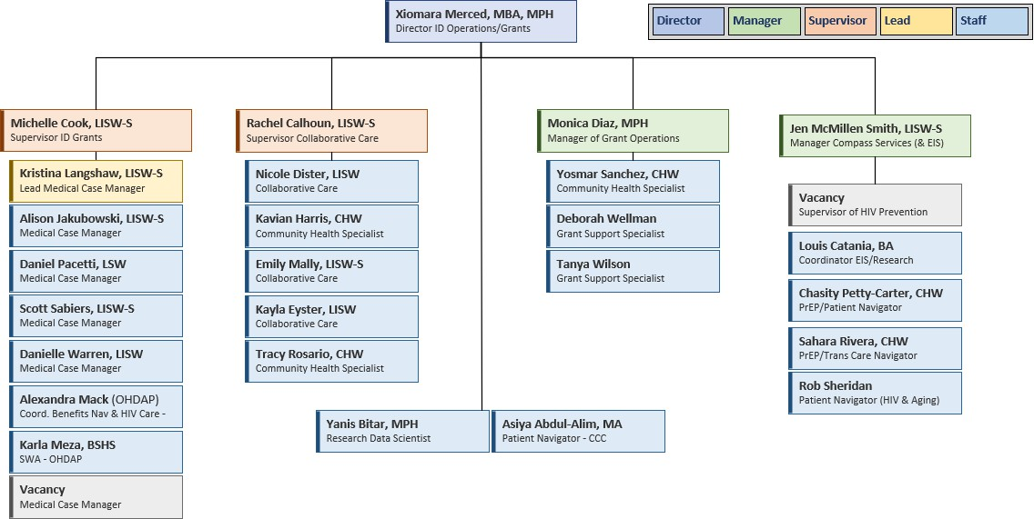
WHO WE ARE
Ryan White Part A (County)
Ryan White Part B (State)
Ending the HIV Epidemic (County)
ODH EIS – PrEP
(State)
FOCUS (Private - Gilead Sciences)
HIV Prevention (County)
Positive Peers NIH Grant (Federal)
AIDS Funding Collaborative
Ryan White Team
Direct Line: (216) 778-2104
Fax Number: (216) 957-8530

Slide 101





SERVICES
Primary Medical Care (Part A)
Nearly 2,600 adult and pediatric patients receive HIV care at MetroHealth
5 Infectious Disease (ID) HIV providers, 3 Internal Medicine/Family Medicine providers, and 2 ID Fellows
  Clinic operates Monday–Friday at Main Campus
Satellite clinics: Parma and Cleveland Heights
Pediatric HIV care support provided by Dr. Amy Edwards (Pediatric ID)
Ryan White services serve as the payor of last resort for ID physician visits and laboratory services
Medical Case Management (Part A)
▪
▪
Connects people living with HIV (PLWH) to community resources, provides emotional support, and promotes viral suppression and health literacy Team of 7 social workers
3 positions funded through Ryan White Part A (RWA)
4 positions funded through Ryan White Part B (RWB)
Provides support with benefits navigation, housing, transportation, and linkage to care
Plays a key role in retention in care and addressing social determinants of health
Walk-in services available
  Located in Hamann Building, 8th Floor (old Hospital C elevators)
Team: Michelle Cook, LISW-S | Kristi Langshaw, LISW-S | Alison Jakubowski, LISW-S | Dan Pacetti, LSW | Scott Sabiers, LISW-S | Danielle Warren, LISW
Medical Transportation (Part A)
Bus tickets, RTA Discount Fare vouchers, gas cards for Part A eligible individuals
Lyft is a last-resort option
Emergency Financial Assistance (Part A)
Medication vouchers are used as a last resort for same-day fills at a MetroHealth Pharmacy location
Medicaid/Medicare, Marketplace, Pharmaceutical Assistance Programs (PAPs) & OHDAP provide patients with long-term prescription assistance
Vision exams are available through Metro Ophthalmology; glasses vouchers can be redeemed at Geauga Vision onsite

Slide 102



SERVICES
Non-Medical Case Management (Part A)
Assists patients in obtaining and maintaining access to Ryan White eligibility and services
OHDAP and Benefits Navigation services through Part B are complementary
Tanya Wilson | Deborah Wellman
Medical Nutrition Therapy (Part A)
Consultation with a Registered Dietitian by referral
Nutritional supplements (Boost or Ensure) available
Referrals: Tanya Wilson; (216) 778-5329 | twilson@metrohealth.org
Oral Health Services (Part A)
MetroHealth can treat uninsured or underinsured patients for their oral health needs within our Department of Dentistry
Cleanings, restorations, implants, and dentures available at a variety of locations:
Ohio City Family Dentistry 3701 Lorain Avenue
Cleveland, Ohio 44113
Broadway Health Center 6835 Broadway Avenue
Cleveland, Ohio 44105
Middleburg Heights Family Dentistry 7123 Pearl Road #100
Middleburg Heights, OH 44130
Referrals: Deborah Wellman; (216) 778-2897 / dwellman1@metrohealth.org Monica Diaz; (216) 778-7819 | MDiaz2@metrohealth.org

Slide 103

SERVICES
Mental Health Services (Part A) & Intensive Behavioral Health Medical Case Management (EHE)
Collaborative Care: follows patients who screen positive for moderate to severe depression and provides initial mental health assessments and ongoing behavioral activation support
Rachel Calhoun, LISW-S | Nicole Dister, LISW | Emily Mally, LISW-S | Kayla Eyster, LISW
Psychiatry: follows patients for medication maintenance in collaboration with therapists
Laurel Ralston, DO | Cassie Badea, APRN
Psychotherapists: see patients at the Main Campus ID Clinic or via telemedicine, with dedicated clinic slots for HIV patients
Graesyn Engler, LISW-S | Meredith Hellmer, LISW-S
Community Health Work: outreach, telephone screenings, patient scheduling
Kavian Harris, CHW – Collaborative Care/Behavioral Health Tracy Rosario, CHW – Substance Abuse Navigator
Patient Navigation & Community Health Workers (EHE & other programs)
Integrating people with lived experience into the day-to-day work in the clinic and social support services
Scheduling appointments, navigating the medical system, outreach for individuals not optimally engaged in care
Rapid Start care coordination & follow-up
Building relationships with PLWH admitted in the hospital and coordinating their care after discharge
Patient Advisory Board participation
Support Groups and facilitating other social support platforms for PLWH
Chasity Petty-Carter, CHW | Sahara Rivera, CHW | Yosmar Sanchez, CHW | Kavian Harris, CHW | Tracy Rosario, CHW / Louis Catania, BA | Rob Sheridan

Slide 104

SERVICES
Psychosocial Support (Part A)
Check out our calendar: www.metrohealth.org/compass-support-groups
Special events are hosted quarterly in the evenings.
Groups at Via Sana – 3335 W. 25th Street (next door to MetroHealth’s Cancer Care Pavilion):
Open Group: 1st and 3rd Mondays from 1:00 pm – 2:30 pm for anyone with HIV
WOW: Women Only Wednesdays - for anyone who identifies as a woman; 3rd Wednesdays at noon
50++: 1st Fridays at Noon
Groups at MetroHealth Medical Center:
Taco Tuesday: 1st and 3rd Tuesdays; 5:00 – 7:00 pm in the Dermatology Clinic lobby
Yoga: Every Thursday at 10:00 am at the MetroHealth Glick Center Meditation Room
Knit Squad: Second Thursdays at 11:15 am outside of the Glick Center Meditation Room
All people with HIV are welcome at our groups and events – no need to be a MetroHealth patient.

Slide 105
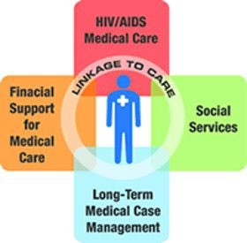
SERVICES
Early Intervention Services (Part A)
Provides counseling, education, and linkage to Rapid Start of HIV care for those who are newly diagnosed.
Tracks all preliminary positive HIV screenings through the EMR
Assists MetroHealth physicians throughout the system deliver positive test results to patients
Links patients to care and serves as a bridge to other services as needed
Outreaches and connects with out-of-care patients to re-link to care
Rapid Start (EHE)
  Starting treatment as soon as possible after diagnosis – ideally the same day, within 5 days maximum. Our median days from the date the test results positive to the date the person is seen in clinic and starts is medication in 2025 was 2.
  Best practice (modeled after the San Francisco Getting to Zero initiative)
  Meds are tubed up and the first dose is observed in clinic
  More frequent follow-up, including a phone visit at 1 week
Jen McMillen Smith, LISW-S | Louis Catania, BA
Year | Mean days Dx to Rx | Mean days Dx to Vs
2020 (n = 52) | 11.23 | 82
2021 (n = 52) | 5.27 | 59
2022 (n = 32) | 4.8 | 52.03
2023 (n = 47) | 4.67 | 42.76
2024 (n = 45) | 3.96 | 66.2
2025 (n=44) | 3.36 (Median is 2) | 69.5 (Median is 59)*
*preliminary data

Slide 106

OTHER SERVICES
MetroHealth Specialty Pharmacy:
Medication adherence support, including compliance packaging
Monthly adherence outreach calls
Over past 6 months, there have been 868 administrations of Cabenuva, for 300 unique patients
Over past 6 months, there have been 237 administrations of Apretude, for 96 unique patients
As of today, 93.5% of patient enrolled in MetroHealth’s Compass HIV Program for at least 6 months are virally suppressed
Refills can be requested by calling 21C-357-MEDS (C337) ext. 3
Infectious Diseases Enrolling Clinical Trials:
NIDA COE with CASE
  Center of Excellence: The purpose of this study is to create, maintain, and expand a database and repository of samples from patients who report recent substance use and have HIV or are at high risk of becoming infected. This data base and repository will be used for future studies.
NIDA COE GUT with CASE
  Clinical Core: Center of Excellence on Substance Use and HIV- GI samples
Contact: Dan Gebhardt, BA (216) 778-5489
ID Clinic Suboxone Program: Scott Sabiers, LISW-S, LICDC | Kristi Langshaw, LISW-S (Dr. Jenkins C Dr. Hileman)
Trans Care Navigation: Sahara Rivera, CHW
Correctional Medicine:
Provides point-of-care testing, patient navigation, and comprehensive medical care (Dr. Jenkins)
Patient Navigator: Asiya Abdul-Alim

Slide 107


HIGHLIGHTS
Wellness groups: Monthly behavioral health groups focused on mental well-being through physical activity, nutrition, and nature-based engagement.
Insurance enrollments: Completed 162 enrollments during open enrollment, including 4 pilot Walk-In Insurance Clinic events, our first time implementing this initiative.

Slide 108
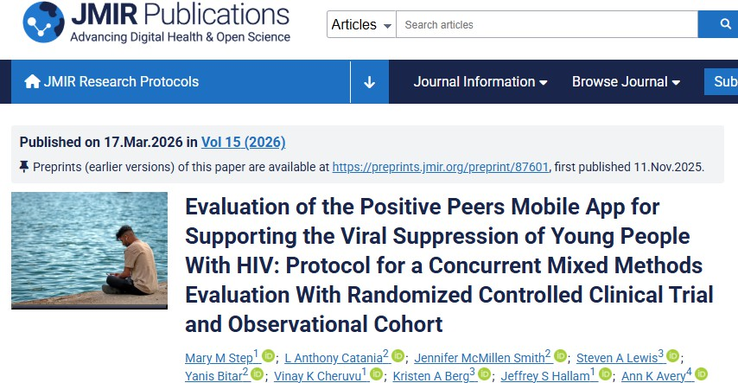
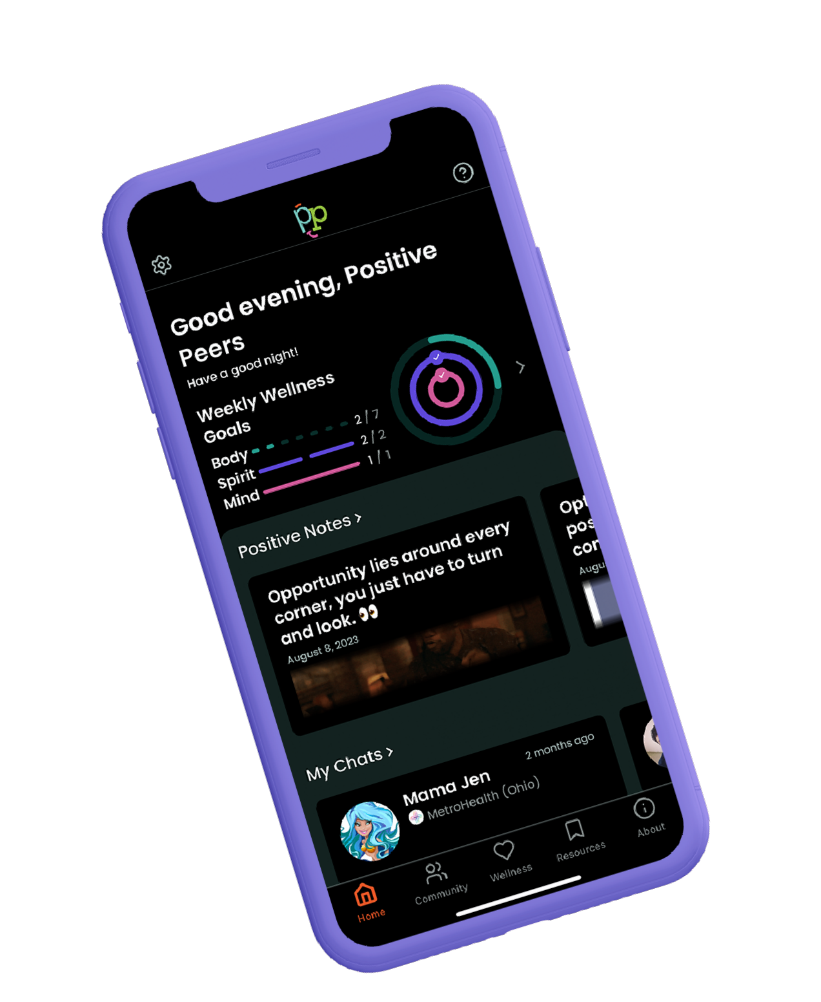
HIGHLIGHTS
The Positive Peers App has surpassed 550 enrollees. Any person with HIV who is 13-34 can self-enroll in this FREE app at
positivepeers.org (follow us @PositivePeers4U)
The Positive Peers Intervention Trial (PoPIT) passed the half-way mark enrolling study participants at six clinical sites in a randomized control trial of the app.
Our protocol paper is published in JMIR >>>

Slide 109
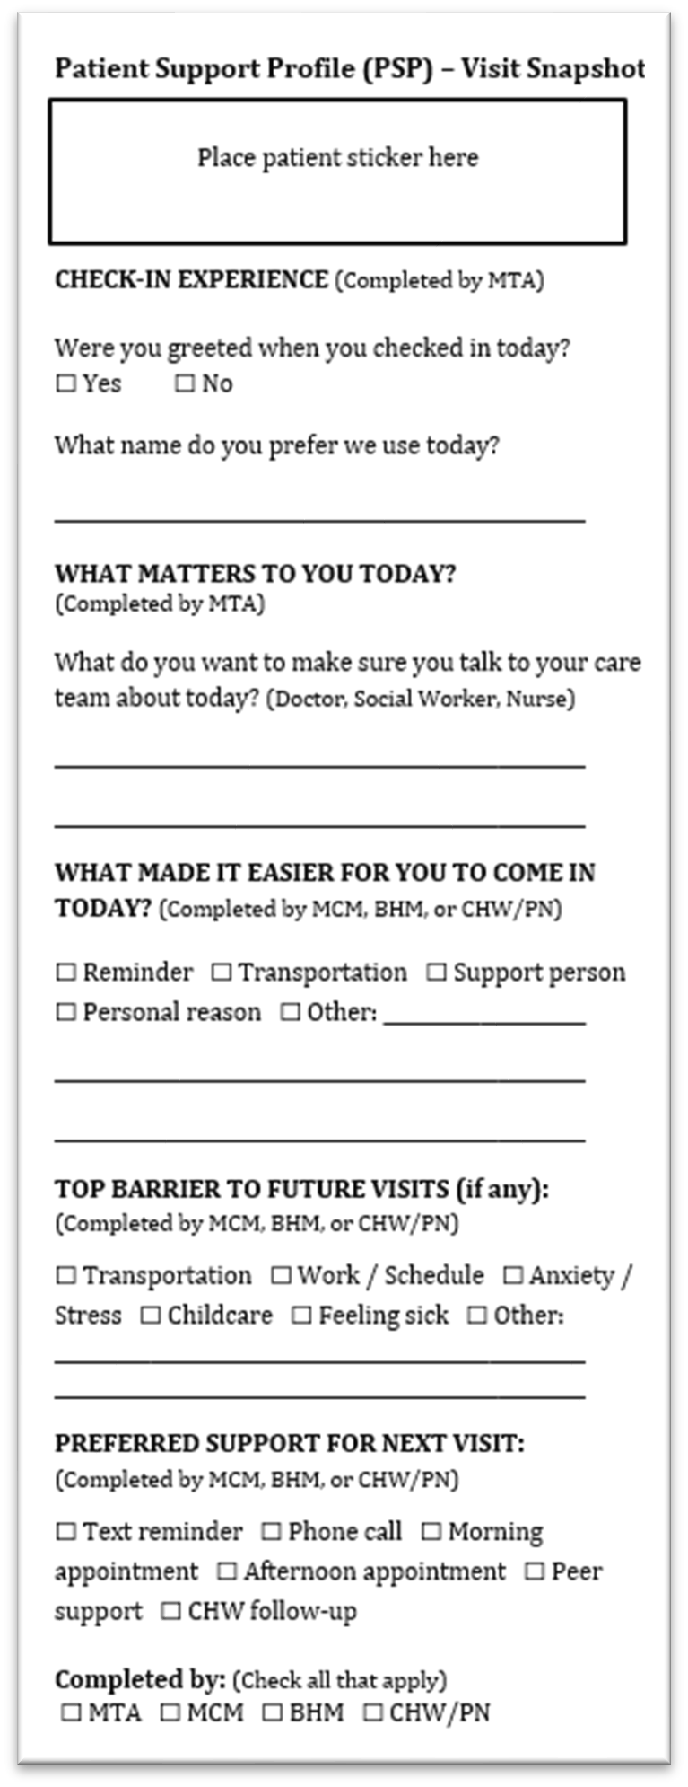
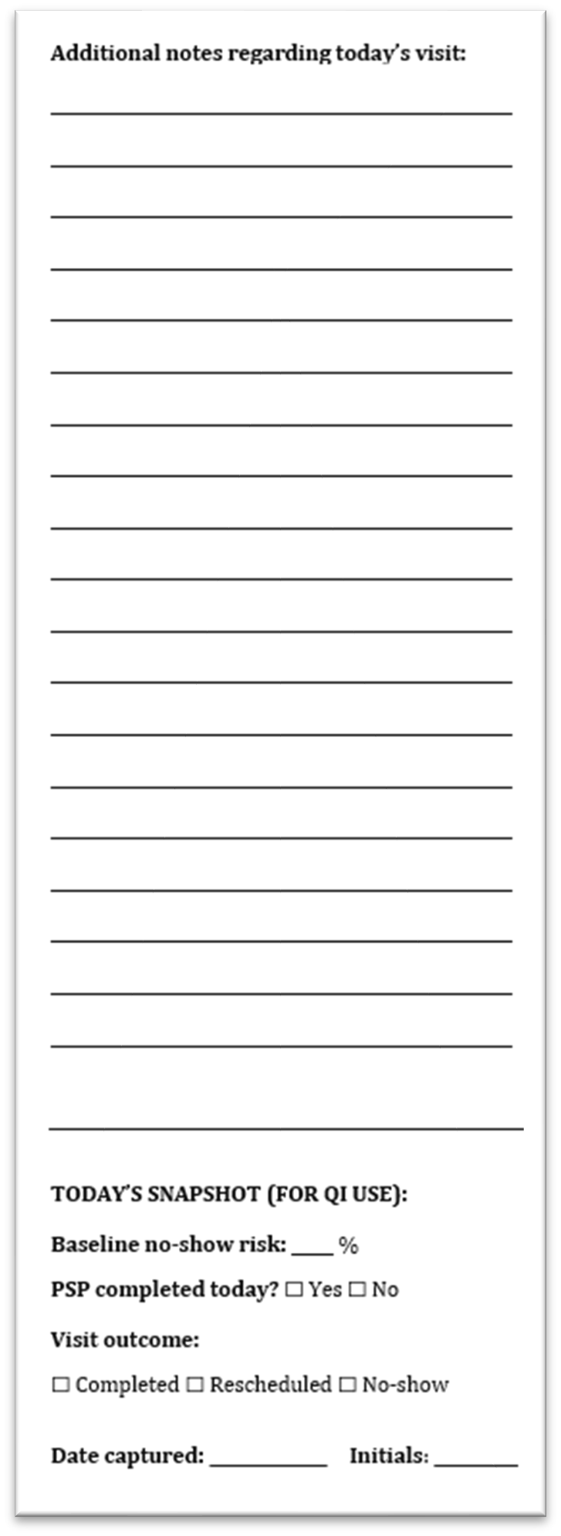
Quality Improvement:
Retention in Care: ǪI Initiative Focus
MetroHealth is participating in the national Clinical Ǫuality Management (CǪM) Care Collaborative, alongside healthcare teams across multiple states, focused on improving viral load suppression, retention in care, and linkage to care.
ǪI Intervention: Patient Support Profile (PSP)
The Patient Support Profile (PSP) is a patient-centered ǪI intervention designed to capture what matters most to patients and integrate it into routine HIV care visits.
Intervention (Tested via PDSA cycles):
A one-page PSP slip used to:
Prompt staff to ask and document “What matters to you?”
Capture patient motivators and priorities
Make patient priorities visible to the care team in real time
Why This Matters
This work shifts the focus from barriers to what helps patients show up, embedding patient voice into routine workflows to improve appointment attendance and retention.
Goal
Integrate patient voice into routine HIV care to strengthen retention in care and sustained engagement.

Slide 110


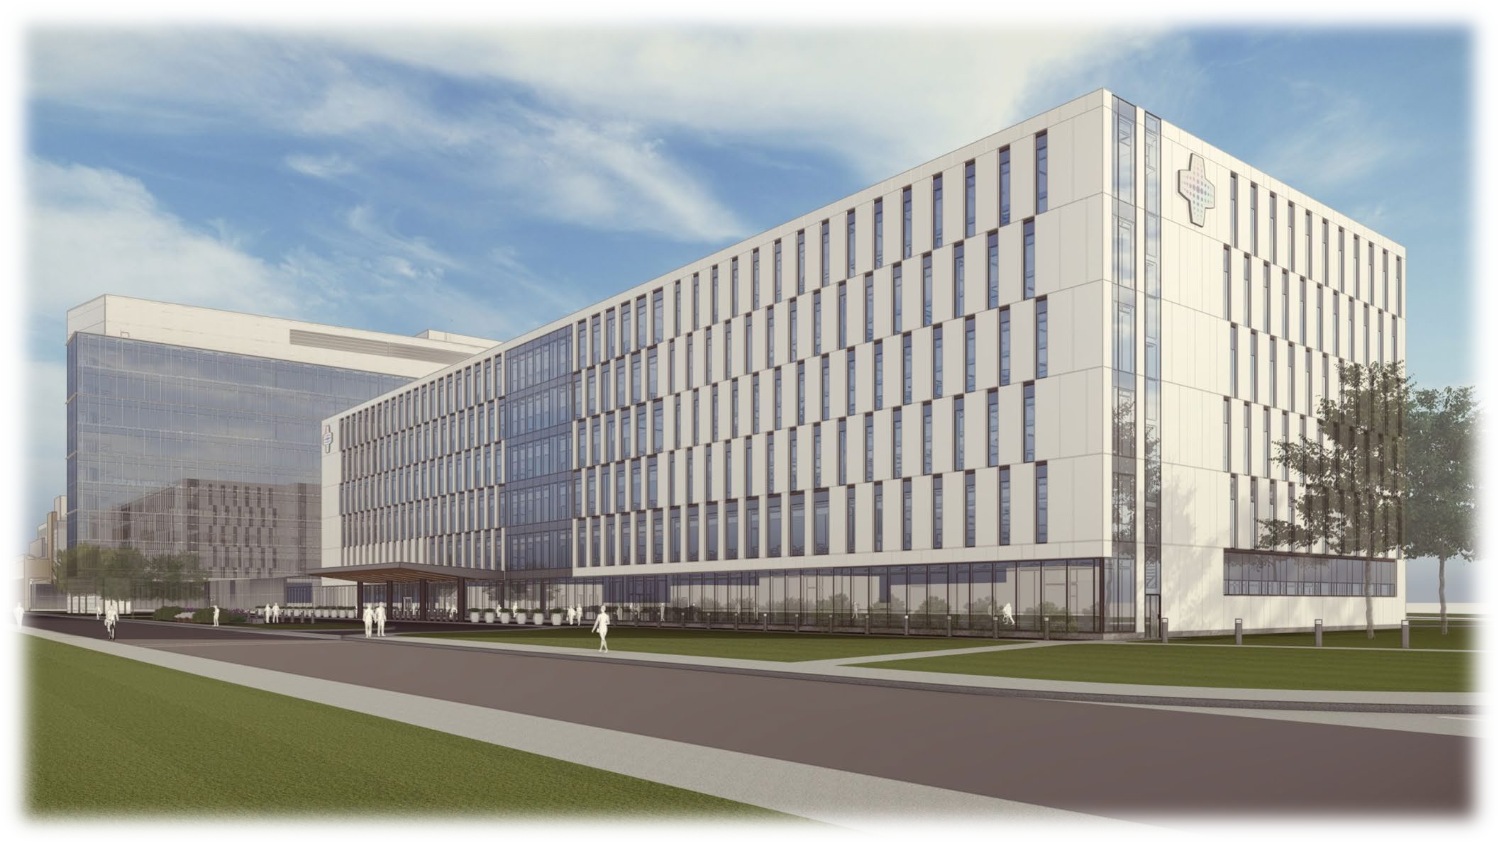
NEW UPDATES
Outpatient Health Center (OPHC) Opening – June 1st
Infectious Disease / HIV Clinic relocating to the new Outpatient Health Center
New facility features include a 24-hour drive-thru pharmacy

Slide 111
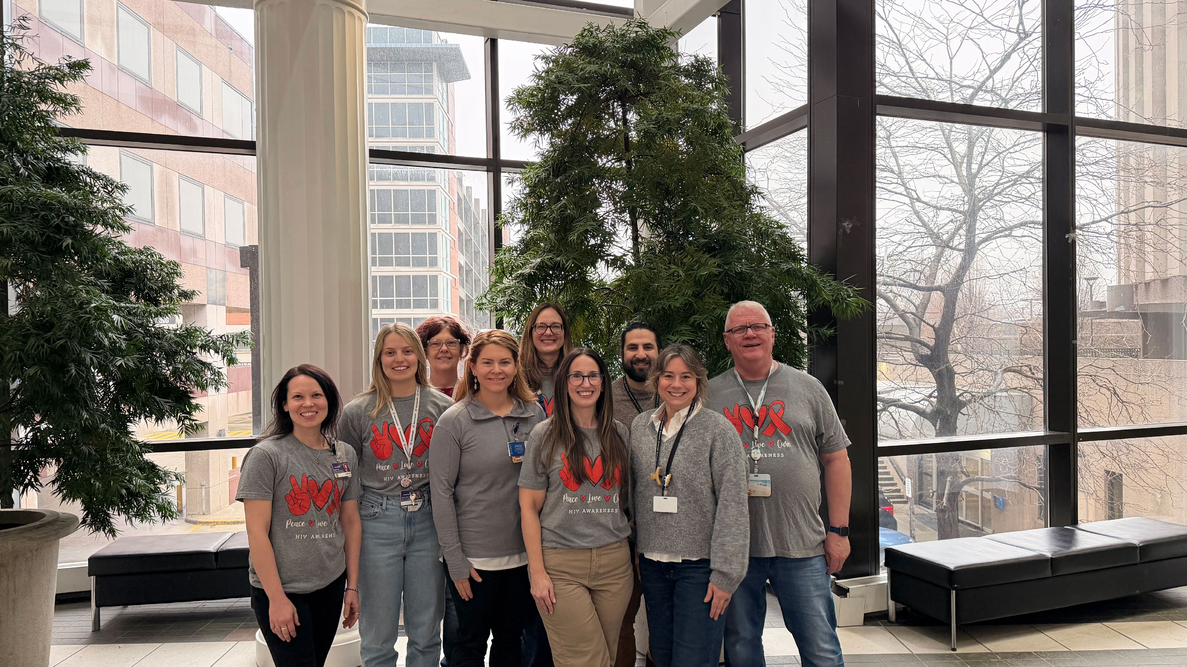

Happy Social Work Month
15
3/30/2026
PROPRIETARY AND CONFIDENTIAL | DO NOT DISTRIBUTE WITHOUT AUTHORIZATION

Slide 112

Up Next…

Slide 113

HIV Primary Care
Program Overview
March 31, 2026

Slide 114
Who We Are
Founded in 1980
Federally Qualified Health Center since
2000
  1 of 6 FQHCs in CLE and 58 in Ohio
Accredited by the Joint Commission
6 locations serving the near west side
Comprehensive Care including Integrated
Primary Care, Behavioral Health,
Midwifery, Dental, Podiatry, HIV &
Pharmacy Services
Bilingual staff and providers, including
Spanish, Nepali, Arabic, Dari/Pashto, and
Swahili

Slide 115
Who We Served in 2025
23,450 patients of all ages
88,347 visits
73% patients at or below 200% FPL
28% patients best served in a language
other than English
Age | % Patient Population
Birth – 18 years | 26%
19 – 64 years | 64%
65 years and older | 10%

Slide 116
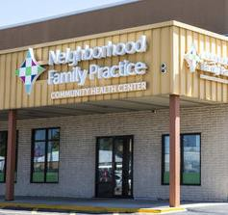
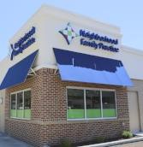

Primary Care in Six Neighborhood Locations
Puritas
Mon, Thurs 8:30a – 5p
Tues, Fri 8:30a – 4p
Wed 8:30a – 8p
NEW LOCATION MARCH 2026-- Ann B Reichsman
M, Th, Fri 8:30 – 5p
Tues, Wed 8:30a – 8 p
Ridge*
Mon-Fri 8:30a – 8p
Detroit Shoreway*
Mon-Wed, Fri 8:30a – 5p
Thurs 10:30a – 8p
NEW LOCATION OCTOBER 2025
W 130th
Mon-Wed, Fri 8:30a – 5p
Thurs 10:30a – 8p
North Coast (Lakewood)
M,W,Th, Fri 8a – 5p
Tues 8a – 8 p
*Locations with Integrated HIV Primary Care

Slide 117
NFP’s
Model of Care for
Patients with HIV
Launched in
Fall 2019
Notes:
Starting HIV care services was a natural fit– the high quality integrated care model mapped directly onto the goals of the Ryan White program. But– NFP took on this expansion of services before securing external funding. NFP saw the need and had faith that it would work.

Slide 118

RWHAP Funding
Ryan White Part A
March 2020
Ryan White Part C
May 2022
HRSA Bureau of Primary Health Care
Ending the HIV Epidemic
Primary Care HIV Prevention (PCHP)
September 2022
    Added to our base Health Center grant in 2025– this ensures ongoing funding

Slide 119

Outpatient Ambulatory Health Services
  Nursing Visits
    Care Coordinator - Lichelle Jennings, RN
      Dedicated to assisting PLWH with any medical/medication/referral needs
      Medication management- pill packing,
      cabenuva/lenacapavir injections
  Primary Care Visits
    Lisa Navracruz, MD, AAHIVS
    Prakash Ganesh, MD, MPH, AAHIVS
    Samaher Hazeen, MA

Slide 120
Wrap Around Care
Medical Case Management
  Brian Scott, LSW
  Shannon Aber, LSW *new to our team!*
Behavioral Health Services
  Michael Cohen, LISW-S
Medical Transportation
  Rideshare through Circulation or Ace Taxi
  Bus Passes – One way and All Day
  Disability Vouchers

Slide 121
Our Success:
2025 End of Year Demographics
Total number patients with HIV: 137
  Total Part A eligible patients: 122
Demographics of RWHAP patients:
  Vast majority of patients are low income
  70% < 200% FPL, 85% < 300% FPL
  Ages range from 13- 79
    43% of patients > age 50, more comorbidities of aging
  27 patients have refugee status or are newcomers to the US
Notes:
Viral suppression and Retention in Care % are for Part A and Part C patients
Program started with 72 patients in 2019

Slide 122
Our Success:
2025 End of Year Health Outcomes
  Viral suppression= 96%
  Retention in care= 99% by HAB measure
  (2 visits in the year separated by 90 days)
      sub-populations of focus have similar 95%+ rates of viral suppression and retention in care
  38 patients on Cabenuva (1 on lenacapavir)

Slide 123
How to reach us:
  216-961-2090
  Brian: x1179
  Shannon x1260
  Lichelle x1424

Slide 124
Up Next…

Slide 126
Locations
Cleveland Office
6600 Detroit Ave.
Cleveland, OH, 44102
Phone: (216)651-8236
Fax: (216)651-8235
Lorain Office
221 West 21st St.
Lorain, OH, 44052
Phone: (440)233-1086
Fax: (440)233-1089
Monday - Friday
9:00 a.m. - 5:00 p.m.

Slide 127
Mission, Vision, Values
Mission: To challenge the root causes of systemic poverty among Latinx and other underserved individuals through holistic and culturally-humble service and community building.
Vision: NLURC attempts to move people from systemic poverty and dependence to lives of empowerment and sustainability.
Values: Our work is informed and fueled by the values of hospitality, spirituality and

Slide 128
Leadership
  Max Rodas - Executive Director
  Kimberly Rodas - Clinical Director
  Christine Davis – Fiscal Controller
  Natalia Rodas – Prevention/Communications Director
  Octaveya Lowe – Non-Clinical Supervisor
  Jean Luc Kasambayi - Clinical Supervisor

Slide 129
Our Staff
  Medical Case Management
  Devin McLaughlin – MCM
  Myeisha Ivy - MCM
  Mayra Perez – MCM
  Vacant - MCM
Non-Medical Case Management
  Octaveya Lowe – Intake/Lead NMCM
  Diamond Green-Philips - NMCM
  Gloriann Irizarry – NMCM
Housing Case Management
  Beatrice Velez – HCM (Director of Lorain Services)
  Keyanna Sanders- HCM
  Monika Henderson- HCM
  Colette Webster - HCM
  Sonja Johnson – HCM
  Yahaira Rodriguez – HCM
  Yessenia Morales – HCM
  Other Professional Services (Legal)
  Staff Attorney - Jackson Flickinger
  Staff Attorney – Hannah Yeack
  Robert Rodriguez – Paralegal
  Psychosocial Services (Recovery)
  Frank Lewis - Recovery Coach/Facilitator
  James Stevenson – Peer Co-Facilitator
  Other Departments/Staff
  Max E. Rodas – Nutrition Coordinator
  Ashley Radke – Benefits Navigator
  Jen Jeffries – Prevention Coordinator
  Susan Yao - Case Aid
  Devin Taylor – SW Intern
  Maria Wesley – Receptionist

Slide 130
Services Provided
  Medical Case Management
  Non-Medical Case Management
  Housing Case Management
  Nutrition
  Recovery Services
  Legal
  Pharmacy
  Transportation
  Prevention/HIV testing and education

Slide 131
Case Management
Process: Intake and eligibility verification are completed, followed by development of the initial PSA/ISP.
Case Management Support: Case Managers (CMs) support clients in achieving the goals outlined in their individualized ISP.
Primary Focus/Goal: Ensure consistent access to HIV care/treatment while identifying and addressing barriers to care, in order to improve health outcomes.
Service Coordination: CMs assist clients in navigating complex medical/health insurance systems, and coordinate access to essential services, including OHDAP, medical care, dental care, mental health/substance use services.
Client-Centered Approach: CMs meet clients where they are both figuratively and literally, to reduce barriers and promote engagement in care.

Slide 132
Transportation
  Clients are provided bus tickets for scheduled HIV-related appointments in accordance with RW Part A guidelines.
  Clients receive vouchers for RTA IDs.
  MCMs assist clients with RTA disability applications.
  Clients must present proof of appointments and confirm that all other transportation options have been exhausted, as RW serves as the payer of last resort.
  Future transportation options are regularly reviewed.

Slide 133
Housing
  Housing assessment/service plan
  Housing support - EDEN, Frontline, CMHA, LMHA, Northwest Neighborhoods…etc.
  Financial assistance programs- ARAP (rent/utilities), PHP, EFA
  Other resources – Temp Hotel Stay (through NEOCH), HEAP, PIPP, Housing Subsidies, other community resources
  Housing search/support – working with landlords/property management companies
  Legal support

Slide 134
Legal Services
.
  Only legal service provider in TGA.
  Legal/Housing collaboration
  Interventions - eviction defense, notices of defective conditions/ repair demands, representation, landlord disputes/negotiations.
  Assist with social security matters, wills, living wills, powers of attorney, other advance directives, name change, employment (wrongful termination), identity theft protection, driver's license reinstatement, and simple immigration matters.
  Grant prohibits work on criminal law and class action suits.

Slide 135
Nutrition/Food Pantry
  Clients may access the food pantry every other week. (receive 2 food -bags – 1 frozen, 1 non-perishable).
  Cleaning supplies, hygiene products and other resources are included whenever available.
  Nutrition Coordinator works with CMs to tailor food bags to meet specific needs by including GOYA food items, boost drinks, or other supplemental foods when additional funding is available.
  Walk-ins are welcome/delivery is coordinated with Case Managers.
  Other resources – community pantries, hot meals, home delivered meals resources provided to clients).
  Clients are referred to Benefit Navigator for assistance with SNAP benefits.
  Collaborate with The Greater Cleveland Food Bank and Second Harvest Food Bank (Lorain).

Slide 136
Recovery Services
  A holistic recovery program designed to support PLWH who are affected substance use.
  Focuses on challenges of living with HIV/impact of substance use.
  Aim – to empowerment and equip PLWHA with tools and resources to successfully recover.
  Meetings - Monday, Wednesday, Friday, 1PM-2:30PM.
  Food/transportation assistance provided.
  All PLWH are welcome!

Slide 137

Prevention/HIV Testing
HIV testing - Offered on-site at NLURC, Monday-Friday. Walk-ins/appointment options.
Newly diagnosed individuals - connected to rapid-start services, ensuring same-day access to ART after confirmatory testing.
Resources - Ryan White programs/other community resources are provided for ongoing care, support.
Education – High school/university, and other public events.
Safer sex – Condoms, dental dams, lube educational materials provided.
PrEP – Internal/external referrals

Slide 138
Pharmacy
  Coordinated Care Network (CCN), an HIV specialty Pharmacy as well as a full-service pharmacy.
  Specialized packaging, labeling and delivery methods tailored to individual client needs.
  This program is designed to highlight client choice.
  Bi-lingual assistance available.
  24-hour service availability with a consistent care team and pharmacy representative.
  Operating from a case management perspective, developed from more than 20 years experience working with PLWHA.

Slide 139
Highlights
  Black History Month Commemoration – Conversation with Kimberlin Dennis/ peer panelists (Living with HIV as African Americans.
  Client Christmas Party – Gifts/food/
  Cleaning Supplies drive
  Immigration/refugee supplies drive
  Community HIV testing

Slide 140
Questions?
Reach out!
Phone: (216) 651-8236
Fax: (216) 651-8235
www.nlurc.org
THANK YOU!

Slide 141
Up Next…

Slide 142
Ryan White Program
Signature Health

Slide 143
Who We Are
Signature Health is a non-profit, Federally Qualified Health Center providing mental health, addiction recovery, primary care, infectious disease, dental and pharmacy services to patients across Northeast Ohio.
Signature Health was founded in 1993 by our CEO, Jonathan Lee; Chief Innovation Officer, Ann Mason; and the late Paul Brickman. We began as a community-focused organization, providing counseling to kids in local schools.
Fast forward three decades and Signature Health continues to grow and meet community health needs. Our clinicians serve more than 32,000 patients each year, at seven outpatient locations and four residential treatment facilities.
We primarily serve Medicaid and Medicare patients, with a sliding fee scale available to eligible individuals without insurance. Our services range from counseling and psychiatry services, to alcohol and drug recovery programs, to primary care, to infectious disease services.
Our locations span as far west as Lakewood, and as far east as Ashtabula.

Slide 144
Mission and Values
Our Core Purpose:
We provide integrated healthcare for our community specializing in patients with mental illness and/or addiction.
Our Vision:
We want people to realize their highest potential.
Our Mission:
To become the most respected integrated behavioral health organization in the country.
Our Values:
PEOPLE FIRST
We honor our patients and colleagues by seeking to know them as individuals and treating them with kindness, dignity, and respect
STRIVING FOR EXCELLENCE
We take full ownership and pride in our work by approaching it thoughtfully, executing with diligence, and continuously improving our skills.
CAN DO
We roll up our sleeves, persist, and innovate together in response to opportunities and challenges.

Slide 145
Part A Funded Services
Medical Case Management
Outpatient Ambulatory Health Services/RN Services
Early Intervention Services
Medical Transportation
Medical Nutrition Therapy
Psychosocial Support
Mental Health Services
Emergency Financial Assistance
Non-Medical Case Management

Slide 146
Ending the HIV Epidemic Funded Services
Intensive Behavioral Health Medical Case Management
Early Intervention Services/Community Health Worker
Emergency Financial Assistance
Medical Transportation
Rapid Start ART
Mobile Health Clinic

Slide 147
Medical Case Management
Ryan White Medical Case Managers are the key to unlock all Ryan White support services and resources
All Ryan White MCMs are Licensed Social Workers
Medical Case Management involves completing psychosocial assessment of case management needs, care planning, linkage to medical-related services, assistance with treatment adherence, advocacy, utilization review, linkage to benefits and insurance, linkage to community resources, OHDAP, Patient Assistance, etc.
Ryan White clients must meet with their MCM at least once every 6 months; meeting cadence determined by risk acuity (Low, Medium, High need)
Ryan White MCM’s coordinate with Behavioral Health case managers to provide collaborative care and ensure no duplication of services
Ryan White MCM’s have access to resources BH case managers don’t and vice versa so sometimes it is necessary for a client to have both BH and RW case managers

Slide 148
Early Intervention Services
These services are provided by the Ryan White Medical Case Managers
This service category targets people living with HIV who are newly diagnosed or inconsistent in care
Connects clients to medications and treatment rapidly and ensures they stay connected to care
Involves linkage to medical-related services, assistance with treatment adherence, advocacy, utilization review, linkage to benefits and insurance, linkage to community resources, OHDAP, Patient Assistance, etc.
Clients graduate to Medical Case Management services from Early Intervention Services once they are able to demonstrate knowledge of HIV medical care, take ART medications as directed and attend appointments regularly.

Slide 149
Outpatient Ambulatory Health Services/RN Services
Assists in connecting patients to medical care, including care at Signature Health or outside organizations/specialists
Reviews and educates on lab results ordered by healthcare providers
Troubleshoots issues with insurance or pharmacy benefits
Collaborates with Ryan White Medical Case Managers to ensure patients have the resources needed to achieve viral load suppression and maintain medical care

Slide 150
Non-Medical/Housing Case Management
Provides help and guidance in finding affordable housing and linking to appropriate housing resources
Assists clients in completing housing applications, viewing apartments, working with landlords
Assists clients in accessing financial assistance related to housing, including security deposit, rent, and utilities assistance.
Clients are referred to Housing Case Management via their Ryan White Medical Case Manager
Provided by Coordinator, Community Resources

Slide 151
Psychosocial Support
Support groups for people living with HIV
Open to any person living with HIV even if they are not current Signature Health Ryan White clients
Non-SH Ryan White clients will need to be willing to register as a Signature Health patient but will not need to switch their Ryan White case management services to SH
Ashtabula HIV Support Group – 2nd Wednesday of each month 10:30am-11:30am, contact Anna Pekarski – 440-261-2905
Lakewood HIV Support Group – Every other Monday 4pm-5pm, contact Ray Bradford – 216-401-3266

Slide 152
Other Part A Services
Medical Nutrition Therapy
Facilitates funding for nutrition supplements, such as Ensure or Boost
Medical Transportation
UberHealth or Lyft, gas cards, and bus tickets to HIV-related medical visits even outside of Signature Health
Ryan White transportation used as last resort – clients should utilize insurance-based transportation and other resources as possible
Can do same-day transportation

Slide 153
Other Part A Services
Mental Health Services
Counseling can be provided by a Ryan White team member if there are no other options – for example, if client is uninsured, not eligible for insurance, and not eligible for the Signature Health sliding fee scale
Emergency Financial Assistance
Financial assistance for prescription eyeglasses, medications
Provided as a last resort and is based on available funds

Slide 154
Intensive Behavioral Health Medical Case Management
Involves assessment of BH needs, rapid and ongoing linkage to mental health and substance use services and resources, monitoring of symptoms and interference with treatment adherence, assistance in overcoming barriers to treatment adherence caused by BH issues, linkage to community resources, etc.
Targeted Caseload – 20 clients on caseload to allow for more specialized and intensive care
Clients receiving this service must have a DSM mental health or substance use diagnosis
Clients graduate to standard Medical Case Management once goals are met

Slide 155
EIS/Community Health Worker Services
Provides support to people living with HIV who are newly diagnosed or inconsistent in care
Assists Medical Case Managers in connecting clients to appropriate resources
Attends community events to provide sexual health education and educate about the Ryan White program at Signature Health
Provided by Coordinator, Community Resources

Slide 156
Other EHE Services
Medical Transportation
UberHealth or Lyft rides to HIV-related medical visits even outside of Signature Health
Ryan White EHE transportation used as last resort – clients should utilize insurance-based transportation and other resources as possible
Can do same-day transportation
Emergency Financial Assistance
Financial assistance for prescription eyeglasses, medications, rent, utilities, food, phone bill
Provided as a last resort and is based on available funds

Slide 157
Other EHE Services
Rapid Start ART
Allows us to build capacity to ensure newly diagnosed or returning to care patients can be given antiretroviral medication at their first appointment or interaction with the medical provider.
Mobile Health Clinic
Ryan White RN completes blood draws, nursing assessments, and Cabenuva injections in targeted patients’ homes and/or mutually agreed upon location in community to decrease barriers to care for hard-to-reach patients
Ryan White team facilitates provider visit via iPad in client’s home or mutually agreed upon location in community to decrease barriers to care for hard-to-reach patients.

Slide 158
FY25-26 Highlights
Strengthened partnerships and increased number of Ryan White referrals received
Several previously non-virally suppressed clients have become virally suppressed due to coordination of Cabenuva injections by the RW RN.
Increased attendance at HIV support groups
Program growth – added an additional EHE Intensive Behavioral Health Medical Case Manager position; promoted a Part A Medical Case Manager to Team Lead; added an additional Part A Medical Case Manager position
Provided Part A and EHE services to 228 enrolled clients (increased from FY24-25)

Slide 159
FY25-26 Highlights
Ryan White Client Feedback
“Anna has been a tremendous support and resource and is always so helpful! Grateful for her and all she does!”
“All in all, I'm happy with them.”
“I really started to take my physical and mental health seriously after I started to see the signature clinic. I trust my team.”
“The Ryan White program has been a help to so many people I don’t know what I would do without it - thanks SH in Lakewood.”
“The team is great, I’m very pleased with the signature team in Painesville.”
“Without this program I would probably be homeless and/or sick!”

Slide 160
Ryan White Part A & EHE Team Members
Brittany Freese, LISW-S (she/her/hers) 440-477-2828, bfreese@shinc.org
Ryan White & Prevention Manager, supervises Ryan White Part A & EHE programs, as well as Signature Health’s Prevention program. Main point of contact for all Ryan White services at Signature Health.
Anna Pekarski, LSW (she/her/hers) 440-261-2905, apekarski@shinc.org
Ryan White, Team Lead, provides Ryan White Medical Case Management, Early Intervention Services, and Psychosocial Support to clients residing in Lake, Geauga, and Ashtabula counties.
Natalie Armstrong-Kinser, RN (she/her/hers) 216-210-9692, narmstrong@shinc.org
Ryan White RN Coordinator, provides Ryan White Outpatient Ambulatory Health Services to clients residing in Cuyahoga, Lorain, Lake, Geauga, and Ashtabula counties. She also provides EHE OAHS Mobile Health Clinic services.
Liz Schaefer, LSW (she/her/hers) 216-644-9476, eschaefer@shinc.org
Ryan White Intensive Behavioral Health Medical Case Manager, provides IBHMCM services to clients residing in Cuyahoga county.
Victoria Piskac, LSW (she/her/hers) 440-488-4777, vpiskac@shinc.org
Ryan White Intensive Behavioral Health Medical Case Manager, provides IBHMCM services to clients residing in Cuyahoga county.
Ray Bradford (he/him) 216-401-3266, Rashawn.bradford@shinc.org
Coordinator, Community Resources, provides Part A Non-Medical Case Management to clients within the TGA and EHE Early Intervention/Community Health Worker services to clients within Cuyahoga county.
Vacant Positions – Part A Medical Case Manager Cuyahoga County & Part A Medical Case Manager Lake County
Working to recruit and fill these positions!

Slide 161
Questions?

Slide 162
Up Next…

Slide 163
The Centers
HIV Services
Adriana Whelan, ND, CNP, AAHIVS, Medical Director
Naimah O’Neal, MSN, LSW, Ryan White Case Manager
Thomas Hayes, LISW-S, Ryan White Case Manager and Counselor
March 31, 2026
-

Slide 164
The Centers’ History
Circle Health Services (the former Free Medical Clinic of Greater Cleveland) opened its doors 50 years ago. In November 2017, Circle Health and The Centers for Families and Children joined forces to provide clients with access to greater levels of health care. In 2021, Circle Health and The Centers for Families and Children finalized a rebrand and a 2021-2023 Strategic Plan, and were unified as THE CENTERS.
The Centers is able to provide comprehensive services to nearly 25,000 individuals annually, including HIV prevention and treatment, primary health care, dental care, workforce development, early childhood education and integrated behavioral healthcare with mental health and substance use disorder treatment.

Slide 165
The Centers – Mission & Vision

Slide 166
The Centers – Who We Are
We do more than provide service. We change lives for the better.
Our integrated model coordinates health and wellness services, including primary care, behavioral health care, addiction services, HIV treatment, in-house pharmacies, and dental, along with family support programs, including early childhood development, career training, and job placement.
Our Services
Integrated Heath & Wellness
Early Childhood Education & Family Support
El Barrio Workforce Development
Residential Youth Programs (New in 2022)

Slide 167
Medical Services
Clinical Management of HIV
HIV Rapid Start
Gender-affirming care
HCV Treatment
MAT Treatment
  Integrated Treatment approach for treatment of Opioid Use Disorder and Alcohol Use Disorder.
  Treatment modalities include Buprenorphine and Naltrexone.
  WinMAT: Walkin Medication Assisted treatment services at The Centers- Gordon Square office, Monday through Friday
Primary Care
  Certified as a Patient Centered Medical Home (Care coordination, Patient navigation)
Immunizations
On-site Pharmacy, including Clinical Pharmacy Services
  Pill reminder packaging, Adherence counseling, Smoking Cessation, Assistance with Prior Authorizations for ART

Slide 168
Case Management
Medical Case Management
Early Intervention Services (Intensive Case management services)
Adherence Counseling Services
Transportation
Patient education and support groups
Emergency Financial Assistance (Medications, Rental and Utility Assistance, Food Cards).

Slide 169
Dental and Behavioral Health Services
Dental Services
  Routine dental care including cleanings, cavities, root canals, and extractions
Behavioral Health Services
  Counseling
  Psychiatry
  Outpatient treatment for Alcohol and Substance abuse Individual and Group Counseling
  Walk-in Urgent Care Behavioral Health Centers

Slide 170
Overdose and Infectious Disease Prevention (OIDP) Services
Services include:
  Needs based needle exchange
  HIV Testing
  Hepatitis C Testing
  Safe syringe kits
  Safe smoking kits
  Safe sex kits
  Fentanyl Test strips
  Drug Test strips (Xylazine, Nitazine, Medetomidine, Methamphetamine)
  Narcan kits
  Outreach Nursing
  Harm Reduction Vending machines
  Home STI kits
  Home HIV test kits
  Peer Support

Slide 171
HIGHLIGHTS
HIV medical services offered at 4 sites:
  The Centers- Uptown: 12201 Euclid Avenue, Cleveland
  The Centers- West: 3929 Rocky River Drive,
  Cleveland
  The Centers- Gordon Square: 5209 Detroit Avenue, Cleveland
  The Centers- East: 4400 Euclid Avenue, Cleveland
    For Appointments call(216)325-WELL
Provider training and Care Coordination:
  Bimonthly HIV case review for Primary care providers, Case Managers and Nursing.
Referrals and Linkage:
Referral form for direct linkage to services. Contact Adriana Whelan at Adriana.Whelan@thecentersohio.org for more information.
Patient Advisory Committee:
Where: 4400 Euclid Avenue, Mandel Conference Room
When: 2nd Tuesday of each month 12:00pm – 1:30pm
RSVP: Option 1: Scan the QR Code and complete the form Option 2: Call 216-435-1454
WHAT’S NEW
In collaboration of The ADAMHS Board, The Centers and Cuyahoga County, a new Behavioral Health Crisis Receiving Center (CRC) will be opening in Fall of 2026 .
The CRC will provide services such as urgent care, medication refills, de-escalation, triage, assessment, observation, treatment, coordination, linkage to services, and the management of both voluntary and involuntary clients, in addition to other services.
The CRC will also develop a robust referral network to route patients on discharge to appropriate in-patient, out-patient, or community services and will work with local hospital partners to assist them in training physicians in behavioral health crisis treatment.

Slide 172
HIV RYAN WHITE & OIDP STAFF
OIDP Team
HIV Medical Management
Clinical and Ancillary Support
Fiscal and Quality Management
-Nicholas Shaffer, Program Manager of OIDP
-Outreach Specialists: Chico Lewis, Zenja Harris, Karen Nieves, Evelyn Velez.
-Peer Specialists: Denies Sweat, Nicholas DeFranco, Alicia Johnson.
-Adriana Whelan, ND, CNP, AAHIVS
Medical Director of HIV Services and OIDP
-Falandia Milligan, CNP Dorothy Rimmelin, MD -Sibley Strader, MD -Pamela Graham, CNP
-Naimah O’Neal, MSM, LSW
-Thomas Hayes, LISW-S
-Sarah Snider, PharmD
-Rhys Wilson, BSN, RN, Outreach Nurse
-Stephanie Ristau, HIV Program Business Manager
-Fatima Warren, VP Health Center Operations
-Shonta Burton, MPA
Manager, Healthcare Compliance

Slide 173

Up Next…

Slide 174
John T. Carey Special Immunology Unit
2061 Cornell Rd.
Cleveland, OH 44106
216-844-7890

Slide 175
Who We Are
Our Mission:
Provide expert comprehensive and compassionate care to all people living with HIV regardless of ability to pay, while furthering progress in the fight against HIV through education and research.
Outpatient Ambulatory Health Services:
The SIU operates with an interdisciplinary approach to patient care where every patient has their own doctor, nurse and social worker. Patients see one of our 10 Infectious Disease Specialists.
We also have an OB-GYN and Sleep Specialist who see patients on designated clinic days.

Slide 176
Nurses
Nurses at the SIU educate patients on the disease, direct patients to necessary resources, and communicate with other disciplines inside and outside of the SIU to establish, coordinate, and maintain continuity of care.
Main contact: 216-844-7890
Sheila Garven, RN (Team #1)
Providers: Gripshover, Caster
Julie Cervenek, RN (Team #2)
Providers: Conrad (PrEP and care), Bartolomeo, Subauste, Yendewa
Trisha Walton, RN (Team #3)
Providers: Lisgaris, Fulton, Chengsupanimit
Isabel Yuzon Hilliard, ND, RN (team #4)
Providers: McComsey, OBGYN

Slide 177
Medical Case Management
Social Workers at the SIU offer emotional support, short-term counseling, referrals, and links to community resources. They also assist with insurance and medication issues, and help coordinate Medical Transportation, when eligible.
Elizabeth Habat, LISW-S
216-844-5316
Providers: Gripshover
Amy Horning, LISW-S
216-844-3407
Providers: Conrad, Yendewa, Chengsupanimit
MJ Lawrence, LISW-S
216-844-7224
Providers: Bartolomeo, Lisgaris, Subauste, Caster
Armina Popa, LSW
216-844-7926
Part D (under 24 years old)
Siyue Xu, LISW
216-844-2653
Providers: Fulton, McComsey

Slide 178
Mental Health Counselor
For patients who need more than the short-term counseling provided by the social work team, the SIU offers an on-site mental health therapist.
Kathryn Raven, LPCC
216-844-6034
Dietitian
The dietitian assesses nutrition, educates patients on tailored food choices, conducts body composition tests, and advises on dietary and herbal supplements.
Aaron Fletcher, MS, RD, LD
216-844-2463
Pharmacy
The pharmacy team works with patients to optimize medication adherence while providing information concerning all aspects of a medication regimen.
Nan Wang, PharmD
216-283-4927
Mary VanMeter, CPhT
216-844-2309

Slide 179
Early Intervention Specialist
The EIS helps link new patients to care and assists with engaging those who may have fallen out of care.
Cielle Brady
216-844-5383
Community Health Worker
The Community Health Worker helps patients find resources, navigate care, address any adherence barriers, and participates in community outreach activities.
Tizita Evans
216-844-3563
PrEP Navigator
The PrEP Navigator (funded through ODH Part B) assists PrEP patients with navigating access to care and plays a key role in promoting HIV prevention efforts in the community.
Chaz Mitchell
216-286-7737 (286-PREP)

Slide 180
Other Support Staff
Gerrye Brown, Financial Coordinator – 216-844-5317
Robert Greathouse, Data/RW Clerk – 216-844-5359
Jacyona Banks, Medical Assistant
Kate Burnett-Bruckman, Quality Manager
Michelle Kucia, Program Director
Mariyah Hullett, Front Desk
Angela Isom, Finance Specialist

Slide 181
Services Provided
Outpatient Ambulatory Health Services
Medical Case Management
Mental Health
Medical Case Management- Behavioral Health
Psychosocial Support
Medical Nutrition Therapy
Oral Health
Prevention and Early Intervention Services
Emergency Financial Assistance
Medical Transportation
Rapid Start Services
Non-Medical Case Management

Slide 182
Oral Health
Oral health care is provided by Case Western Reserve University's AEGD residency program, offering cleanings, X-rays, fillings, crowns, extractions, dentures, and other restorative services. Referrals to oral surgery are made as needed.
**You do NOT have to be an SIU patient to access Oral Health services**
CWRU AEGD Clinic
216-368-8730
9601 Chester Rd.
Cleveland, OH 44106

Slide 183
Support Groups
Women’s group: 1st Thursday of the month at from 1-3pm
Contact:
Linda Xu
216-844-2653
Youth Group: for patients ages 18-24; 4th Thursday of the month from 3-5pm
Contact:
Armina Popa
216-844-7926
Yoga Group: Floor or chair Yoga held every 2nd and 4th Wednesday of the month from 4:30-5:30pm
Contact:
Armina Popa
216-844-7926
Patient Advisory Group: Focus group of SIU patients for improvements and suggestions for the clinic
Contact:
Amy Horning
216-844-3407

Slide 184
End the Epidemic
Rapid Start/OAHS
Medical Transportation
Behavioral Health MCM
Emergency Financial Assistance
EIS
EHE – Behavioral Health MCM
The SIU adopted a Collaborative Care model for behavioral health in October 2020, integrating a Primary Care Physician (PCP), Case Manager, and consulting Psychiatrist. Case Managers review patients with the Psychiatrist, who provides medication recommendations to the PCP, ensuring psychiatric expertise without extra appointments.

Slide 185
PrEP
The SIU offers PrEP as a prevention option for those who are at high risk of getting HIV. Funding for PrEP navigation is through ODH Part B.
Services available include:
Consultation with HIV/ID practitioner
HIV testing
Prescription of PrEP medication and lab monitoring
Vaccines for Hepatitis A and B, and HPV as indicated
Individual risk reduction counseling
Financial assistance through PAPI
Contact:
Chaz Mitchell, PrEP Navigator
216-286-7737
Prep@uhhospitals.org

Slide 186
HIV Testing
The SIU offers free anonymous and confidential HIV testing four days a week. Trained staff members are available to counsel individuals before and after test results and to discuss risk reduction including PrEP referral.
**Not RW Funded**
Testing Hours:
Monday – Thursday: 8 a.m. – 4 p.m.
Call 216-844-5316 to schedule

Slide 187
Clinical Trials
The Case Western Reserve University/University Hospitals AIDS Clinical Trials Unit (ACTU) is a founding unit of the AIDS Clinical Trials Group, the world’s largest network of AIDS-related treatment clinical trials. In addition, UH has an active HIV Metabolic Research Unit.
Both research units shares space with the SIU, facilitating easy participation for interested patients.
Since its beginning, more than 1,800 people have volunteered to participate in HIV treatment trials at the Unit.

Slide 188
2025 Data
In 2025, we had 1,143 patient who had at least one OAHS service

Slide 190
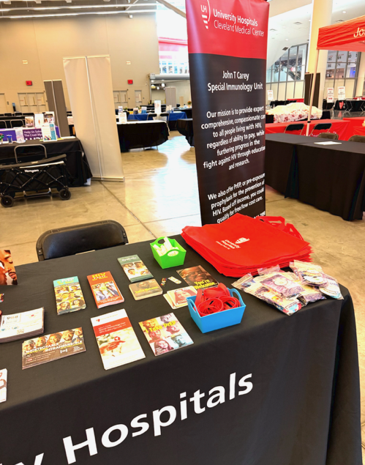
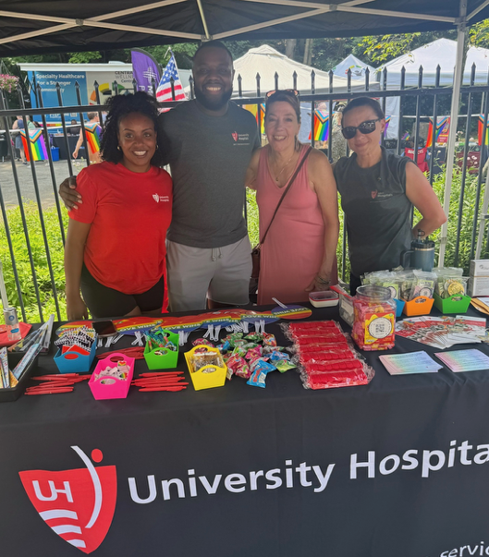
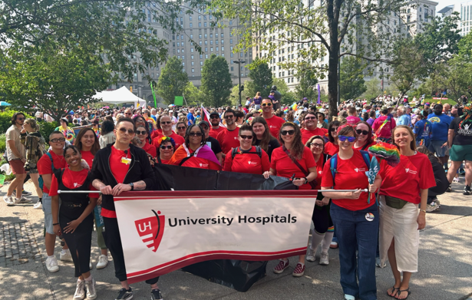

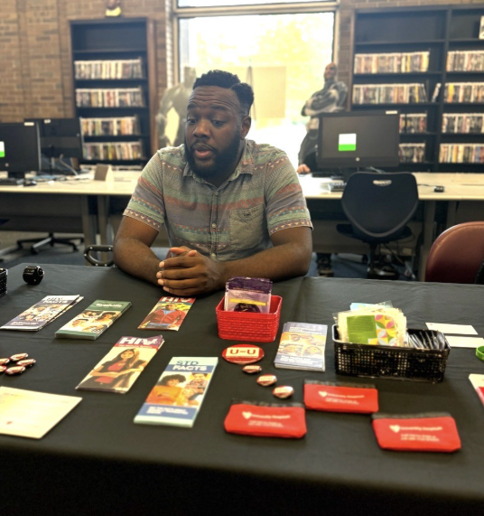
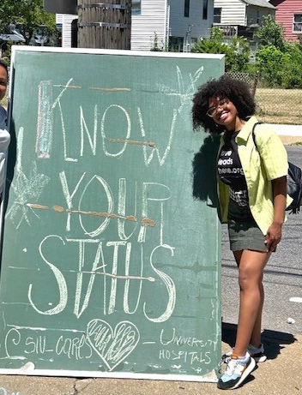
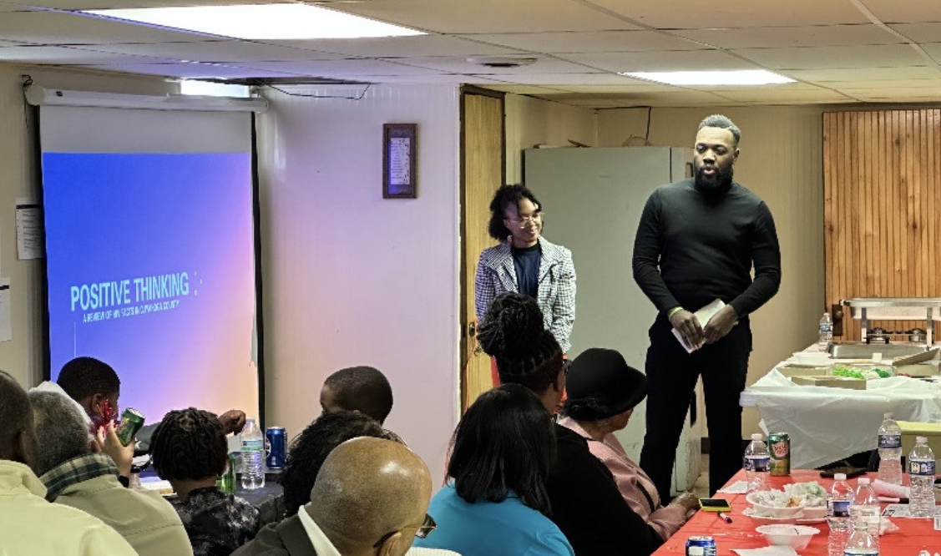
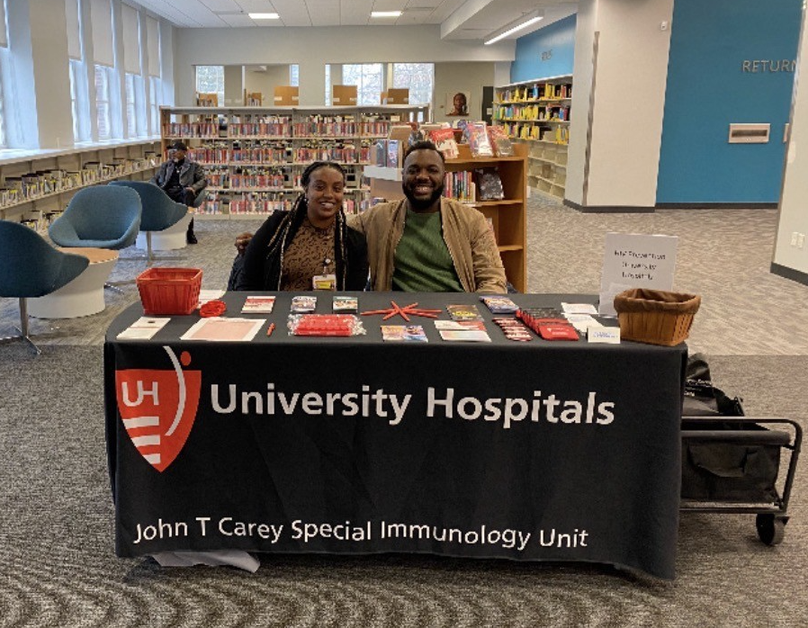
Highlights – Outreach Events in 2025
CLE Pride
Men’s Health and Wellness Expo
Cleveland Heights Pride
Summer Health Fair with Kings and Queens
HIV/Prevention at a local church
Our PrEP Navigator tables at 3 local libraries each month (Shaker, MLK, and Garfield)

Slide 191
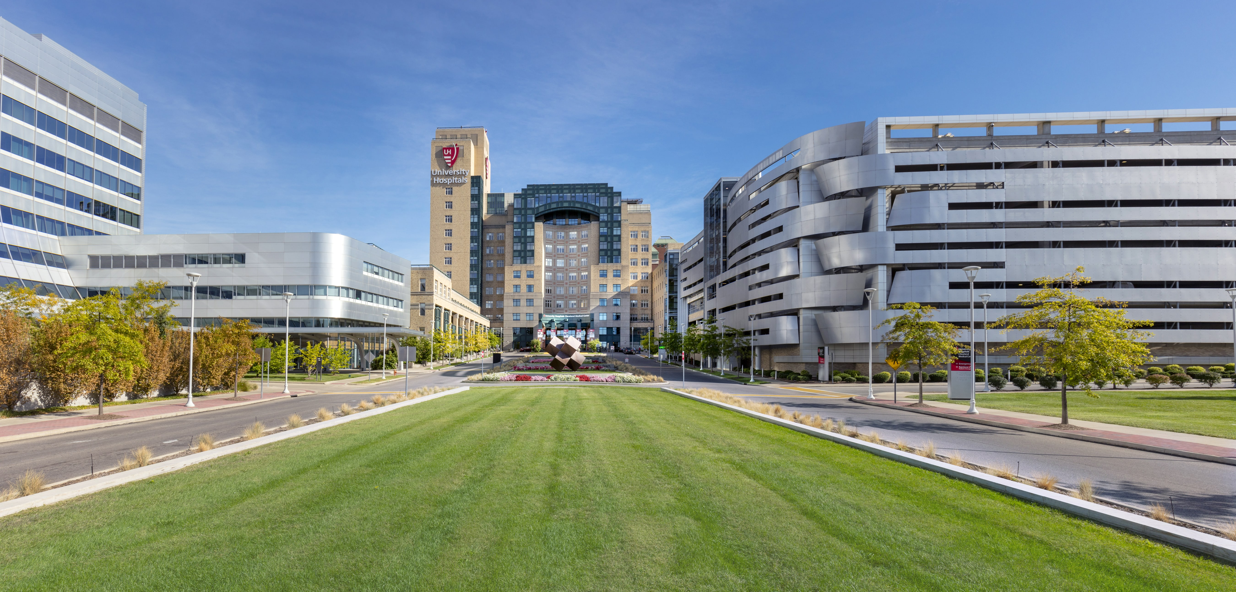
Questions?

Slide 192

Closing & Networking
Thank you for all that you do!
Please use this time to network with other Part A agencies or get to know the HIV Services staff at CCBH
Don’t forget to have someone from your agency pick up your FY26 Flash Drive!

