Slide 1




Ryan White Part A and EHE
FY2026 Kick Off Meeting
Presented by: Ryan White and EHE Teams
March 12, 2026
ccbh.net
216.201.2000
5550 Venture Drive, Parma, OH 44130

Slide 2
Meeting Agenda
      Welcome & Introductions
      General Program Updates
      Fiscal Overview
      Epidemiological Overview
      CQM Overview
      Part A Services Updates
      Training & CAREWare
      Ending the Epidemic (EHE)
      Questions

Slide 3

Notes:
Ryan White Part A funds HIV medical care and support services in cities/counties hardest hit by the epidemic, while EHE (Ending the HIV Epidemic in the U.S.) initiatives use targeted funding to connect newly diagnosed or previously disengaged individuals to care.
The Ryan White HIV/AIDS Program (RWHAP) Ending the HIV Epidemic (EHE) initiative directly supports Part A by providing targeted funding to the same high-prevalence jurisdictions—Eligible Metropolitan Areas (EMAs) and Transitional Grant Areas (TGAs)—to accelerate local efforts, fill gaps in care, and reduce new infections.
Key Support Mechanisms:
Accelerated Planning & Implementation: EHE funding enables Part A jurisdictions to implement specific, aggressive plans to diagnose, treat, prevent, and respond to HIV, bridging gaps that existing formula/supplemental Part A funds cannot cover alone.
Targeted Outreach and Linkage: EHE supports intensive outreach to identify people with HIV who are unaware of their status or are not in care, directly connecting them to the comprehensive medical and support services provided by Part A providers.
Enhanced Service Delivery: While Part A provides foundational care (medication, case management, housing), EHE funds allow for "last mile" efforts, such as hiring specialized staff, implementing rapid start programs, and using data to target specific populations in high-burden areas.
Enhanced Local Infrastructure: EHE strengthens the capacity of planning councils and lead agencies (which manage Part A) to implement innovative, high-impact HIV prevention and care strategies.
Essentially, EHE provides the accelerator funding for the specific, localized, and innovative strategies that complement the broader, established infrastructure of RWHAP Part A

Slide 4

Welcome and Introductions
Anastassia Idov
Part A Grant Supervisor
aidov@ccbh.net
216-201-2000 ext. 1446
Elly Falter
Part A Program Manager
efalter@ccbh.net
216-201-2000 ext. 1552
Melissa Hansen
Part A Program Manager
mhansen@ccbh.net
216-201-2000 ext. 1527
Brittanie Evans
Part A Grant Coordinator
bevans@ccbh.net
216-201-2000 ext. 1316

Slide 5
Welcome and Introductions
Erin Lark Turcoliveri (she/her)
EHE Grant Supervisor
elark@ccbh.net
216-201-2000 ext. 1326
Erin Janowski (she/her)
EHE Program Manager
ejanowski@ccbh.net
216-201-2000 ext. 1502
Brian Lutz (he/him)
EHE Program Manager
blutz@ccbh.net
216-201-2000 ext. 1543
Sonji Deal (she/her)
EHE DIS
sdeal@ccbh.net
216-201-2000 ext. 1714

Slide 6
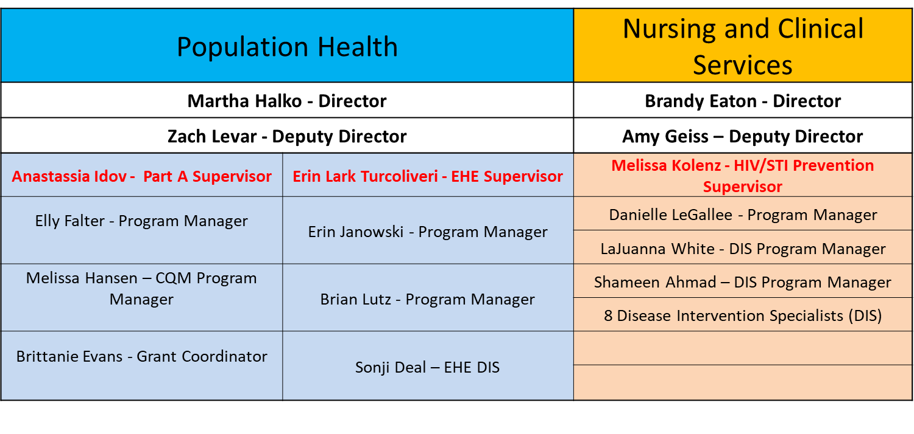
General Updates
HIV Services at CCBH
Notes:
CCBH is the current grantee and program administrator for the Ryan White Part A Program, Ending the HIV Epidemic Program (Care & Prevention), HIV Prevention Program, STI Prevention Program, and Disease Intervention Specialists. DIS are critical for ending the epidemic, linking patients to care, and disabling networks through contact tracing and testing.

Slide 7

Fiscal Summary
Part A and EHE Care partial awards received
Part A initial contracts with partial awards were sent out to all sub-recipients, which is in compliance with legislative requirements
EHE initial contracts will be disseminated the week of March 16th
Budget meetings will be scheduled after full award is received
Part A program income monitoring and tracking process is being developed in FY26
Notes:
It is the responsibility of the recipient to monitor and track program income earned by subrecipients. Program income means gross income earned by the non- Federal entity that is directly generated by a supported activity or earned as a result of the Federal award during the period of performance except as HIV/AIDS BUREAU POLICY 15 2 -03 provided on 2 CFR § 200.307(c). In the context of the RWHAP, program income is most commonly generated by recipients and subrecipients as a result of charging for services and receiving payment from third-party reimbursement.

Slide 8

Invoices are due monthly. The dates are listed in contracts.
  Submit invoices to Rwinvoices@ccbh.net
For late invoice submissions, an approval must be requested.
Backup documentation must be included with all invoices and align with data reported in CAREWare.
Program lead should monitor time and effort between budget and CW units.
Administrative costs cannot exceed 10% of total invoice
Cannot pay FTE percentages higher than what is listed on the approved budget
Please update cover letter to include the correct name of Grant Supervisor
  Part A: Anastassia Idov
  EHE: Erin Lark Turcoliveri
Please include Program Supervisors on all communication:
  Part A: Anastassia Idov AIdov@ccbh.net
  EHE: Erin Lark Turcoliveri elark@ccbh.net
Invoices

Slide 9

Communication
Designate a Program Contact
  This individual acts as the liaison between CCBH and respective agency
  Responsible for dissemination of materials to applicable staff
  This team member is responsible for all requirements of the program being accomplished
  Designate a Fiscal Contact
  This individual should be a point person for all fiscal needs
  Designate CQM Representative
  This individual is the lead for CQM activities

Slide 10

Reporting Submissions
Semi-Annual reports; September 2026 and March 2027
Invoices are due by COB on the date specified in your contract
Quality Improvement activities – required participation
Monthly data cleaning deadlines – required prior to invoice submission
Ryan White Services (RSR) begins in February 2027

Slide 11

Grievances
Grievance section should include the language:
  The Sub-Recipient shall provide the Board with written notification of any concerns or complaints. Where a conflict cannot be resolved, the Sub-Recipient may initiate a grievance process which shall consist of mediation and, if necessary, binding arbitration.
Review language in Standards of Care (SoC) and contract
Ensure clients know the payer of service to grieve appropriately
Grievance process available on CCBH RW Website
Grievance policy should be reviewed with the client during eligibility and annually with a signed copy the in client file
Agencies should maintain file of clients who are refused services with reasons specified; including any backup documentation from client/agency and outcome

Slide 12
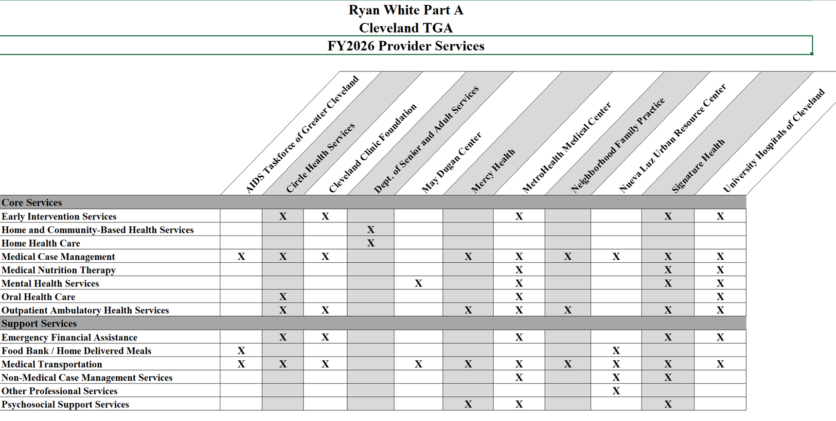
Part A Provider Services

Slide 13

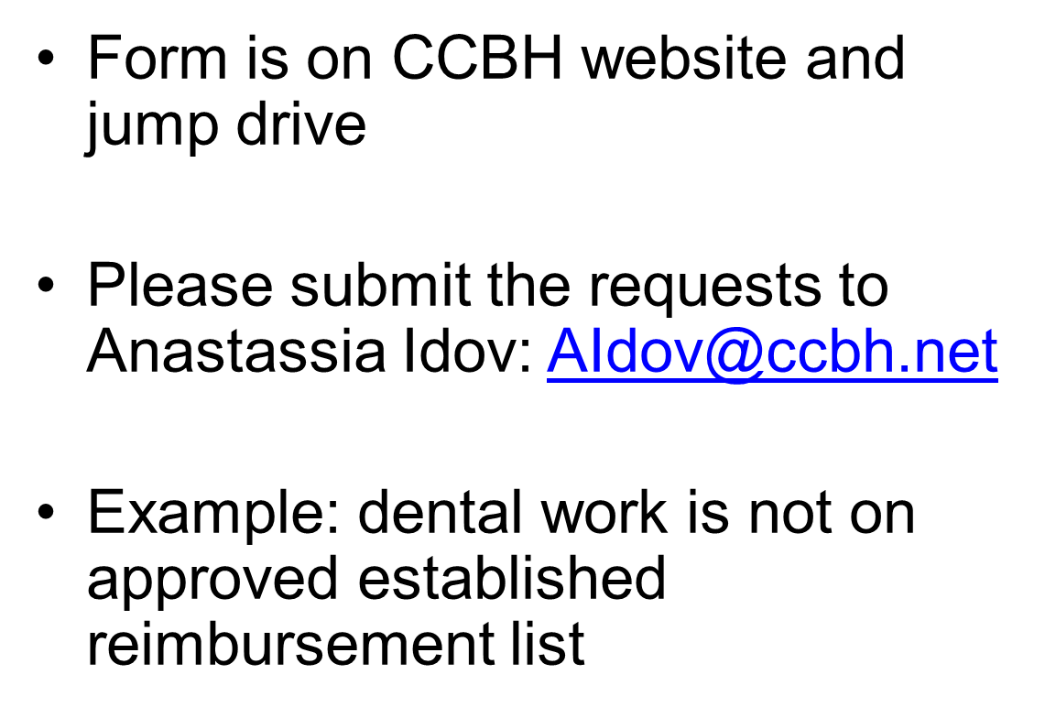
Dental Exceptions

Slide 14
2025 Cleveland TGA Epidemiology Overview
Alisha Cassady, MPH
March 12, 2026
ccbh.net
216.201.2000
5550 Venture Drive, Parma, OH 44130

Slide 15
2025 TGA Incidence
187 new HIV diagnoses in 2025* - 6.25% increase from 2024
81% male (43% Black/African American males)
19% female
31% of cases: age 30-39
29% of cases: age 20-29
21% of cases: age 25-29
Average age: 36 years old
*2025 data as of 2/23/2026. Data is preliminary and subject to change as new information becomes available.

Slide 16
2025 TGA Incidence
35% of cases were males who had sexual contact with
another male (MSM) in the last 12 months
5% injection drug use (IDU)

Slide 17
HIV Incidence in Region 3, 2020-2025*
Text

Slide 18
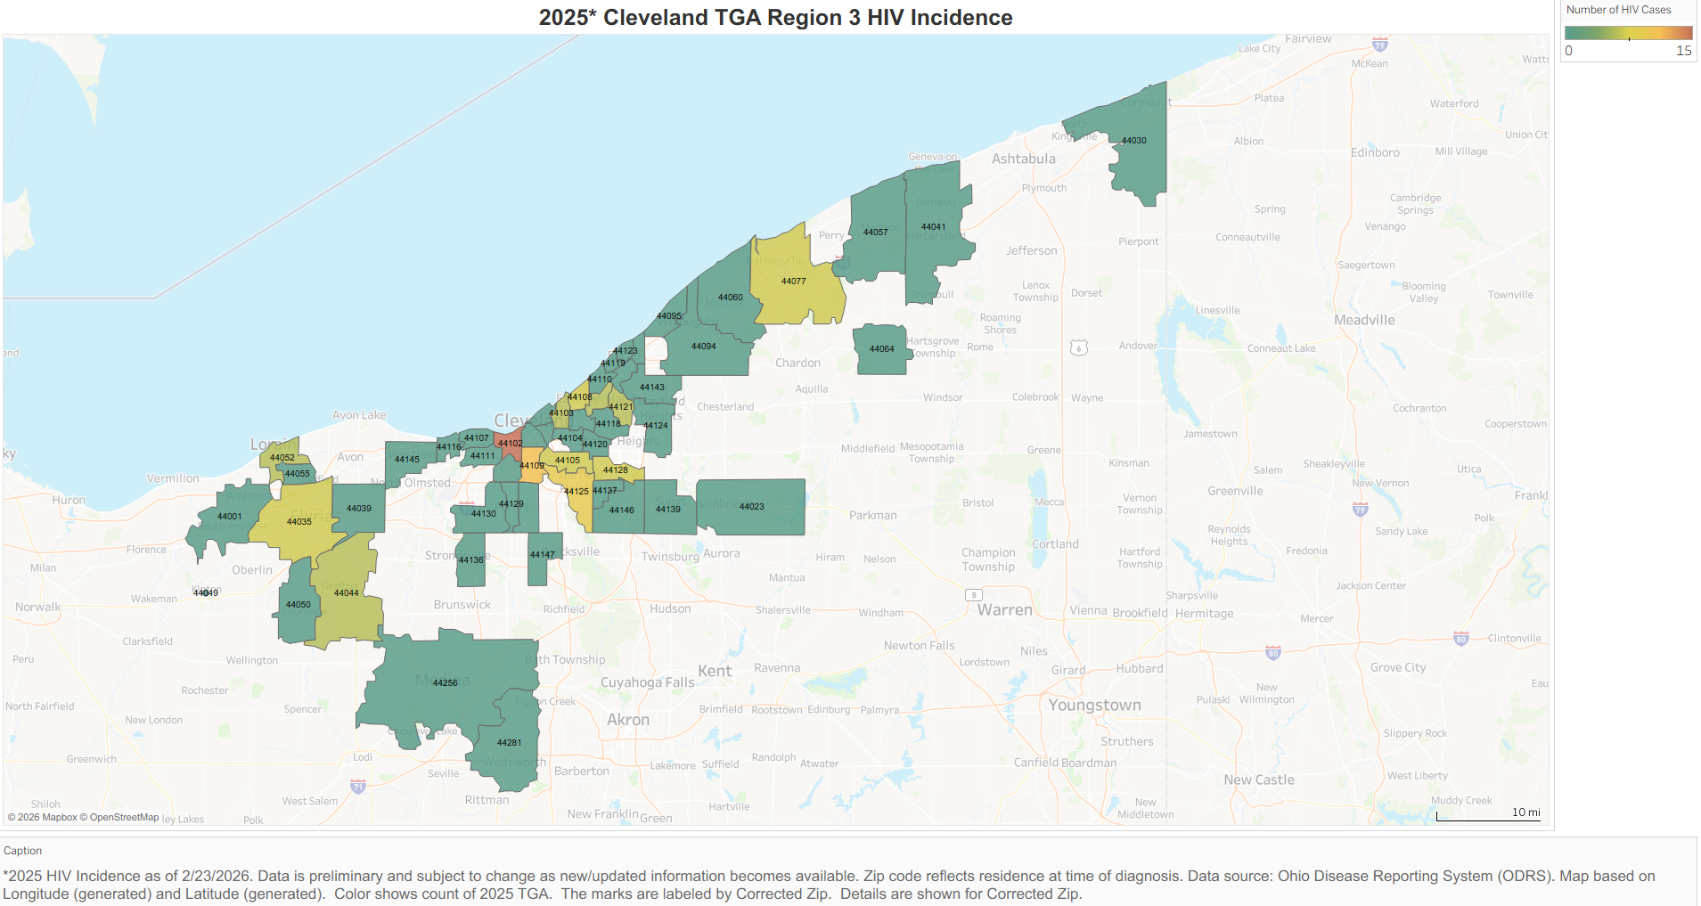
Text

Slide 19
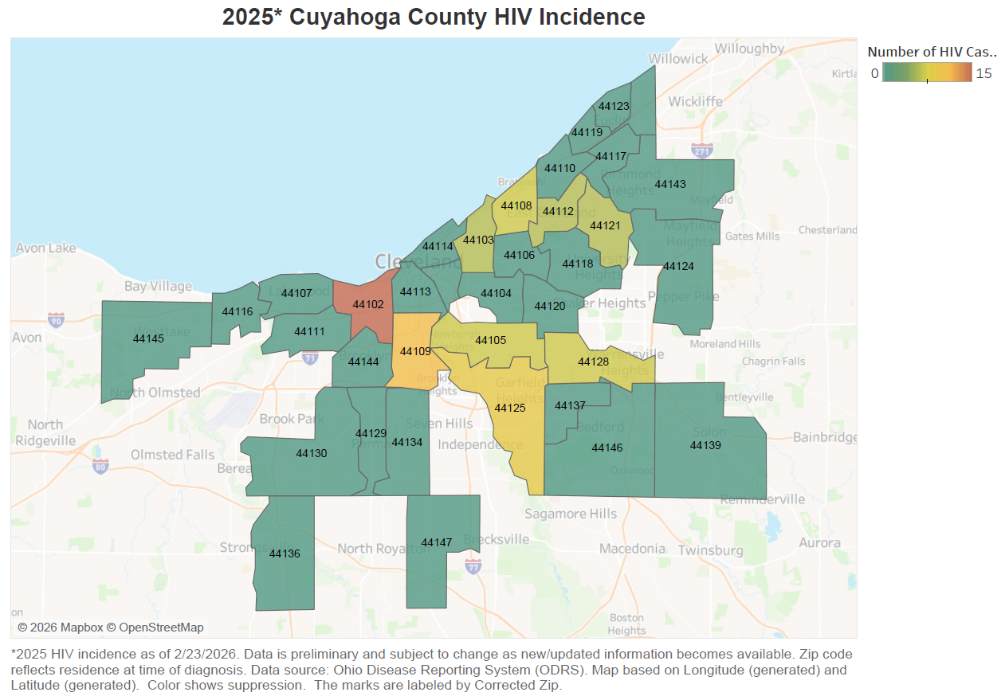
Text

Slide 20
Top Incidence Zip Codes
2025
44102 – 15 cases Detroit-Shoreway
44109 – 11 cases Old Brooklyn, Tremont, Brooklyn Center, Clark-Fulton
44125 – 9 cases Garfield Heights, Valley View
44128 – 7 cases Lee-Miles, Warrensville Heights
44108 – 7 cases Glenville, Forest Hills
44105 – 7 cases Newburgh Heights, Broadway-Slavic Village, Union-Miles
44077 – 7 cases Eastern TGA/Painesville
44035 –7 cases Western TGA/Elyria

Slide 21
2024 TGA Prevalence
6,213 people living with HIV
80% male (40% Black/African American males, 25% White males)
20% female
53% of cases: age 50+
52% of cases: Black/African American
2,814 (45%) AIDS as current disease status
68% MSM, 5% IDU

Slide 22
HIV Prevalence in Region 3, 2020-2024
Text

Slide 23
2025 Western Counties Incidence
Lorain & Medina counties
29 new HIV diagnoses in 2025* (16% of new diagnoses in TGA)
90% male (34% White)
10% female
28% of cases: age 30-34
45% MSM, 7% IDU
*2025 data as of 2/23/2026. Data is preliminary and subject to change as new information becomes available.

Slide 24
HIV Incidence in Western Counties, 2020-2025*
Text

Slide 25
2024 Western Counties Prevalence
542 people living with HIV
77% male (42% White)
23% female
56% of cases: age 50+
51% of cases: White
259 (48%) AIDS as current disease status
68% MSM, 5% IDU

Slide 26
HIV Prevalence in Western Counties, 2020-2024
Text

Slide 27
2025 Eastern Counties Incidence
Ashtabula, Geauga, & Lake counties
16 new HIV diagnoses in 2025* (9% of new diagnoses in TGA)
81% male (50% White)
19% female
38% of cases: age 35-44
Average age: 46
31% MSM, 13% IDU
*2025 data as of 2/23/2026. Data is preliminary and subject to change as new information becomes available.

Slide 28
HIV Incidence in Eastern Counties, 2020-2025*
Text

Slide 29
2024 Eastern Counties Prevalence
411 people living with HIV
82% male (50% White)
18% female
55% of cases: age 50+
59% of cases: White
189 (46%) AIDS as current disease status
66% MSM, 5% IDU

Slide 30
HIV Prevalence in Eastern Counties, 2020-2024
Text

Slide 31
2025 Cuyahoga County Incidence
142 new HIV diagnoses in 2025* (75% of new diagnoses in TGA)
80% male (51% Black/African American)
20% female
42% of cases: age 20-29
23% of cases: age 25-29
Average age: 34 years old
33% MSM, 4% IDU
*2025 data as of 2/23/2026. Data is preliminary and subject to change as new information becomes available.

Slide 32
HIV Incidence in Cuyahoga County, 2020-2025*
Text

Slide 33
2024 Cuyahoga County Prevalence
5,260 people living with HIV
80% male (45% Black/African American)
20% female
53% of cases: age 50+
58% of cases: Black/African American
2,366 (45%) AIDS as current disease status
69% MSM, 5% IDU

Slide 34
HIV Prevalence in Cuyahoga County, 2020-2024
Text

Slide 35
Priority Population Recommendations
Based on Incidence and Prevalence
MSM & MSM of Color
Youth ages 13-24
Entire TGA
Entire TGA
IDU
White Males aged 30+
Outlying Counties
Outlying Counties

Slide 36

Testing Recommendations
Based on Incidence and Prevalence
Top incidence zip codes
25-40 year-olds
MSM & MSM of Color
Black/African American males
IDU in outlying counties

Slide 37

Care Continuums
CY2025
MSM &
MSM of Color
Youth Age 13-24
Females
IDU

Slide 38
Care Continuum Definitions
HIV Diagnosed: diagnosed HIV prevalence in the jurisdiction as reported by the Ohio Department of Health (ODH). *Please note: The most recent prevalence data from the ODH is as of December 31, 2024.
Clients: number of diagnosed individuals who received a funded HIV service (Ryan White Part A or Ending the HIV Epidemic [EHE]) in the measurement year.
Linked to Care: Number of eligible clients that had at least one medical visit, viral load test, or CD4 test in the measurement year.
Retained in Care: Number of eligible clients who had two or more medical visits, viral loads, or CD4 tests performed at least three months apart during the measurement year.

Slide 39
Care Continuum Definitions
Antiretroviral Use: Number of eligible clients receiving medical care who have a documented antiretroviral therapy prescription on record in the measurement year.
Viral Suppression: Number of eligible clients receiving medical care whose most recent HIV viral load within the measurement year was less than 200 copies/mL.
Newly Diagnosed – Linked to Care: Number of eligible clients receiving a diagnosis of HIV in the measurement year that had at least one medical visit, viral load test, or CD4 test within ninety days of diagnosis.
^Please note: The denominator for Newly Diagnosed – Linked to Care is different from the denominators used to calculate other steps in the continuum.

Slide 40
Text
84%
99%
90%
73%
91%

Slide 41
Text
82%
99%
90%
72%
89%

Slide 42
Text
81%
99%
88%
70%
87%

Slide 43
Text
87%
94%
79%
55%
87%

Slide 44
Text
83%
100%
93%
65%
90%

Slide 45
Text
88%
98%
87%
74%
100%

Slide 46
Progress Since 2020
+16%
in number of clients
+3%
+2%
+2%
-6%
Notes:
2019:
Ltc 84%
Ric 79%
Art 97%
Vls 87%
2024:
Ltc 86%
Ric 73%
Art 99%
Vls 89%

Slide 47
Progress Since 2020
+8%
in newly
diagnosed clients
+12%

Slide 48
Contact Information
Alisha Cassady, MPH
Epidemiologist, HIV/STI
216.201.2001 ext.1642
acassady@ccbh.net
ccbh.net
216.201.2000
5550 Venture Drive, Parma, OH 44130

Slide 49

Questions?

Slide 50
Clinical Quality Management (CQM)
Melissa Hansen
CQM Program Manager
Mhansen@ccbh.net
216-201-2001 x 1527
ccbh.net
216.201.2000
5550 Venture Drive, Parma, OH 44130

Slide 51
CQM Program Manager
Responsible for leading the Ryan White Part A Clinical Quality Management Program
Develops and implements the CQM Plan and Work plan
Facilitates CQM Committee meetings, workgroups, internal task force, and other stakeholder meetings to support quality improvement work
Provides QI training and technical assistance
Participates in annual monitoring
Reviews semiannual reports and requests for proposals (helpful for generating QI ideas!)
Assists with grant writing and reporting for HRSA

Slide 52

RW Clinical Quality Management

Slide 53

Components of a CQM Program

Slide 54

What is the CQM Committee?
The CQMC is a group of recipient, subrecipient, and stakeholder representatives who guide quality improvement efforts across the TGA
The CQMC helps to:
Review performance data
Identify areas for improvement
Guide and implement quality improvement (QI) projects
Share best practices

Slide 55
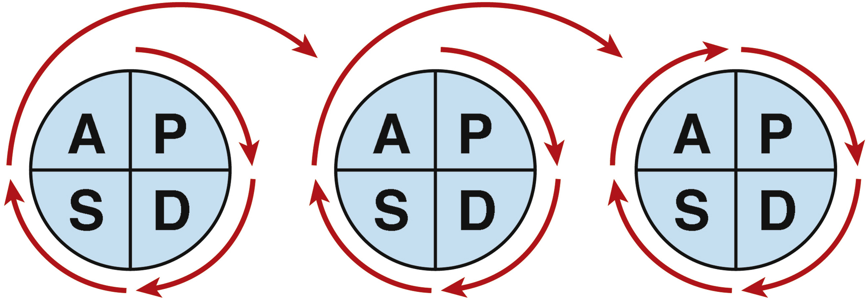
What is Quality Improvement (QI)?
Similar to problem-solving that we already do in daily life
QI is a structured way to test small changes that make care better for patients
We notice what’s not working, try a small change, and keep what works best

Slide 56
How Does QI Impact our RW Program?
The CQM Program provides a structured way to make improvements in how care is delivered
Uses data + Teamwork + Patient feedback
Focuses on improving patient outcomes and experiences through quick, small tests of change

Slide 57
Current and Ongoing Projects/Activities
TGA project focused on Retention in Care (RIC)
CQII Care Collaborative
Linkage to Care Guidebook
Ohio 2030 Collaborative
Statewide Integrated Plan
CAREWare data integrity

Slide 58
CQM Updates for FY2026
Launching of the CQM Monitoring Pilot with input from subrecipient agencies
Monitoring will focus on:
CQM program structure
Performance measurement and data review
Quality improvement activities and documentation
The pilot will help us establish a baseline of CQM across agencies
Feedback from the pilot will be used to refine the process moving forward
Our goal is to strengthen the CQM program across the TGA while supporting agencies in implementing meaningful quality improvement activities that improve patient outcomes

Slide 59
FY2026 CQMC Meeting Reminders
March 18, 2026*
June 18, 2026**
September 16, 2026*
December 16, 2026**
*9:30am-12pm, CCBH
**2pm-3pm, Virtual

Slide 60
Questions?

Slide 61
Standards of Care and
Part A Services Updates
Elly Falter
Program Manager
EFalter@ccbh.net
216-201-2001 x 1552
ccbh.net
216.201.2000
5550 Venture Drive, Parma, OH 44130

Slide 62
Ryan White Part A Program Manager
Supports the Ryan White Part A sub-recipients in providing HIV care and support services to underserved and underinsured clients in Cleveland TGA
Responsible for administrative contracts
Assists in monitoring sub-grantee budgets
Reviews requests for proposals
Monitors program activities and processes
Reviews semi-annual reports from sub-grantees
Participates in annual monitoring
Assists with TA coordination
Provides MCMs with additional information and resources, based on requests and needs

Slide 63
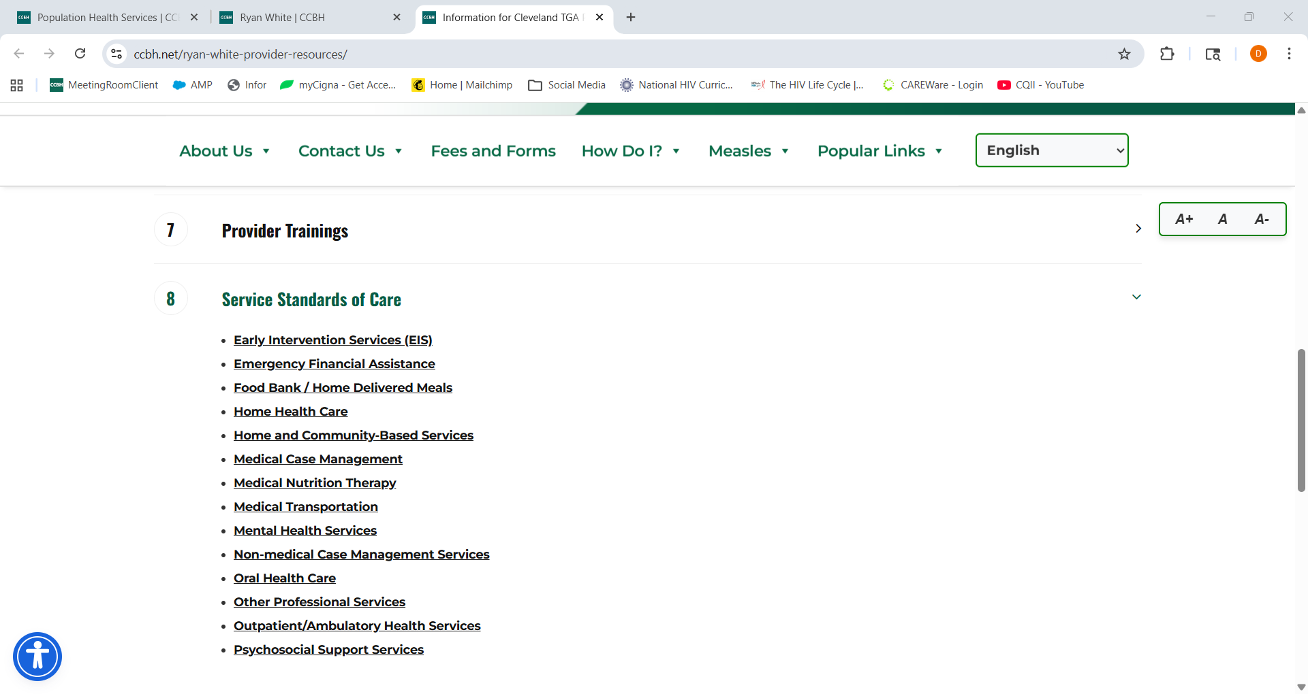
Cleveland TGA Standards of Care (SOC)
Accessible on the CCBH Website Here:
https://ccbh.net/ryan-white-provider-resources/

Slide 64
Core Services
Early Intervention Services (EIS)
Home and Community-Based Health Services
Home Health Care
Medical Case Management (MCM)
Medical Nutrition Therapy
Mental Health Services
Oral Health Care
Outpatient Ambulatory Health Services (OAHS)
At least 75% of Part A service funds must be used for core medical-related services

Slide 65
Support Services
Emergency Financial Assistance (EFA)
Food Bank / Home Delivered Meals
Medical Transportation (MT)
Non-Medical Case Management Services (NMCM)
Other Professional Services
Psychosocial Support Services
Up to 25% of Part A funds may be used for support services that contribute to positive medical outcomes

Slide 66
Medical Transportation (MT) Policy Update
HRSA requires sub-recipients who offer MT services to have an up-to-date internal, agency specific Ryan White Part A policy on file. We will be monitoring this moving forward and are looking for the following details:
Policy is in alignment with HRSA Standards of Care for MT
Policy is Ryan White Part A specific
Policy includes information like eligibility criteria, allowable MT services, documentation requirements, etc.
Policy informs practices to efficiently manage funds
Policy is current and dated
Policy includes stated plan to review and revise in the future

Slide 67
Program Reminders
Contracting process for FY26 will remain the same
Reminder: Part A staffing changes are expected to be reported within a week of that change
Resumes, credentials, and licenses are required to be provided for staff in the following positions:
Early Intervention Services
Home and Community-Based Health Services
Home Health Care
Medical Case Management
Medical Nutrition Therapy
Mental Health Services
Oral Health Services
Other Professional Services (Legal)
Outpatient Ambulatory Health Services

Slide 68
Program Reminders
Semi-annual reports for FY25 can be turned in between March 15th – March 30th
Semi-annual reports for FY26 should be returned by September 15th, 2026, and between March 15th-March 30th, 2027

Slide 69
Questions?

Slide 70
CAREWare & Provider Training
Brittanie Evans
Ryan White Part A Grant Coordinator
Bevans@ccbh.net
216-201-2001 x1316
ccbh.net
216.201.2000
5550 Venture Drive, Parma, OH 44130

Slide 71
Grant Coordinator
CAREWare Lead
  Training new users
  TA requests
  Annual RSR assistance
  First point of contact for any Cleveland CAREWare issues
Monitoring Lead
  Annual site visit at each agency to monitor services provided in the previous fiscal year
  Ensuring eligibility requirements are met
Social Media
Medical Case Manager Network
  Organizing quarterly meetings
Bi-Weekly Info Share
  Bi-Weekly email sent to the HIV services network with trainings, events, and/or resources available to consumers and providers
CCBH Ryan White website updates
  Ensuring provider resources are up-to-date
Planning Council Support

Slide 72

CAREWare Data
Enter services and correct data deficiencies monthly
Refer to the CAREWare Manual to resolve issues
Program lead should monitor time and effort between budgets and CAREWare units
Ryan White Services Report (RSR) – annual client level data report submitted to HRSA
I am the first point of contact for any CAREWare issues. Email (with screenshots) is usually the best way to reach me.

Slide 73
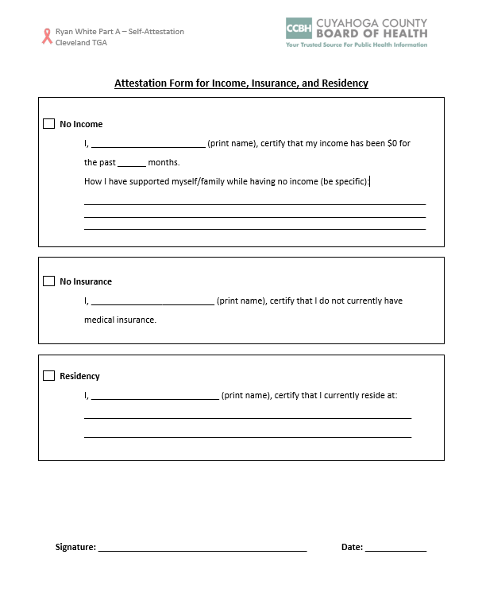
Eligibility
  Ryan White Part A eligibility policies should align with HRSA/ Cleveland TGA guidance
  Upload eligibility documents to CAREWare within 3 business days
  Ensure eligibility is up-to-date before providing services
  Self-attestation statements should be used as a last resort.
  New for FY26: The standard attestation form from CCBH should be used for no income, no insurance, or residency. This form will be available on the FY26 flash drive.

Slide 74
Provider Trainings
  A training needs survey was sent out in February.
  Thank you to everyone who completed the survey!
  Most Requested Training Topics
  Health Literacy for Clients
  Mental Health and HIV
  Housing
  Substance Use
  Youth and HIV
  Next Steps
  I will send a follow-up email requesting more information about the topics above. Please reply with your feedback and ideas!

Slide 75
Meeting Reminders
Provider Services Meeting – in person at CCBH
  Tuesday, March 31st from 9:00 AM-12:00 PM
  PowerPoint slides and RSVP due to me by Friday, March 20
Medical Case Manager Meetings - virtual
  April 14, 2026
  July 14, 2026
  October 13, 2026
  January 12, 2027
Eligibility Training - virtual
  April/ May
  Required for all CAREWare Users & direct service providers
  Save the date email will be sent out soon

Slide 76
Ryan White Part A Consumer Survey
Help spread the word!
The survey will remain open until March 23, 2026
This survey was originally released in January of 2025. Over 300 people completed this survey, but most of those people were in Cuyahoga County.
We are now trying to reach:
  People under 40 years old
  People who are Latino
  People who live in Ashtabula, Lorain, Lake, Geauga, and Medina Counties
Who should take the survey?
  If you completed the survey ONLINE in 2025, you do not need to take it again.
  If you took the paper survey, please take it again.
  If your needs have changed, you can take the survey again.

Slide 77
Ryan White Part A Consumer Survey
Please share the survey online
Most of the paper surveys submitted last year were not completed correctly and could not be used.
If you need help completing the survey online, call or text Lj at (216)264-9858
English: www.surveymonkey.com/r/PR55VGL
Spanish: www.surveymonkey.com/r/6QXJ9Q7

Slide 78
Questions?

Slide 79


Ending the HIV Epidemic (EHE)

Slide 80

EHE Program Contacts
Erin Lark Turcoliveri (she/her)
EHE Supervisor
elark@ccbh.net
Ext. 1326
Brian Lutz (he/him)
EHE Program Manager
blutz@ccbh.net
Ext. 1543
Erin Janowski (she/her)
EHE Program Manager
ejanowski@ccbh.net
Ext. 1502
Sonji Deal (she/her)
EHE DIS
sdeal@ccbh.net
Ext. 1714

Slide 81
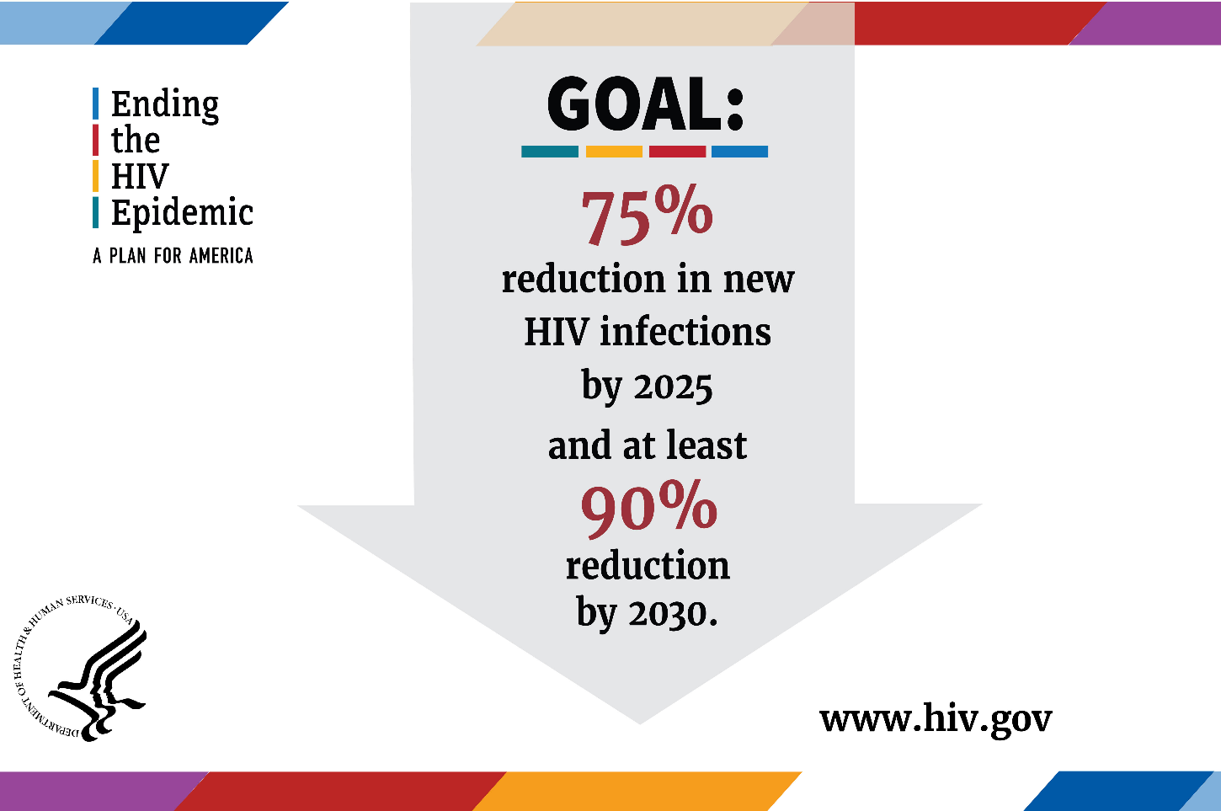
151
2018
15
2030
Cuyahoga County

Slide 82
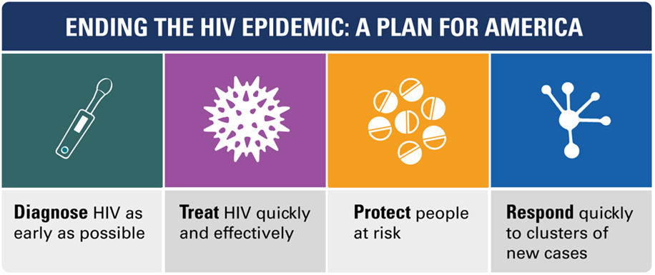
EHE Care Eligibility
Must Have—
  An HIV Diagnosis and either:
  Live in Cuyahoga County, or
  Receive Services in Cuyahoga County
EHE supports the under-insured, uninsured, and RWPA patients.

Slide 83
Data-Driven Focus Populations
Not-in-care, not virally suppressed, or newly diagnosed
Highest Incidence Rates among:
  Men who have sex with men (MSM)
  MSM of Color (Black & Hispanic/Latin)
  Youth & Young Adult (ages 13-24)
  People aging with HIV (Long-term survivors)
By 2030, >70% of adults with HIV will be over age 50.*

Slide 84
EHE Care Projects*
(EIS) Peer Navigation
Emergency Financial Assistance
Food Bank/Home Delivered Meals
Intensive Medical Case Management
Medical Transportation
Mobile Health Clinics
Nonmedical Case Management
(OAHS) Rapid Start ART
(Other Professional Services) Legal
Psychosocial Support Services

Slide 85
(EIS) Peer Navigation
Enhances clinical and non-clinical client engagement, particularly at the start of treatment.
The peer model has shown to increase patient retention and trust in the medical provider.
Best practices include using certified Community Health Workers.
Funded positions at multiple providers.

Slide 86
Emergency Financial Assistance
Provides limited one-time or short-term payments to assist the client with an emergent need to pay for essential items or services to improve (or maintain) health outcomes.
EFA activities are composed of the following eligible services:
  Emergency rental assistance (first month’s rent, past due rent)
  Emergency utility payments (gas, electric, and water)
  Emergency telephone service payments
  Emergency food vouchers
  Emergency moving assistance
  Emergency medication

Slide 87
Intensive Medical Case Management
Extension of RW MCM
Smaller caseload to address more time-intensive needs such as behavioral & mental health.
Does not need to qualify for RWPA
Efforts to streamline the identification of clients, transition process & client satisfaction with services.

Slide 88
Medical Transportation
Transportation Assistance for non-virally suppressed clients or clients to maintain suppressed viral load & maintain health status.
Includes ONLY non-traditional options like ride-share (ex. Lyft).
Enhances other projects like IMCM & Rapid ART.

Slide 89
Mobile Health Clinic
OAHS HIV care for difficult-to-reach populations living in the zip codes with the highest HIV prevalence and are medical deserts for HIV care.
Uses professional team to meet patients where they are for labs, testing, and case management. Telemedicine is also used for patient-to-prescriber consult.
New in 2025 (with planning period). Full service year in 2026.

Slide 90
Nonmedical Case Management
Extension of RW MCM & EHE IMCM
Case Managers provide assessments and interviews to address social and behavioral health needs
Does not need to qualify for RWPA
Efforts to address social determinants of health, substance use, and remove barriers to healthcare

Slide 91
(OAHS) Rapid Start ART
Enhances EIS services with same-day meds (or within the week) for newly diagnosed or re-engaged in-care clients
Outreach soon after treatment & continues for a period of time (ex. 6-12 mts.)
Collaboration with ED, satellite clinics, & community testing sites to “fast track” patients

Slide 92
(Other Professional Services) Legal
Legal matters related to or arising from the client’s HIV status
Includes SSDI benefits, interventions to gain access to benefits (discrimination/breach of confidentiality), & preparations of healthcare power of attorney, durable powers of attorney, and living wills.
New in 2025 (with planning period). Full service year in 2026.

Slide 93
Psychosocial Support Services
Psychosocial Support Services provides individual and/or group support and counseling services to address clients’ continuing behavioral and physical health concerns.
Key activities include:
  Support and counseling activities
  HIV support groups
  Pastoral care/counseling services
  Caregiver support
Exclusions: Funds under this service category may not be used for social/recreational activities or to pay for a client’s gym membership.

Slide 94
EHE Care-funded Agencies & Services
Agencies | Service Categories (Abbrev.)
AIDS Taskforce of Greater Cleveland | EFA, MT, NMCM
Cleveland Clinic Foundation | ART, EFA, IMCM, MT, NMCM, (EIS) PN
The Centers | EFA
MetroHealth System | ART, EFA, IMCM, (EIS) PN, PSS
Nueva Luz Urban Resource Center | EFA, LEG, PSS
Signature Health | ART, EFA, IMCM, MT, MHC, (EIS) PN
University Hospitals | ART, EFA, IMCM, MT, (EIS) PN, PSS
We Think 4 A Change | EFA, FB*, MT, (EIS) PN

Slide 95
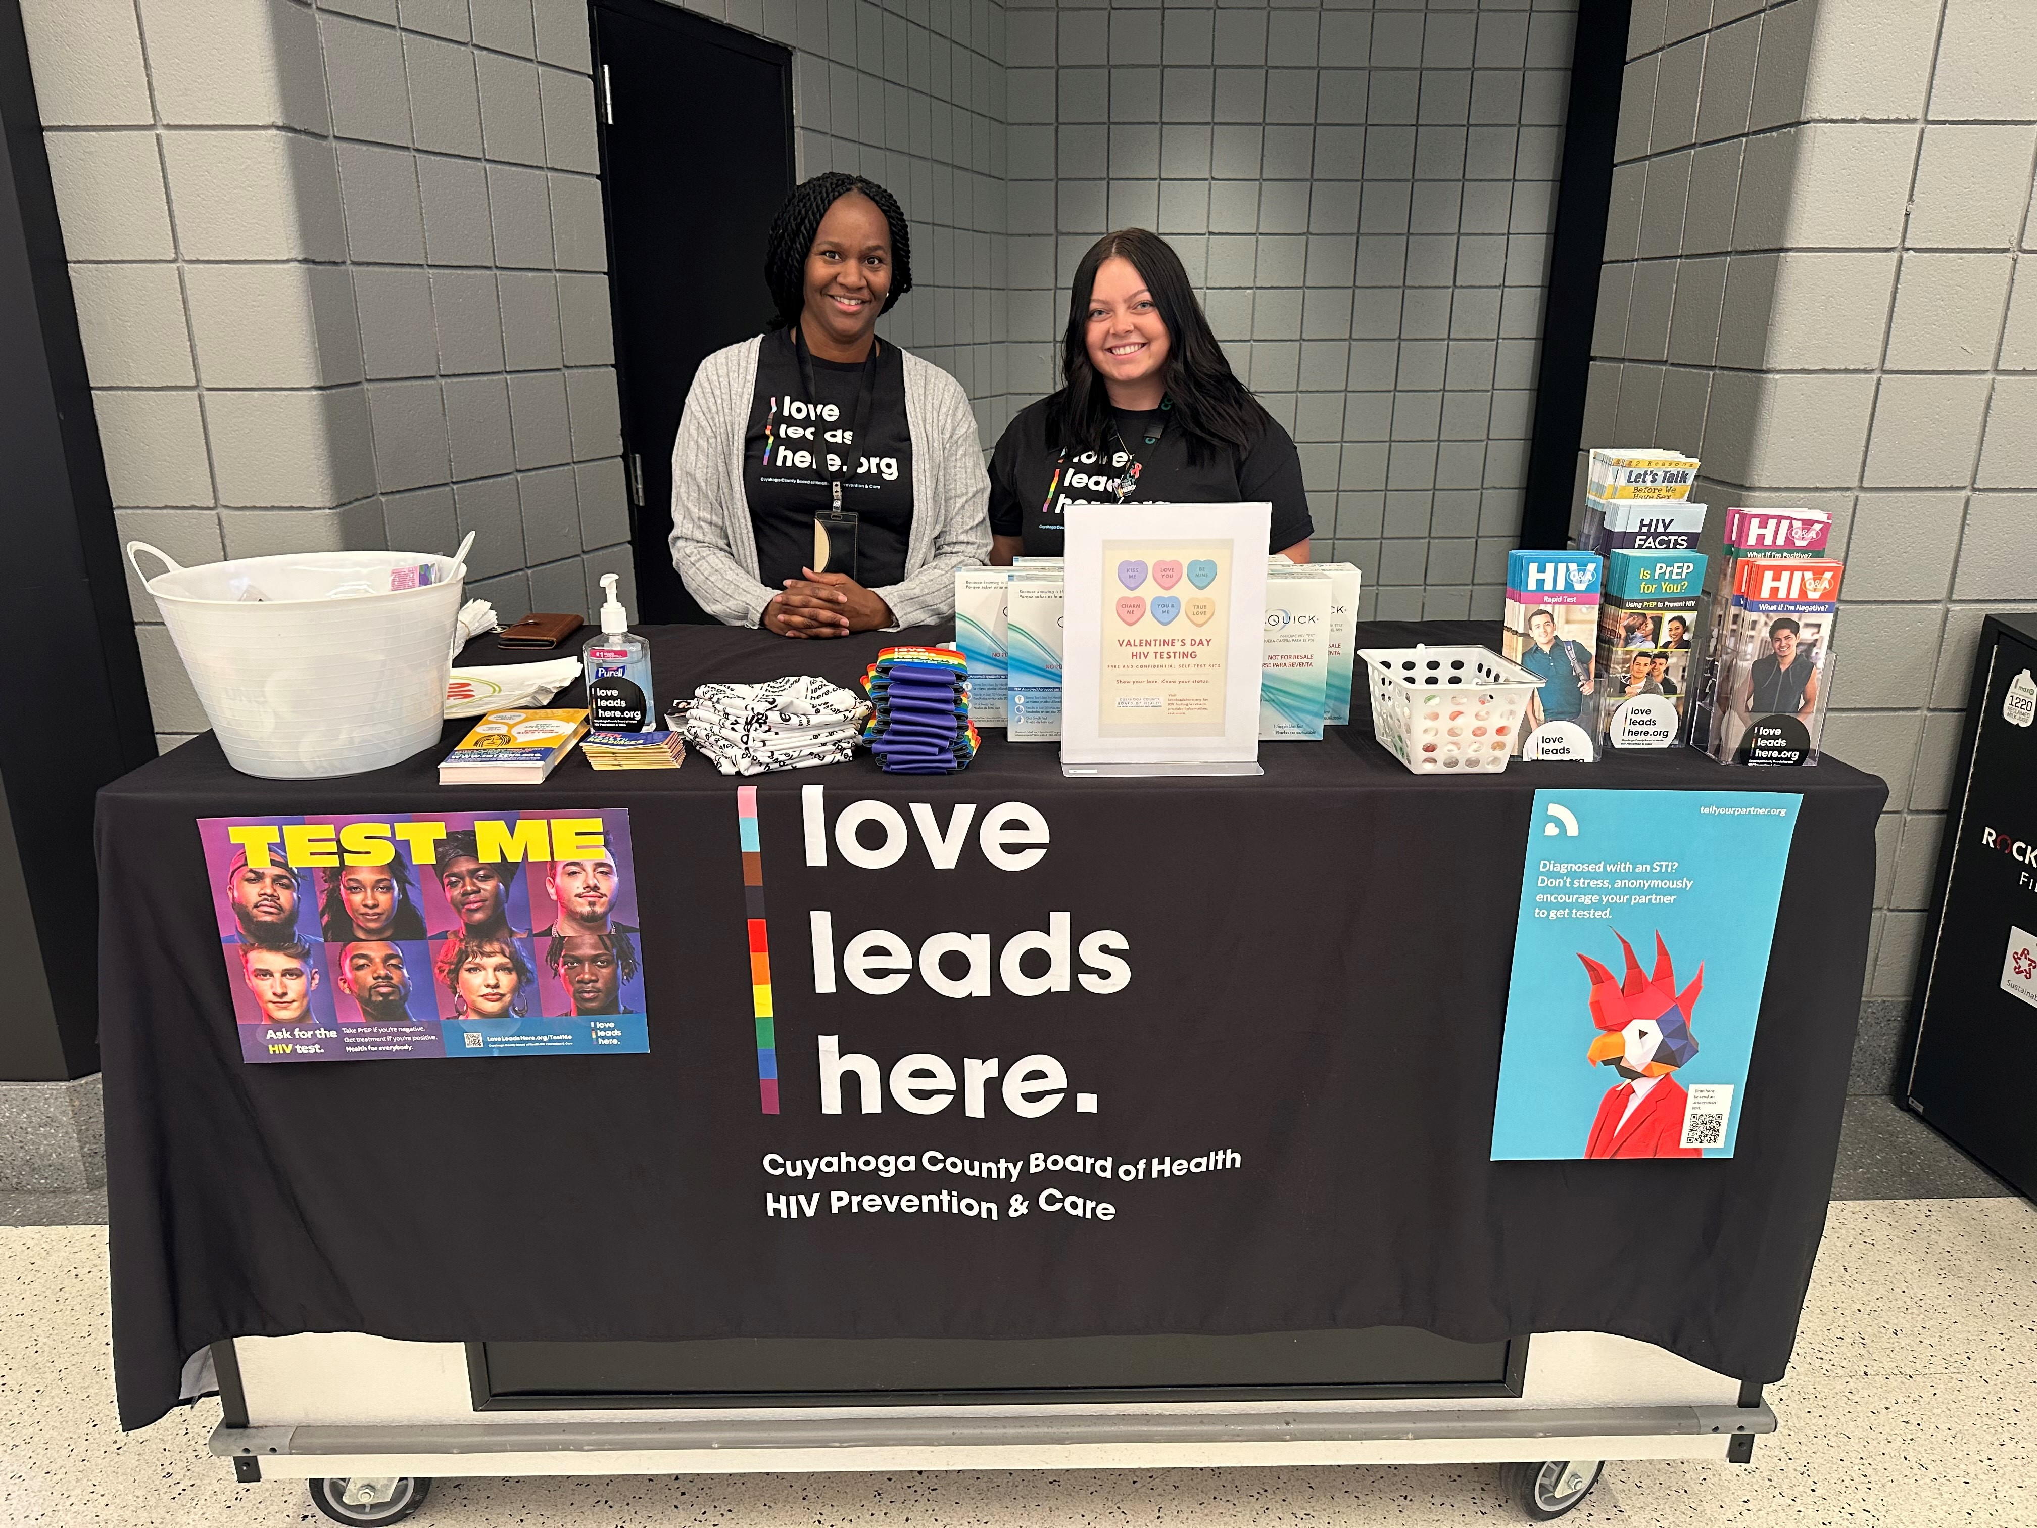
LoveLeadsHere.org

Slide 96

Community Advisory Group (CAG)

Slide 97

Looking Ahead to 2026
Partial & Full Award Announcements
Implementation Plans
60-Day Check-ins
CAG SMART Goal Projects

Slide 98
Questions?

