Slide 1




Ryan White Part A
Eligibility Training
Brittanie Evans
May 14, 2026
ccbh.net
216.201.2000
5550 Venture Drive, Parma, OH 44130

Slide 2



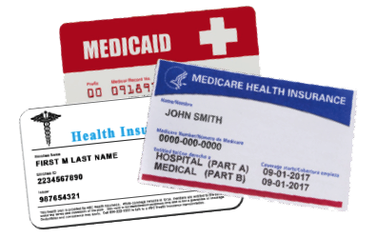
Ryan White Part A Eligibility Requirements
HIV diagnosis
Residency
Income
Insurance

Slide 3
HIV Diagnosis
Applicants must provide documentation of an HIV/AIDS diagnosis
Documentation must include:
Client’s name
Licensed provider’s signature or official healthcare letterhead
Common forms include:
Lab results
This is the only eligibility criteria that does not need to be uploaded annually.

Slide 4
Residency
Applicants must reside in one of the following counties: Ashtabula, Cuyahoga, Geauga, Lake, Lorain, Medina
Common forms include:
Medicaid eligibility screenshot from JFS website
Driver’s license
Rental lease
Utility bill
Social security benefit award letter
Forms must include the client’s full name and address

Slide 5
Income
Monthly income must be at or below 500% of the current Federal Poverty Level (FPL)
Common forms include:
Medicaid eligibility screenshot from JFS website
Pay stubs
Social Security benefits award letter
Signed letter from employer
Forms must include the client’s full name

Slide 6
Insurance
Agencies must explore and eliminate all other possible sources of third-party payment before using Ryan White funds to pay for services. Clients with insurance or access to insurance must submit documentation of coverage.
Common forms include:
Medicaid eligibility screenshot from JFS website
Scanned insurance card

Slide 7
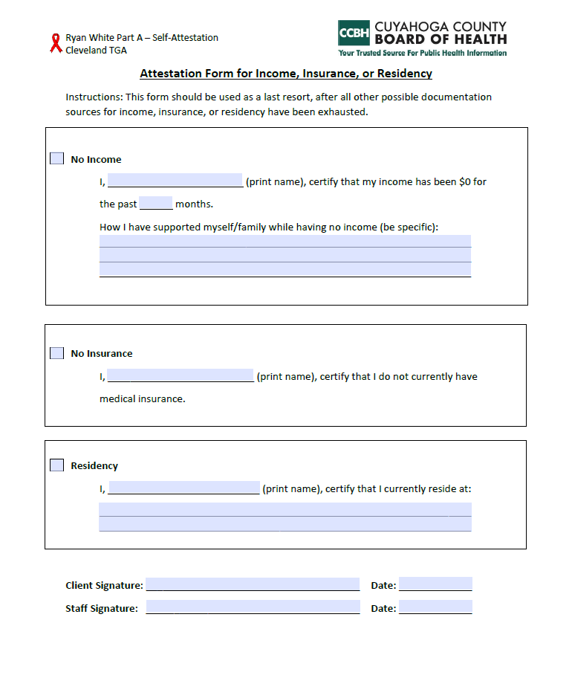
Self-attestation Statements
Self-attestation Statements for no income, insurance, or residency are acceptable as a last resort
Any self-attestation statement must be dated and signed off by the client and case worker
Use the attestation form from CCBH

Slide 8
Eligibility Application
The application and supporting documentation must be uploaded once per calendar year
The application must be completed in its entirety and signed and dated
Eligibility expires 12 months from the date the application is completed and signed

Slide 9
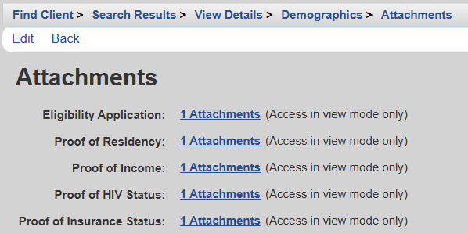
CAREWare
The eligibility application and supporting documentation is uploaded under Attachments on the Demographics page

Slide 10
File Naming Format
Each file name should include 2 digits for the month, 2 digits for the date, 2 digits for the year, 3-letter abbreviation, and the appropriate spacing. No extra numbers, letters, or punctuation should be added. Ex: 05 27 25 POI
Eligibility Document | File Name Format
Eligibility Application | mm dd yy APP
Proof of Residency | mm dd yy RES
Proof of Income | mm dd yy POI
Proof of HIV Status | mm dd yy HIV
Proof of Insurance | mm dd yy INS

Slide 11
Eligibility Record
Update the eligibility record each year when eligibility is renewed or when eligibility status changes.
You should add a new record every year by clicking Start. Do not edit the existing record.
When a client becomes ineligible, you will select the current eligibility record and click Stop. Do not edit the existing record.

Slide 12
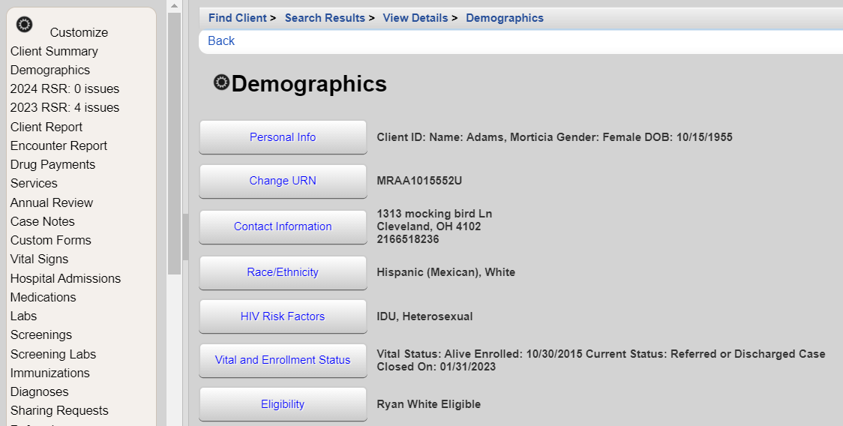
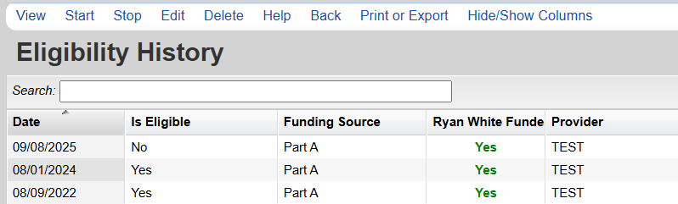

Slide 13
Changes Throughout the Year
If a client’s residency, insurance, or income changes at any point in the year, then new documentation must be uploaded
This does not apply to clients whose income changes monthly
        - The most recent 2-3 pay stubs is sufficient in this case
        A new eligibility application does not need to be completed - The client’s current application will expire 12 months after the date that it was complelted and signed.

Slide 14
Eligibility Monitoring
Sliding Fee Scale
All clients should have a sliding fee scale in their client record. The sliding fee scale should state that Ryan White clients will not be charged for Ryan White services.
Clients must review and sign the sliding fee scale annually
Upload this document to your agency’s EMR or keep a copy in the client’s file. This document does not get uploaded to CAREWare.

Slide 15
Eligibility Monitoring
Grievance Policy
All clients should have a grievance policy in their client record.
Clients must review and sign the grievance policy annually.
Upload this document to your agency’s EMR or keep a copy in the client’s file. This document does not get uploaded to CAREWare.

Slide 16
Eligibility Monitoring
Common Findings
Using the eligibility application as proof of income, residency, or insurance
Documentation does not have identifying client information or is not legible
Eligibility was expired at the date of last service
Missing documentation in CAREWare

Slide 17
Reminders
All documentation should be uploaded to CAREWare within 3 business days
Eligibility is established when all verification and documentation criteria are met and up to date
Verify eligibility before providing services
Searching CAREWare just to see if a client exists in the system is considered phishing and is a violation of security protocol.
*The user agreement states: I agree that I will only attempt to lookup clients for the purpose of entering the data as it relates to the Ryan White Part A services the client has received from my agency. (i.e., I will not ‘phish’ for client names through the CAREWare system).

Slide 18
Review 2021 HRSA Guidelines
Eligibility only needs to established once per year
Providers should utilize all available resources to confirm eligibility before reaching out to the client. Ex: information obtained from the Medicaid database
Staff are highly encouraged to check in with clients intermittently throughout the year to ensure client eligibility is maintained

Slide 19
Contact Information
Brittanie Evans
Ryan White Part A Grant Coordinator
216-201-2000 x1316
bevans@ccbh.net
ccbh.net
216.201.2000
5550 Venture Drive, Parma, OH 44130

