Slide 1
Functional Needs
Support Services
Megan Koeth, Disaster Response Specialist

Slide 2
Presentation Objectives
Review current philosophies and guidance around Functional Needs Support Services
Look at Functional Needs Support Services in a shelter environment
Focus on Integrated Community Planning
Provide resources and scenarios
Notes:
Facilitator
Before we continue our presentation it is important to review the objectives. At the end of the presentation we will review the objectives one more time to be sure we met the objectives and answered all of your questions.
TRAINING DISCUSSION
Serving People with Disabilities – removed as a RC course
New awareness course being developed by FL State – will not incorporate some things from SPD (not teaching ASL or changing oxygen tanks), but will provide an overall awareness on the types of disabilities, etiquette, etc.
SH & HS Handbooks are currently being written to incorporate FNSS into all areas of these activities.

Slide 3
ADA Guiding Principles
Inclusion
Integration
Equal Access
Self-Determination
Physical Access
Reasonable Modifications to Policies, Practices, and Procedures
Effective Communication
Notes:
MASS CARE
Inclusion, Integration, & Equal Access – Emergency programs typically must be provided in an integrated setting, this means we must integrate people with disabilities into congregate shelters. This enables people with disabilities to access the same programs and services as the general population.
Inclusion also is being part of what everyone else is, being welcomed and feeling that you belong.
Self-Determination - People with disabilities are the most knowledgeable about their own needs, and can decide where to shelter.
Physical Access – People with disabilities must be able to access locations where emergency programs and services are provided.
Program Modifications – In order to accommodate people with disabilities, we may need to make reasonable modifications to rules, policies, practices, and procedures,
Access to Effective Communication – People with disabilities must be given the same information provided to the general population that is timely and in a format that clients can understand.

Slide 4
Accommodate Individuals with Functional and Access Needs
  Reasonable modifications to policies, practices, and procedures
  Durable medical equipment (DME)
  Consumable medical supplies (CMS)
  Personal assistance services (PAS)
  Other goods and services needed such as assistive technology
Notes:
HEALTH
If we understand the definition of the word accommodate it makes it easier to meet our clients needs. Accommodate means to provide for, supply, to adjust or make suitable.
These are new acronyms or terms to learn. Let’s take each one and think through how it would provide or supply a client with equipment, supplies or help a client with every day tasks that are routine but maybe more difficult when they are not in their own home and in a shelter..
Assistive Technology definition – assistive technology enables clients to communicate, receive instruction, learn, play, move about and be independent. These may be customized for that individual and they know best how to care for their devices.
Any item, piece of equipment, product system, whether acquired commercially, modified, or customized, that is used to increase, maintain, or improve functional capabilities of individuals with disabilities. Here are some examples:
DME –
Any medical equipment used to aid in a better quality of living , for example, wheelchairs, walkers, canes, nebulizers, oxygen, glucometers for blood sugar checks.
CMS –
Medical supplies (medications, diapers, adult briefs, syringes, bandages, etc.) that are ingested, injected, or applied and/or are one time use only.
PAS –
Personal Assistance Services (PAS) are services that enable children and adults to maintain their usual level of independence in a general population shelter.
Remember: The clients coming to your shelter are coming from HOME. They have been living with their disability, their illness, their accommodations and have strategies, know who their vendors are, and what they do when things aren't going the way they are used to. Our job is --with their guidance--help them stay independent and safe in
the shelter environment.

Slide 5
People Requiring Functional Needs Support Services
Individuals requiring Functional Needs Support Services may have physical, sensory, mental health, and cognitive and/or intellectual disabilities affecting their ability to function independently without assistance.
Notes:
FACILITATOR
Physical – people with mobility issues – spinal cord injuries, amputation, cerebral palsy
Sensory – visual and hearing impairments
Mental health – depression, Schizophrenia, bi-polar disorder
Cognitive/Intellectual – developmental delay, dyslexia, attention deficit disorder, brain injury

Slide 6
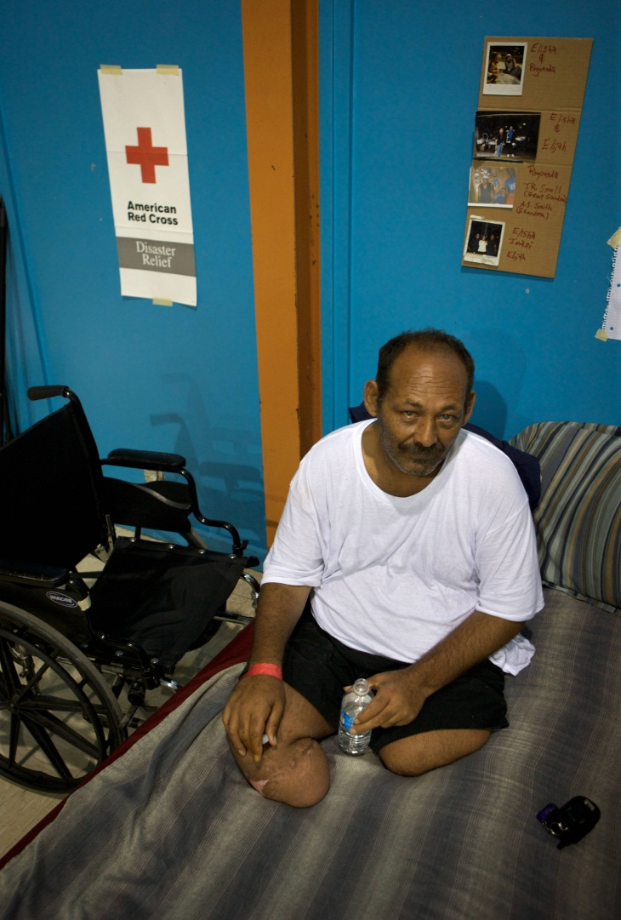
CMIST ++ defined
Communication
Medical/Health
Independence
Safety, supervision
Transportation
+ Behavioral Health
+ Mobility
Notes:
The original model from June Isaacson Kailes is the five letters of CMIST—but I have added two Bubbles as I find that
Behavioral Health is a support need that is possible in all areas and thus may need its own consideration and
Mobility is not transportation, nor is it entirely independence or safety and thus can get missed in the discussions and planning.
Anyone who has tried to evacuate a nursing home understands that mobility is its own consideration.

Slide 7
Functional & Access
Needs Includes
Mental Health Disabilities
Developmental and Other Cognitive Disabilities
Visual
Hearing Disabilities
Aging (services/support)
Substance Abuse Issues
Health Conditions (nursing support services)
Physical Disabilities
Notes:
This is not meant to be a complete list, but is a way to help us all
Think about who is in our community that we need to be planning for
And prepared to serve.

Slide 8
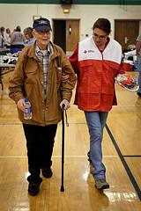
Activities of Daily Living
Eating
Bathing/toileting
Grooming
Dressing
Communicating
Sleeping
Taking medications on time
Orientation to time, place, day, etc.
Notes:
To be clear about what are we talking about…these are some ideas of what are typically considered
As ADL’s. There can be others.

Slide 9
Discussion Question
Who else do you think may require functional needs support services in a general population shelter?

Slide 10
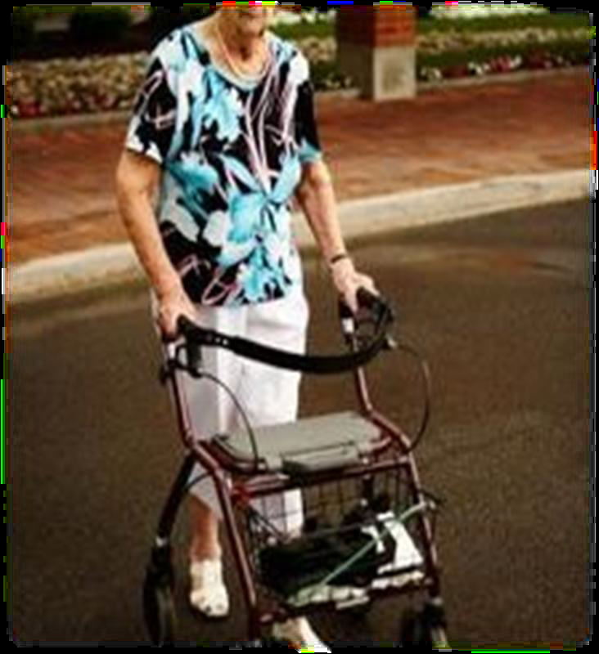
Conditions that Affect Mobility
Paraplegic/quadriplegic
Frail elderly
Amputees
Parkinson’s Disease
Visually impaired
Morbid obesity

Slide 11
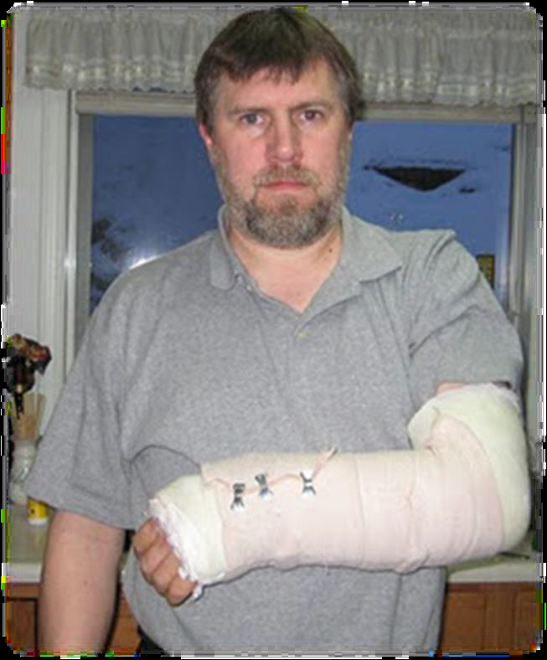
Temporary Physical Limitations
Post-surgery recovery
Injuries
Pregnancy

Slide 12
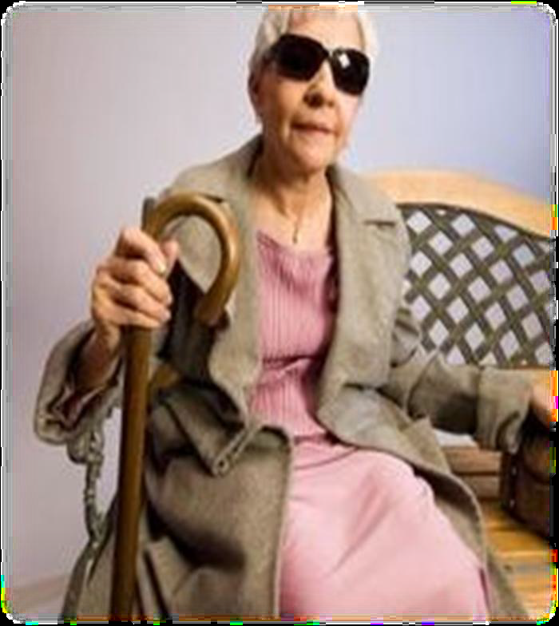
Sensory and Communication Challenges
Deaf or hard of hearing
Blind or low vision
Speech disabilities
Language/cultural
differences
Illiteracy

Slide 13

Intellectual, Cognitive and/or Mental Health Disorders
Chronic or acute mental health concerns
Developmental delays
Dementia/Alzheimer's Disease
Post-concussive syndrome
Attention Deficit Hyperactivity
Disorder (ADHD)
Autism spectrum disorders

Slide 14
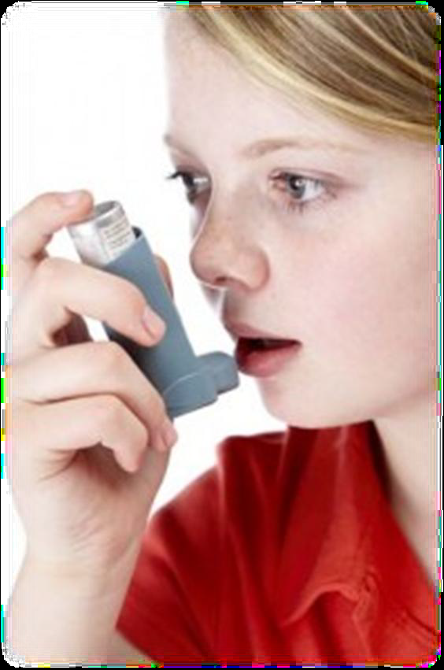
Chronic But Stable Conditions
Heart disease
Hypertension
Diabetes Mellitus
Asthma
Emphysema/COPD
Allergies (food and
environmental)

Slide 15
Functional Needs
Support Services
in Shelters

Slide 16
Red Cross Commitment
Work to ensure accessibility
Assess the needs of each client
Assist clients to maintain their usual level of independence
Address functional and access needs through
  Self-determination
  Direct services
  Partnership with government and non-government
Notes:
Accessibility, not compliance:
We are not a regulatory agency, we cannot ensure compliance.
We do not own the facilities we provide services in.

Slide 17
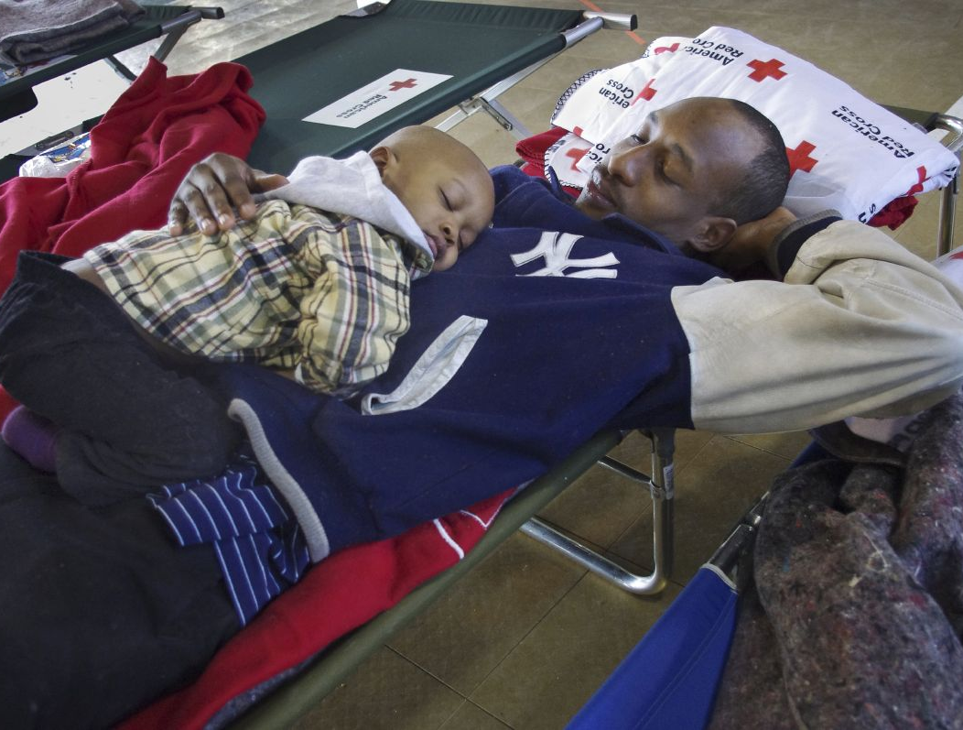
Sheltering Philosophy
Shelters must be, first, places of
comfort and safety.
Shelters must be readily accessible
to those affected.
All shelter workers must be strong
advocates for their clients.
Clients must remain proactive participants in recovery.
Shelters must provide a safe and secure environment that accommodates the broadest range of needs in our communities.
Notes:
The litmus test for our shelters becomes this question:
Would you be comfortable with your mother, grandfather, siblings, or children in this shelter?

Slide 18
Common Issues
Disabilities are seen and/or treated as medical issue rather than a functional need.
Access issues are seen as challenges rather than opportunities.
Local assets for support are either unknown or have not been contacted/involved prior to the disaster.
Americans with Disabilities Act is not well understood or operational in some communities.
Notes:
Most disabilities are functional in nature meaning that providing accommodations and support in the area of supervision, transportation or communication will allow them to remain able to manage day to day living skills.

Slide 19
Shelter Planning
Think broadly when planning for shelter accessibility
The Shelter Facility Survey (6564) will assist in determining what physical access modifications will be needed for each facility
For the Red Cross to open a shelter with inaccessible features, a community plan must be in place to make the shelter accessible before use
Notes:
Mass Care
Accessibility, NOT Compliance
It’s our role to determine if we can provide emergency services that is accessible to people with disabilities and functional/access needs, not whether a facility is ADA compliant.
New free text field (in survey & NSS update) to capture information regarding what will be needed to make a facility accessible when we use it as a shelter. Examples: will need portable ramp, toilet seat risers, accessible toilets,…
Accessibility is required in the following areas:
At least one entrance
Routes to all service delivery areas: Registration, Dormitory, Feeding, HS/DMH, Recreation,…
Restrooms (routes within toilet rooms & stalls)
Community plan should detail who is responsible for providing modifications when necessary, including resource lists. This is not a Red Cross do it alone plan, it’s all the stakeholders we’ve discussed.
Newly identified shelter during a disaster
We do understand that there will be times when you need to open a shelter that you have not pre-identified, so there will be no community plan for accessibility specifically at these locations. In these cases, we must work with our plan stakeholders to make the facility as accessible as possible as soon as possible.
Or when we assist with a community shelter that we are not managing.

Slide 20
Shelter Facility Survey –
Accessibility Assessment
Relevant areas of the facility are accessible to people with disabilities without adjustments.
Facility has at least 1 accessible entrance and restroom, and otherwise is capable of being made accessible during a disaster with minor adjustments.
Facility would require extensive adjustments to be accessible during a disaster.

Slide 21
Applying ADA Basic Principles
Operate shelters so all residents get the same benefits of basic needs, medical care, and the support of family and friends
Meet the access and functional needs of shelter residents while keeping families together with assistance from community partners
Notes:
How does the Americans With Disabilities act inform our work?

Slide 22
Applying ADA Basic Principles
Continued…
Coordinate with facility owners, Emergency Management, community organizations and other non-profits to make shelters accessible
Consult shelter residents to understand and meet their individual needs
Notes:
The last bullet is probably the most important of all.
Remember your clients in the shelter have been living with themselves for a very long time.

Slide 23
Shelter Layout
Cots and other furniture must be placed in such a way that routes are accessible to people who use mobility devices.
People who use mobility devices, lift equipment, service animals, and personal assistance services could need up to 100 square feet.
Notes:
MASS CARE
Numbers are from MC Standards and Indicators developed by NVOAD MC committee, which Red Cross currently chairs. Located on MC Neighborhood.
Ensure that routes are accessible to all service areas including bathrooms, dining and recreation areas, and to health and mental health service areas. Be sure that those with visual impairments are aware of changes in floor plans and all walkways are clear of obstructions.
Mobility devices = wheelchairs, canes, motorized scooters
Lift equipment – while there may be lift equipment in the shelter, we do not expect Red Cross personnel to be operating it. However if they need help with locating resources or trained assistants to assist health services should be contacted.

Slide 24
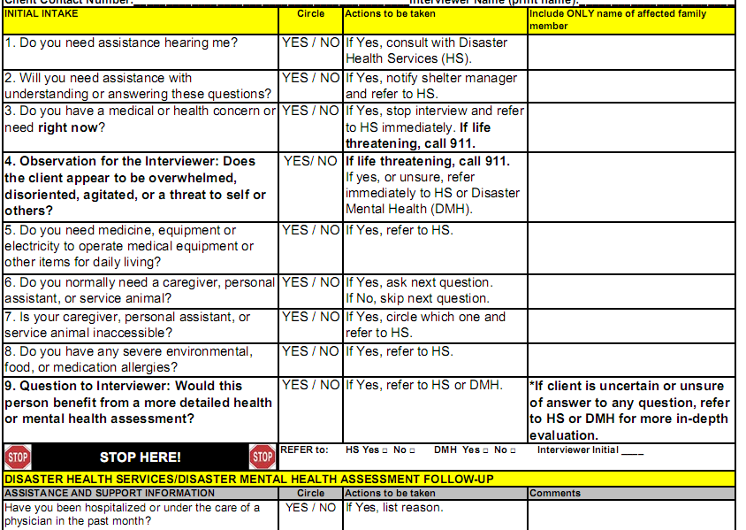
Opening the Shelter
Shelter
Registration
Form
Initial Intake
and Assessment Tool
Family Reunification

Slide 25
When a Shelter Opens
Health Services’ presence will be key to the success of shelter operations
Identify and address individual client needs
  Use Initial Intake and Assessment Tool
  Use HS & DMH at registration
  HS and DMH will work directly with clients to determine the appropriate resources and next steps
  Assist people in maintaining their usual level of independence
Notes:
HEALTH
during registration and refer to HS and DMH to address next steps in meeting individual client needs
Health Services and Mental Health staff are shelter team members and should be deployed to every opened shelter as soon as possible.
The intake tool when used at initial registration can identify needs quickly and expedite care, treatment and resources. Use of this tool has not been consistent and we have a new emphasis on implementing it as soon as a shelter is opened. It was designed with Health and Human Services and Advocacy groups following the 2005 hurricane season because (“Special needs” a term used then) were not being met. .
The tool will help you gather the information you need to meet the needs as clients register and alleviate their worry and apprehension knowing supplies and resources are on the way. It is also the opportunity to contact partners and resources.
The new Health Services Concept of Operations (Enhanced Disaster Health Services practice) which will expand the practice of nursing to the scope of practice allowed under the Nurse Practice Act of the state of licensure of the health professional. We used to function under “Protocols” or guidelines. The Protocols will be obsolete and used as a reference only document. This change will enhance service delivery and attract new health service volunteers. Please refer to the Nursing Neighborhood for all new guidance and information.
Currently revising the Initial Intake and Assessment Tool – due June 1st. The group revising the tool includes HHS, FEMA and Red Cross. The revised version will better meet the needs of individuals with disabilities and functional needs. There will be imbedded instructions for its use and a clarification component regarding the process for referral to medical settings.

Slide 26
Assessment Continues
Beyond Registration
Pre-existing conditions, both physical and psychological, are frequently exacerbated during times of extreme stress
Previously healthy individuals may have new medical/mental health needs due to the disaster
People do not always “know” what they will need in the shelter—they may be in shock or otherwise distracted because of the disaster

Slide 27
Shelter Operations
Modify kitchen access for people with medical conditions who may require access to food outside normal meal times
Assist with cutting food
Provide way-finding assistance to visually impaired
Provide effective communication
Offer individual Safe and Well registration assistance
Assist Client Casework to ensure clients return to the most appropriate, least restrictive environment when the shelter closes
Notes:
MASS CARE
Here are some examples of how Mass Care can assist people with disabilities:
Feeding – consider special diets for low sodium, gluten free.
Modifying kitchen access – people with diabetes, for ex, might need to eat outside of normal meal times.
Communication tools:
Pen and paper or message boards for people with hearing impairments.
ASL Interpreters
Translators for non-English speaking clients
Transitioning out of shelter:
Working with CC and appropriate external partners to assist clients in finding the least restrictive environment to meet their housing needs.

Slide 28
Communication Tools
Notes:
Multilingual Shelter Communication Tool-
on MC & FNSS Nbrhds
13 languages + Braille (will need to print locally) to assist you at registration & intake.
If you have a language not included, please inform Amy Green.
Communication Boards
Working on a national communication board.
Look to local partners for products as well, many organizations develop their own.

Slide 29
Service Animals
A service animal is individually trained to provide assistance to a person with a disability
Shelter staff may ask only two questions to determine if an animal is a service animal:
(1) “Is this a service animal required because of a disability?”
(2) “What work or tasks has the animal been trained to perform?”
Notes:
MASS CARE
Service animals are not pets.
Many service animals are easily identified because they wear special harnesses, capes, vests, scarves, or patches. Others can be identified because they accompany individuals with visible disabilities and the functions they perform can also be readily observed. When none of these identifiers are present, shelter staff may ask only two questions to determine if an animal is a service animal (on slide)
Accommodating a service animal in the shelter
While the owner is responsible for the care of the animal, we do assist with providing food and supplies for service animals when needed (e.g., dishes for food and water, arrangements for the hygienic disposal of waste; and, if requested, portable kennels for containment). (Another partnership opportunity)
Definition Change of a Service Animal
While the Dept of Justice has changed the definition of a service animal under the Americans with Disabilities Act to state that a service animal is a dog only, however, we will not change our program at this time. We will continue to accept other animals that perform as service animals.
We also understand that many states have legislation and laws on the topic. Regardless of how they determine to define service animals or certify them, we will continue our program practice and make all reasonable accommodations for those with service animals.
Are therapy animals permitted in Red Cross service delivery sites, including shelters?
No. They are not part of our disaster services program and there are good reasons that they are not allowed in red cross service delivery sites: 1) disaster survivors are not allowed to bring pets into our service sites and shelters (for safety and health reasons) and it would be confusing and possibly frustrating to see a Red Cross worker bring a therapy dog into a service delivery site; and 2) there are currently no Red Cross protocols, guidelines, credentialing, or screening procedures in place to support a therapy dog program.
However, chapters are able to have them as a community resource to offer to clients.
Emotional Support/Companion Animals
We do not consider these to be service animals as they are not trained to perform a task to assist someone to maintain their independence; therefore we do not accommodate them in our shelters.

Slide 30
What to Do When You Have Limited Health and Mental Health Staff?
Telephonic support from Health or Mental Health Services until they can arrive
Reach out to local Emergency Management or Public Health
Reach out to Regional Chapters or NHQ
Notes:
HEALTH
These strategies are suggestions for when you have exhausted all internal resources and are waiting for DSHR recruitment to arrive.
Ensure that the shelter manager is aware of staffing issues relating to Health and Mental Health. Shelter managers should also be part of decisions regarding transfers out of the shelter and the need for specific equipment or additional space to accommodate a situation.
If children are separated from families or guardians they will be supervised by health and mental health services until appropriate agencies arrive. If the child has a functional or medical need it is even more important to have a team approach to safely care for the child.
NOTE:
Mental Health now has the same staffing requirements as Health Services, they should be on the shelter team just as HS.
STOP FOR QUESTIONS

Slide 31
Suggestions for Mental Health
Let the conversation with individuals guide you, not assumptions about mental illness
Keep your communications simple, clear and brief
If someone is confused, don’t ask multiple questions, ask or state one thing at a time

Slide 32
Suggestions for Cognitive/Intellectual Disabilities
Reduce outside distractions when communicating
Speak clearly, slowly, use short sentences
Ask concrete, open ended questions, avoid yes/no answers
Allow for additional time for two-way communication
Allow time for information to be fully understood
Avoid complex terms and use shorter, distinct terms

Slide 33
Discussion Question
When might a shelter client need to be referred to a medical needs shelter, hospital or other medical setting?
Notes:
All shelter clients should be invited into the shelter even if you think that they need to be in a medical setting.
If we cannot safely accommodate.
If their situation changes… go into labor, need for more medical supervision, they become medically unstable.
What if we don’t have a reliable electrical supply? C-PAP, electric wheelchair
What other kinds of conditions would be more safely accommodated elsewhere?
Home dialysis
Recent surgery in which the client requires constant supervision
Someone with a significant health issue who’s not comfortable remaining in the general population shelter

Slide 34
Considerations for Referral
Individuals who need
  Continuous medical supervision
  Acute, life-sustaining medical care
Individuals who are a danger to themselves or others
Notes:
HEALTH
It’s critical to have Health and Mental Health Services in the Shelters for assessment and referral. In the first moments of registration clients may immediately request help or may not feel comfortable or just too scared or frightened by the disaster to tell us their needs. If you think someone needs more help or was reluctant to accept help let the health and mental health professionals know. They are there to help clients with all of their needs and to assist you at registration or anytime during the time shelters are open..
The majority of our clients will be able to safely remain in our shelters. But we do assess whether the clients need help that we can’t provide or additional care would be the best solution. Our responsibility is to make decisions that maintain independence but not allow a clients condition to deteriorate. We will always use common sense and clinical judgment to the well being of the client.
Health and Mental Health will work with the client and family to keep the client connected to the health care system, Physicians, counselors and vendors that are established. This is necessary for continuity and quality of care and referral.
NOTE: Presenters should add information specific to their state or experience.

Slide 35
Integrated Community Planning
Notes:
FACILITATOR

Slide 36
FEMA Guidance on Planning for
Integration of Functional Needs Support Services in General Population Shelters
Audience: Emergency Management and Shelter Operators
This guidance does not establish new legal obligations; instead, it is a guide to integrating service delivery in general population shelters
Outlines planning and response steps for serving people with disabilities and access and functional needs in general population shelters
Notes:
HEALTH
FEMA’s guidance was released in November 2010.
The American Red Cross has a Memo of Agreement with FEMA and this guidance is a planning document, a tool to help everyone that provides services during a disaster a way to prepare and welcome clients that have immediate needs as a result of the disaster.

Slide 37
Integrated Community Planning Steps
Current Plans
Identify Stakeholders
Community Gap Analysis
Identify Resources & Establish Relationships
Notes:
FACILITATOR
Integrated Community Plan means that all stakeholders are present representing government, NGOs, FBOs, and the private sector. The planning includes transportation, sheltering, evacuation in an integrated setting. The planning should be inclusive of a cross section of the community which includes the people with disabilities, the elderly and children.
The term Functional and access needs may not be used commonly because it is a new term for what we used to call “special needs”. Be aware that communities are all different and in varying phases of planning for functional and access needs.
BUT A good place to start community planning is by reviewing existing “special needs plans” and integrating appropriate components into of those plans into general population sheltering plan
Convene planning activities if there are none underway. One of the Disaster Services’ business plan goals is to partner effectively and lead the sector. Convening planning for functional needs support services is a great example of partnering and leading.

Slide 38
Identify Stakeholders
  All levels of government—local, state, tribal
  Local Emergency Management, Public Health, Human/Social Services, Family Services
  Area Agencies and Councils on Aging
  Centers for Independent Living
  Providers of transportation, CMS, DME, PAS, assistive technology, communication
  MRC
Notes:
There are NEW stakeholders who may or may not have any experience in disaster planning. In fact, it may seem overwhelming to a new stakeholder....its important to communicate how grateful we are to have them at the table and that no one is alone in the planning process.

Slide 39
Identify Stakeholders (cont.)
  Pharmacies and home health care agencies
  VOAD, COAD
  Local organizations on disabilities, children, and elderly
  National Disability Rights Network (NDRN.org)
  Faith Based Organizations
  Community Based Organizations
Notes:
FACILITATOR
Nat’l MOU w/ The National Disability Rights Network (NDRN).
The nonprofit membership organization for the federally mandated Protection and Advocacy (P&A) Systems and Client Assistance Programs (CAP) for individuals with disabilities. The P&A/CAP agencies that are a part of the NDRN network are located within communities in each state; you can locate them through their website, www.ndrn.org.
Query participants, provide them with the opportunity to talk about specific local and state examples of stakeholders/partners.
Veterans associations
Nursing home administrators
These are reciprocal relationships where they can help us with varied resources and we can help them on their emergency plans.
Note their answers for use in next slide.

Slide 40
Community Gap Analysis
Work with local disability groups and government partners to identify the types of disability and/or functional needs that exist within the community
Work with partners to determine the types of resources that will be needed to serve the community
Notes:
MASS CARE
Community Gap Analysis is not new to you in planning, but now we need to increase our scope to assess areas where gaps exist in meeting the needs of clients with disabilities and functional needs.
1st bullet – incorporate examples brought up from the field. Also pull out examples they didn’t bring up. Or ask for examples.
2nd bullet – examples of types of resources, also can use from their examples with local partners. DME, CMS, …

Slide 41
Identify Resources and
Establish Relationships
Work with partners to help determine which tasks and responsibilities will be met by all stakeholders
Establish relationships with providers and identify how they can support client needs
Notes:
MASS CARE
Procuring supplies pre-event
EM is being encouraged to apply for Homeland Security Grant Program: As new dollars are made available, purchase access and functional needs equipment, focusing on items that would be difficult to procure quickly at the beginning of an event (ex. universal cots, communication boards, toilet seat risers, mobility devices, privacy screens, wheel chair transfer boards). Also order supplies for children as well as adults.
NHQ working on creating a Chapter Suggested List to assist chapters in making decisions with EM on what items to purchase when money is available.
Unusual vendors (in certain jurisdictions):
Churches and senior centers may maintain DME closets or be excellent resources for additional items and supplies.
Civic organizations, like the Jaycees and Knights of Columbus, will build portable ramps.
Post Event Procurement:
Commonly Used Shelter Items & Services Listing (CUSI-SL) is a federal supply cache for declared disasters.
All CUSI items are requested in coordination with the affected State.
CUSI Items are available to minimize shortfalls of needed supplies for feeding and sheltering.
NGO's do not request CUSI items directly, but could be the recipient of the items as a provider of Mass Care services for the State.
States request items to support NGOs under a "Stafford Act" Declaration
Some CUSI items (Infant & Toddler Items) will be pushed into the impacted area as directed by the FEMA Administrator, independent of any State request.
Categories:
"Major Items" (e.g., water, bulk food, cots, blankets, bottled water, emergency meals)
"Hygiene Items" (e.g., personal hygiene kits of 17 items)
"Shelter Cleaning Items" (e.g., brooms, buckets, mops, trash bags)
"Miscellaneous Items" (e.g., hand sanitizer with nozzles, caution tape)
"Leased/Contracted Items" (e.g., fuel, dumpsters with service., reefer trailers)
"Infants and Toddlers Items" (e.g., push package of 27 items, plus other items available)
"Durable Medical Equipment" (e.g., wheelchairs, crutches)
"Consumable Medical Supplies Items" (e.g., bandages, catheters)

Slide 42
Exercise
You have been invited to an FNSS planning meeting.
Identify who needs to be at the table (internal and external).
Who do you need to approach for the first time? How?
What local, regional, state and national MOU’s will you use?
What demographics/needs are you likely to see in a shelter?
What services are needed at a shelter?
What are the steps in the planning process?
What resources do you need? Who owns them?
How do you introduce FNSS into shelter site selection? What are the additional considerations?
Notes:
In your group, answer these questions in your FNSS planning meeting.

Slide 43

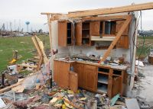
Lessons learned from 2011
Photos courtesy of the American Red Cross
Notes:
Floods, tornados, wildfires and hurricanes, we had them all
And climate change predictions imply this trend will continue
Going forward.

Slide 44
Alabama Tornados
Over 23,000 units (homes and businesses) were affected
248 deaths and 236 hospitalized
35 shelters with >7900 overnight stays
2439 individuals shelter clients
>16,000+ health contacts
>10,000+ mental health contacts

Slide 45
Alabama Tornadoes
The Alabama Interagency Coordinating Committee established
60 members including state and nonprofit agencies who serve people with disabilities and chronic illness, individual advocates, university faculty and students
Integral participation by FEMA and Red Cross
Formed two days after the tornadoes
Notes:
FORMATION
from the onset of the planning and coordination – RC reinforced “this is your community” and supported the Disability Organizations in taking ownership. RC urged the CIL to take the lead, bring in the partners, identify unmet needs, and look for resources. CIL brought together all the stakeholders from the old coalition and new partners, including State Agencies, who were spread around the state.

Slide 46
AL - Daily conference calls during response
Community as well as individual client needs.
Support for locating clients with disabilities (reunification with family and support agencies)
Replacement of durable medical equipment, medications and consumable medical supplies
Provision of personal assistance services (PAS)
Placement of ASL interpreters' in shelters
Identification of long term recovery programs

Slide 47
AL - Lessons Learned
Coordination team activation asap
Mechanism for closing the loop
Resource lists that are local, regional, and statewide
Coordination between Red Cross and FEMA Disability Integration Specialist

Slide 48
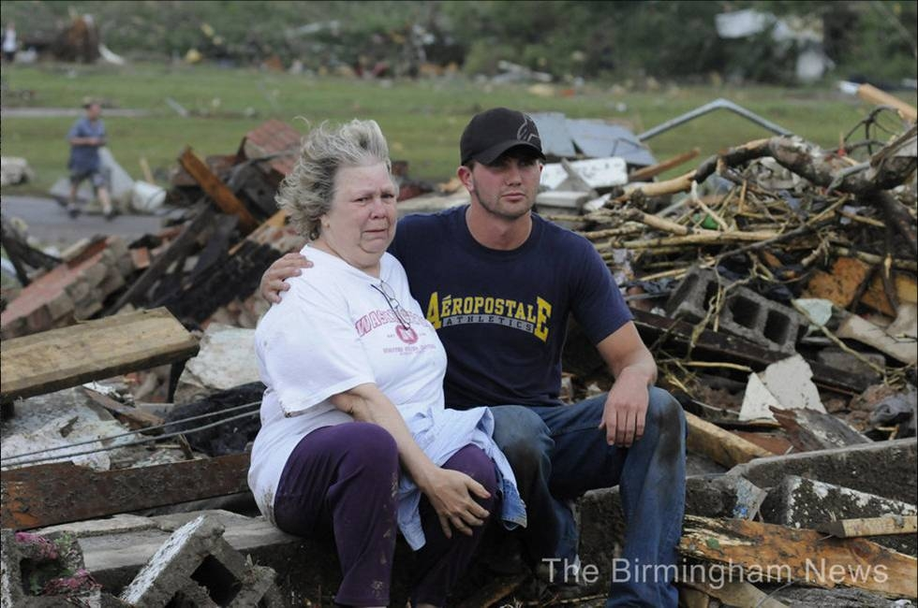

Slide 49
Key Considerations

Slide 50
Key Considerations
Planning and responding with partners is key
Functional Needs Support Services Guidance does not require stockpiling supplies, but the ability to secure resources when needed
Understand ADA Principles and how to apply them
Be aware of Functional Needs Support Services at all levels in your chapter
Notes:
FACILITATOR
Partner access integration into shelters is in development.

Slide 51
Key Considerations (cont.)
Nursing kits for each shelter should be stocked with appropriate supplies
Exercise and evaluate your integrated community plan with real people
Anticipate client needs in your community – focus on accessibility and planning
Notes:
FACILITATOR
Disaster Officers: provide feedback regarding chapters sharing best practices.
Sheltering and Nursing Kit supply lists are under revision to include new supplies to meet functional need supplies. The supply lists are suggested supplies based on your community demographics. Some supplies are basic and need to be available as soon as a shelter opens and others are resource or purchase as needed.
Do what we’ve always done, continue focusing on the needs of clients.

Slide 52
Scenario Exercise
The Red Cross has opened a large shelter for hurricane evacuees. Mr. Green is at the registration desk and has indicated that he was unable to bring his motorized scooter and walker on the bus. He is out of breath from walking, upset, and does not have his medication for several health issues. He is a large man and is concerned he will not be able to fit on a cot. What actions will you take?

Slide 53
For More Information
Functional Needs Support Services Neighborhood:
https://neighborhoods.redcross.org/sites/FNSS/
Connection 1010-10: Serving People with Disabilities and People with Functional and/or Access Needs in Red Cross Shelters
https://crossnet.redcross.org/chapters/connections/disaster/2010-010.pdf
Mass Care Standards and Indicators: https://neighborhoods.redcross.org/response/mascar/General%20Mass%20Care%20Library/MCStandardsIndicators%20Jul09.pdf
FEMA Comprehensive Preparedness Guide 101:
http://www.fema.gov/pdf/about/divisions/npd/CPG_101_V2.pdf
Disability Etiquette Handbook:
https://crossnet.redcross.org/every/diversity/disability/etiquette_conversation.asp
Notes:
FACILITATOR
We have provided the following resources. Be sure to check your state websites for additional information, resources and programs available in your state.
At the beginning of the presentation we discussed the objectives.
Let s review:
Review Current policies and philosophies around Functional Needs Support Services – do you know what policies that may need revision?
Focus on Integrated Planning – internal at Red Cross and in your community
Look at Functional needs and support services in a shelter environment- What is our current practices and what do we need to adjust?
Provide Resources and scenarios – did the presentation provide resources that would help you with your planning? Did the scenario provided provide a framework for discussion as a team?

