Slide 1
Peritoneal Dialysis

Slide 2
Source of information
http://kidney.niddk.nih.gov/kudiseases/pubs/peritoneal/

Slide 3
PD basics
Soft tube (catheter) inserted into peritoneal cavity
Dialysis solution is instilled into the peritoneal cavity, dwelling there to pull off fluid, waste products and minerals by osmosis
Usual volume of 1.5 liters to 3 liters
After several hours dialysis solution is drained from the peritoneal cavity and then replaced by fresh dialysis solution

Slide 4
PD basics
CAPD – Continuous Ambulatory Peritoneal Dialysis
Exchanges 3 – 4 times/day
CCPD – Continuous Cycler-assisted Peritoneal Dialysis
Usually over night
Requires equipment needing a power supply

Slide 5
Needs in shelter setting
CAPD – most likely to be done in shelter unless the person brings cycler
Secluded area to do exchanges, best if sink for hand-washing is available
Equipment and supplies
Mask
Administration sets
Dialysate
Heater for dialysate

Slide 6
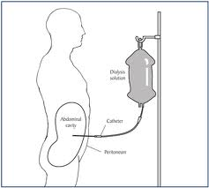

Slide 7
